Slide 1
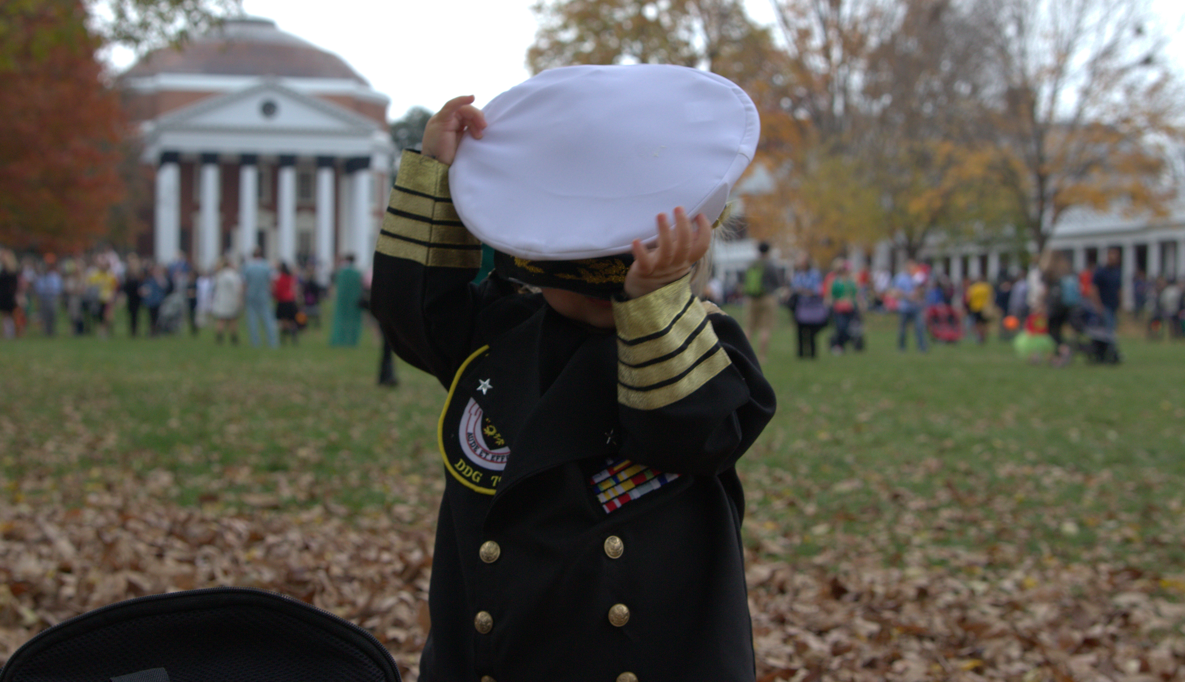
Class 18:
Midterm Confirmations
Cryptocurrency Cabal
cs4501 Fall 2015
David Evans and Samee Zahur
University of Virginia

Slide 2
Plan for Today
Midterm Discussion
Schedule Update:
PS3 is due Sunday, November 8
(There is no PS4)
Project Pre-Proposal: Friday, November 13
Project Update: Monday, November 23
Last class: Monday, December 7

Slide 3
Midterm Summary
Threshold of “bitcoin expert”
qualification ~ 85
Number answering well (out of 30)

Slide 4
Confirmations

Slide 5
How long is the expected wait for the first confirmation?

Slide 6
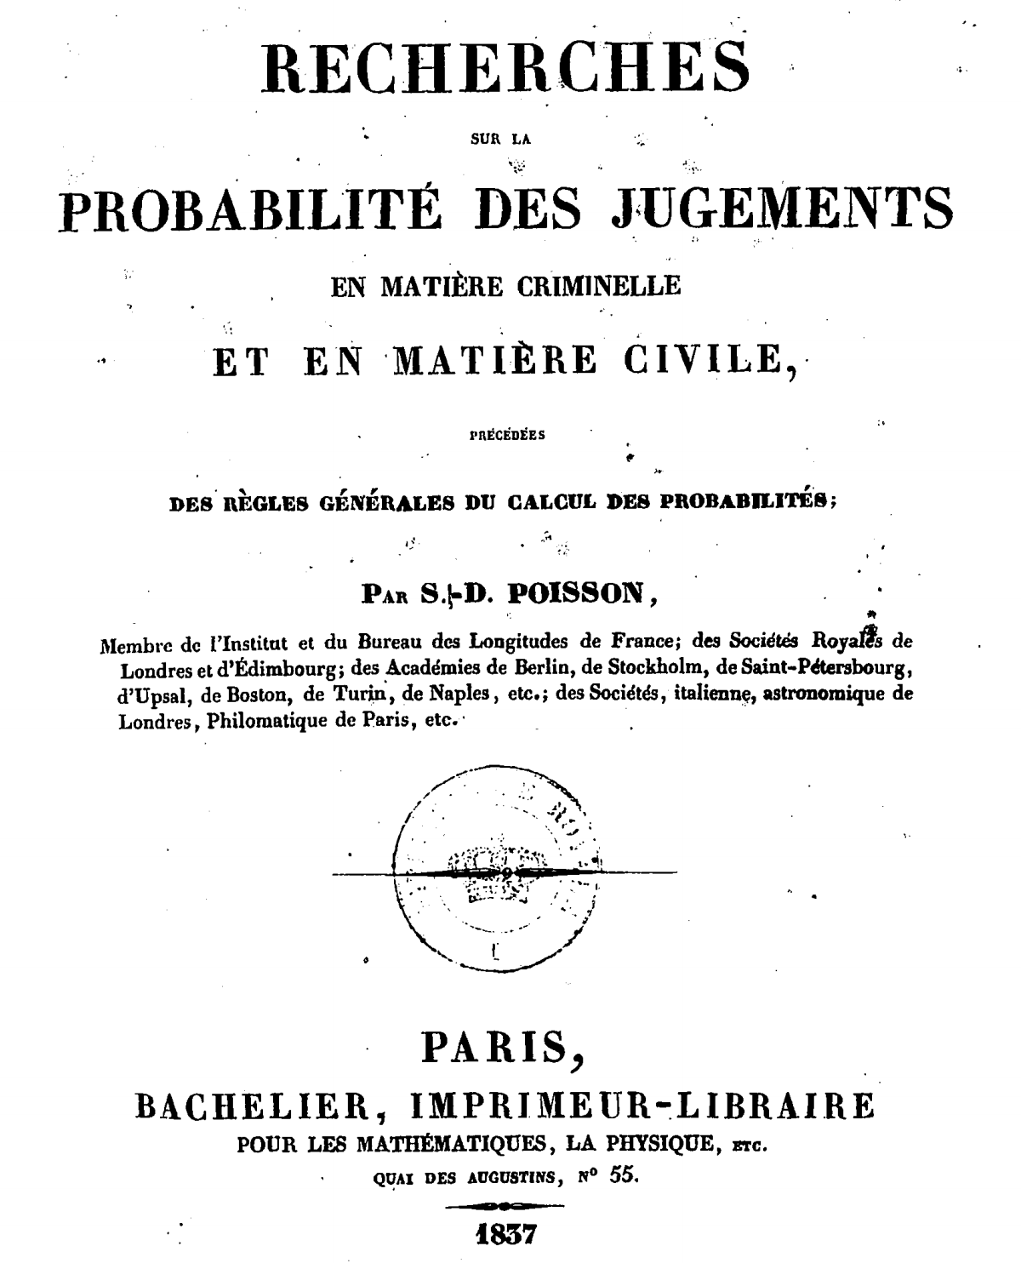

Slide 7
Poisson Process
Bitcoin mining is memoryless:

Slide 8
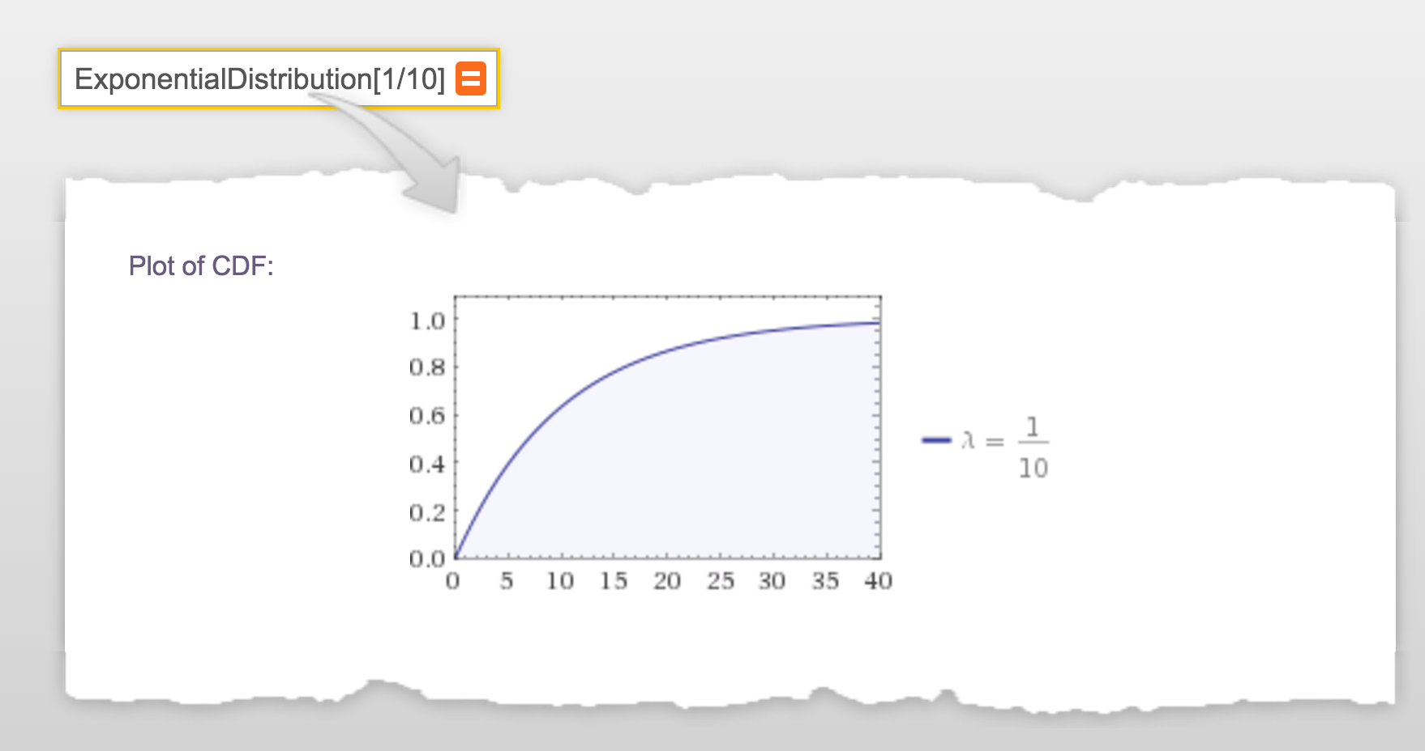
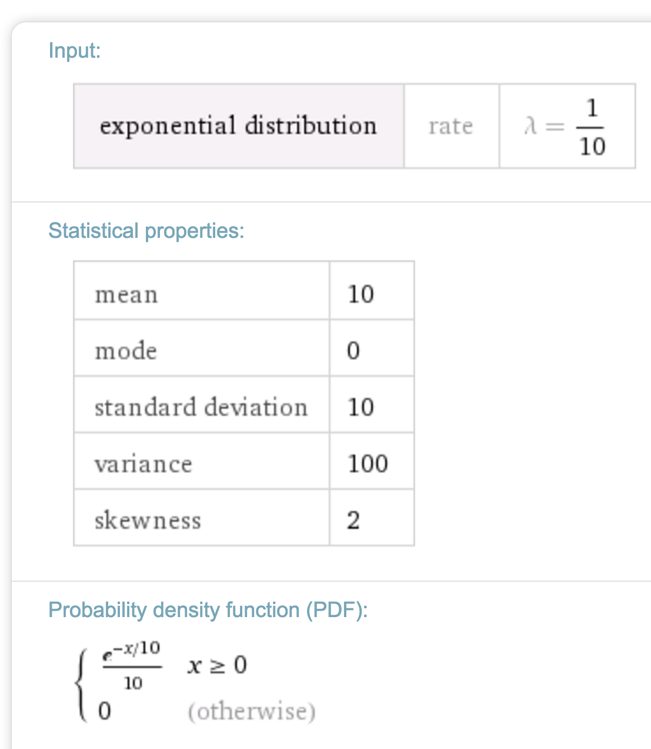

Slide 9
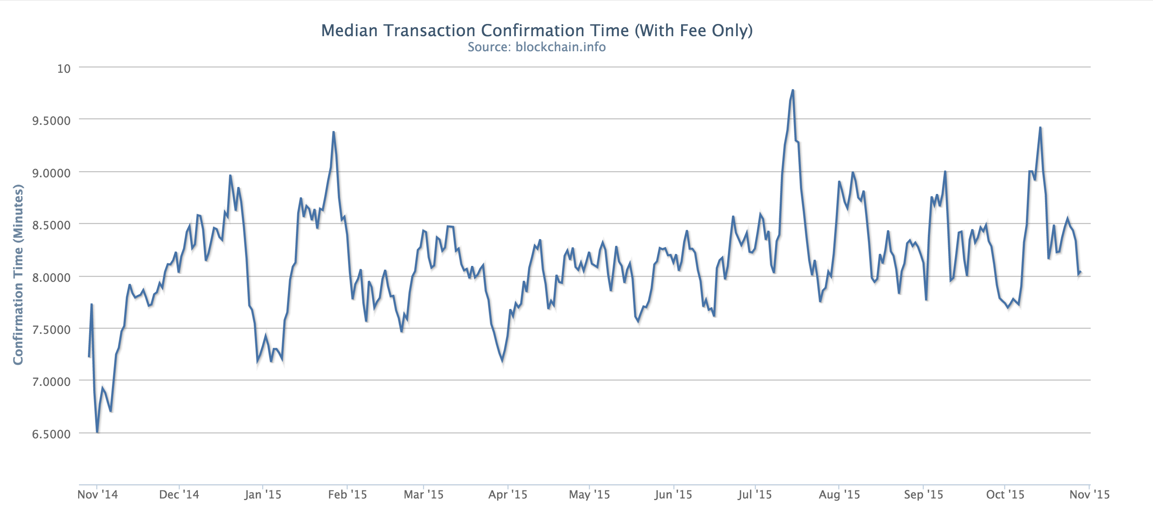
Blockchain.info

Slide 10
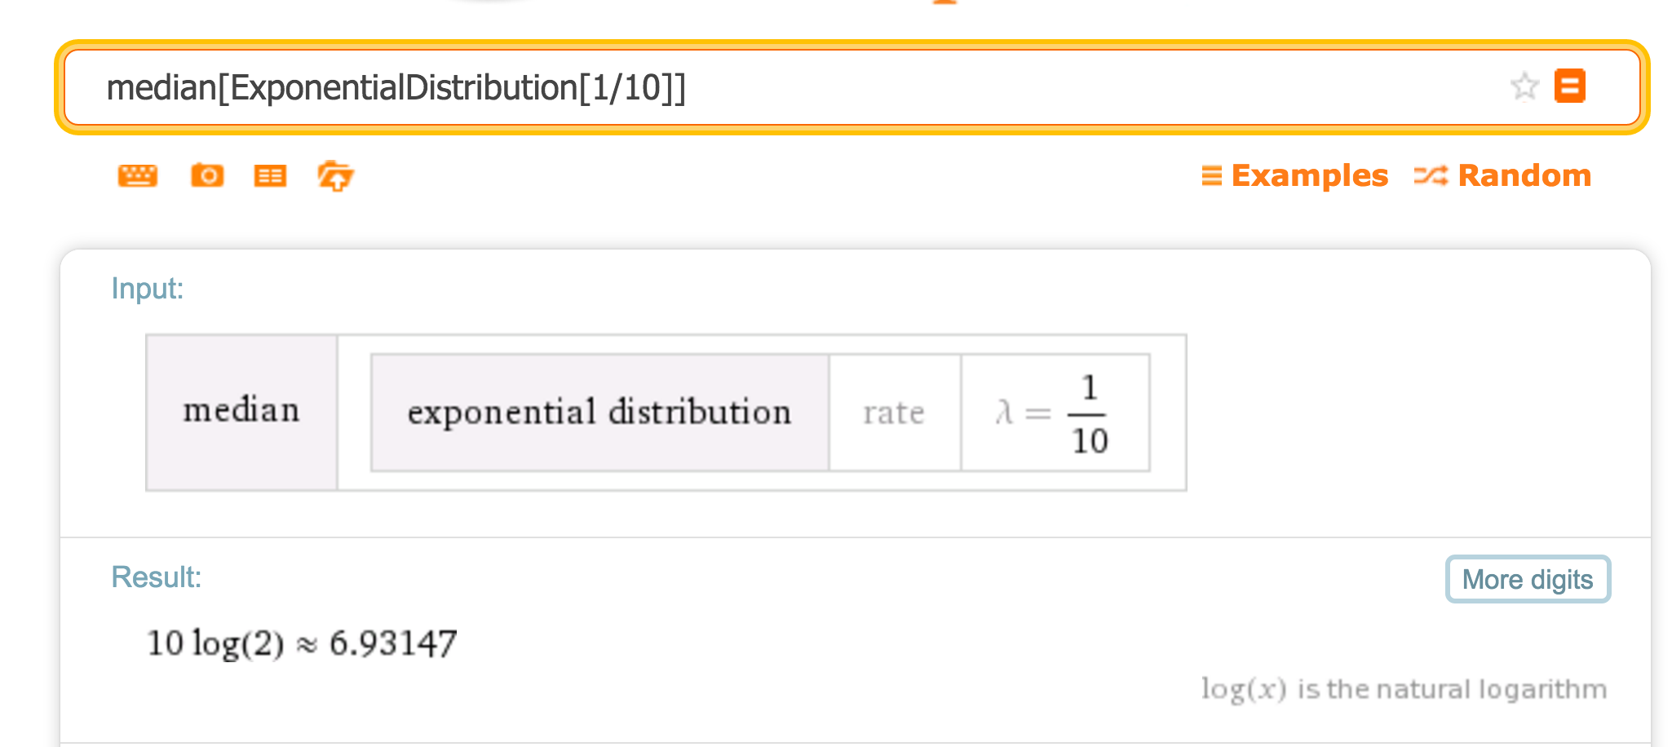

Slide 11
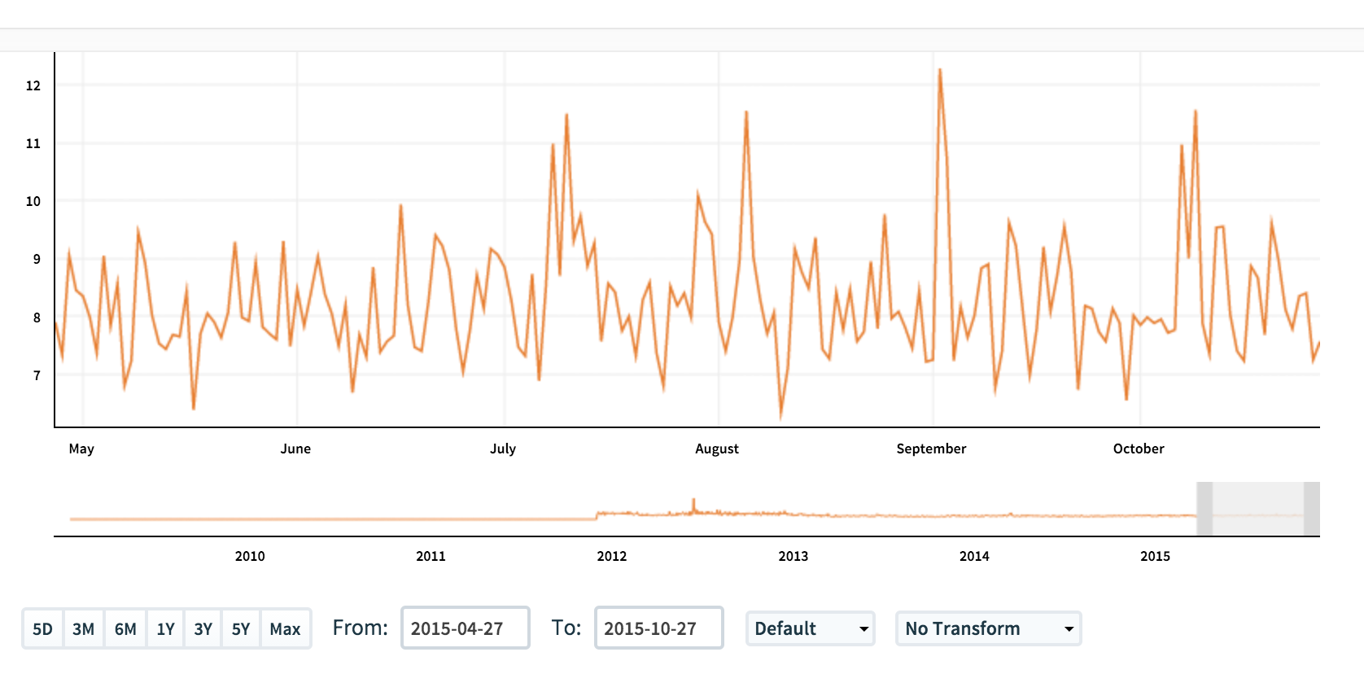
https://www.quandl.com/data/BCHAIN/ATRCT-Bitcoin-Average-Transaction-Confirmation-Time
Project idea?
How can average transaction confirmation time be less than Poisson rate?

Slide 12
Can we gain confidence without confirmations?

Slide 13
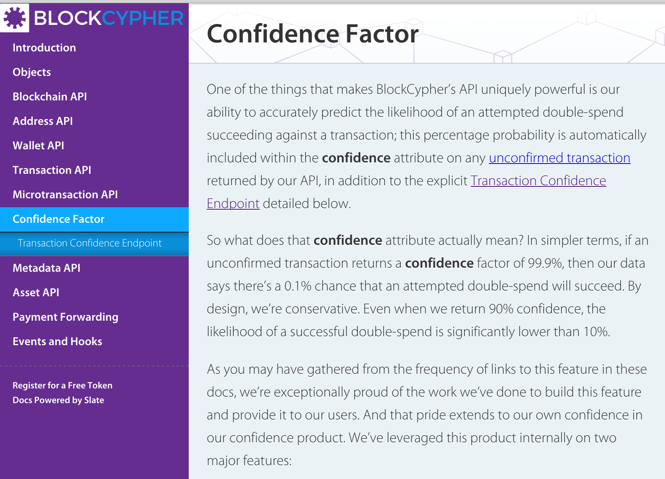

Slide 14
“Pre-confirmations”?

Slide 16
How do buyer and seller interact in a bitcoin transaction?

Slide 17
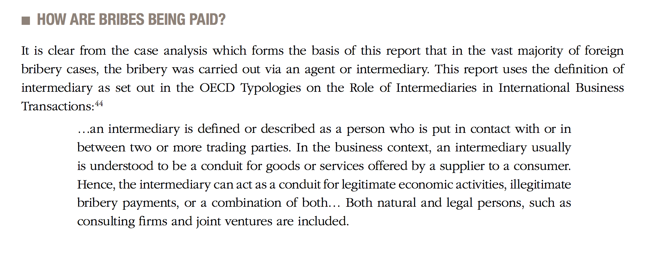
“Third-party intermediary”

Slide 18
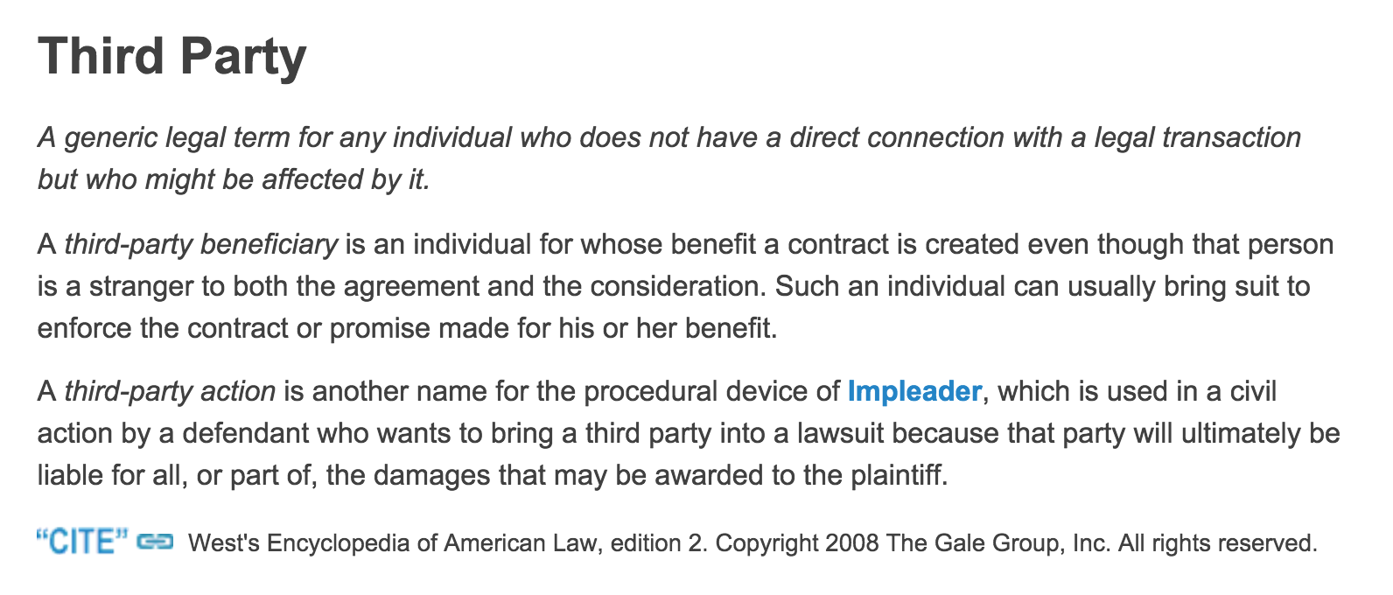

Slide 21
Threshold of “bitcoin expert”
qualification ~ 85
Number answering well (out of 30)

Slide 22
If you didn’t reach “expert” qualification on the Midterm because of poor answer to questions 1-4, you can improve your score by finding incorrect statements in the Blockchain Report Josh mentioned, and restating them correctly (and clearly).
Threshold of “bitcoin expert”
qualification ~ 85
Number answering well (out of 30)

Slide 23
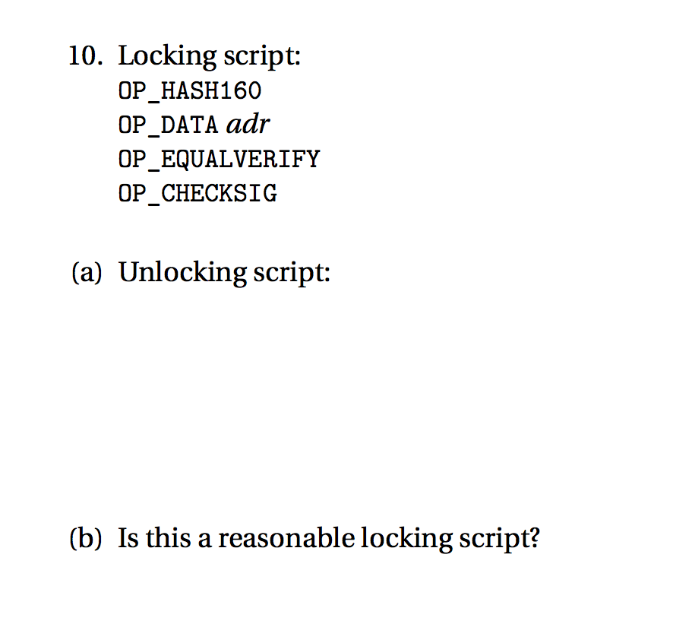
Transaction Scripts

Slide 24
Transaction Scripts

Slide 25
Charge
Upcoming office hours:
Now: 3:30-4:30pm (Samee, Rice 442)
Tomorrow: 2:30-3:30pm (Dave, Rice 507)

