Slide 1
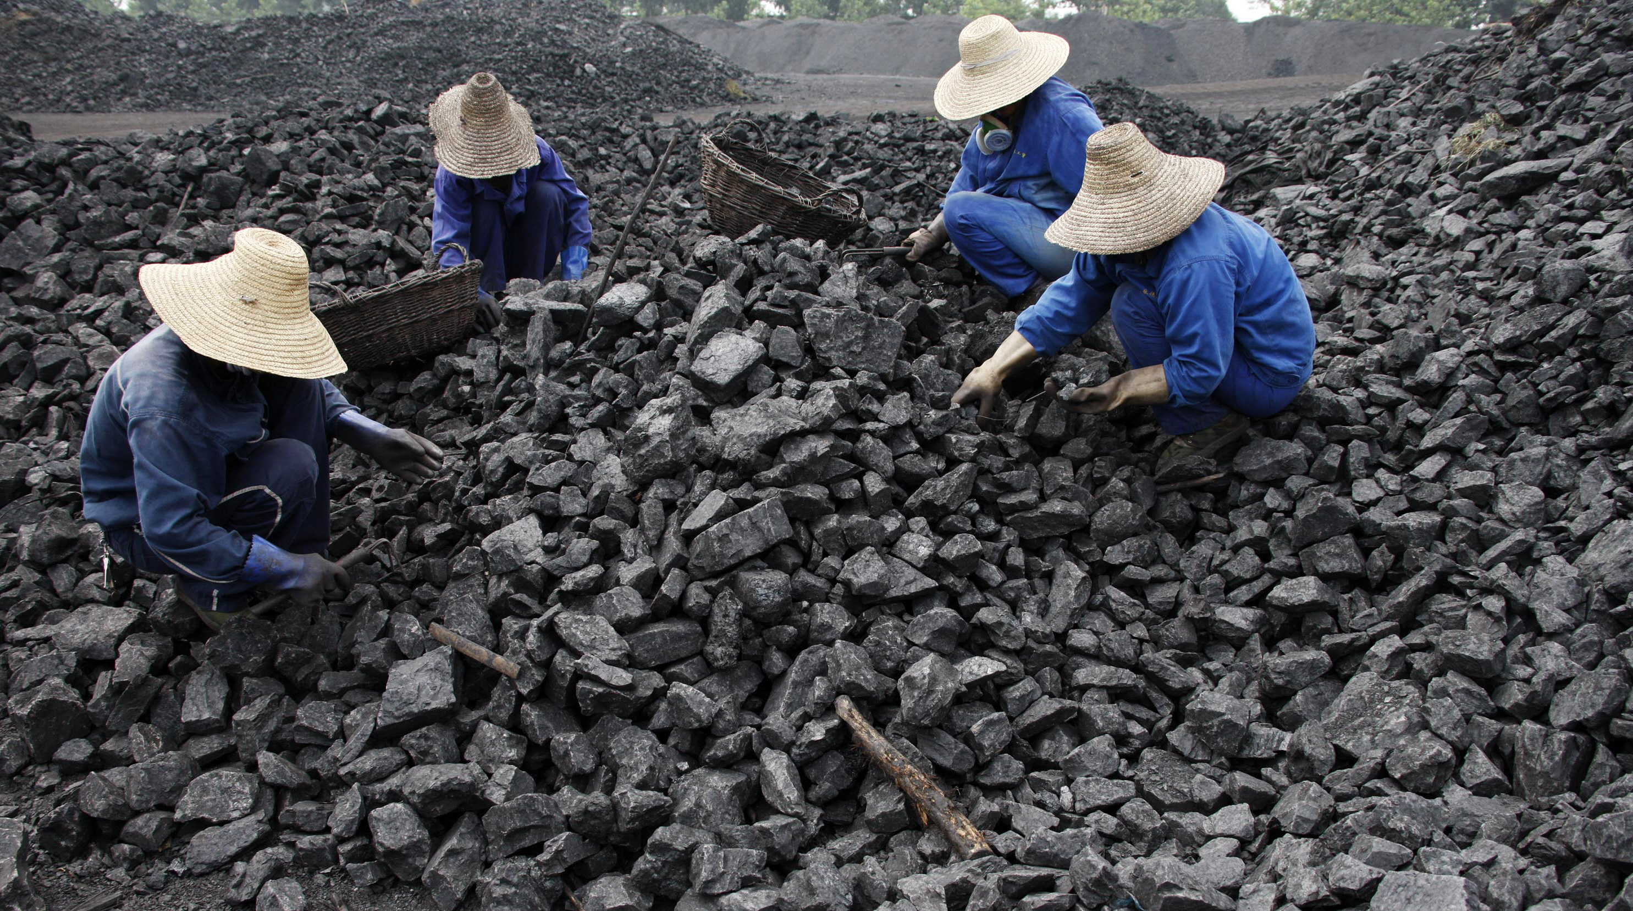
Class 9:
Mining Economics
Cryptocurrency Cabal
cs4501 Fall 2015
David Evans and Samee Zahur
University of Virginia

Slide 2
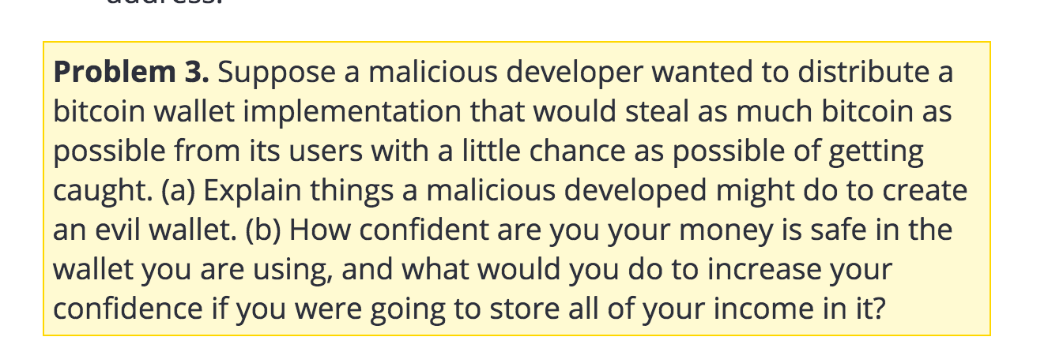
How Paranoid Should We Be?

Slide 3
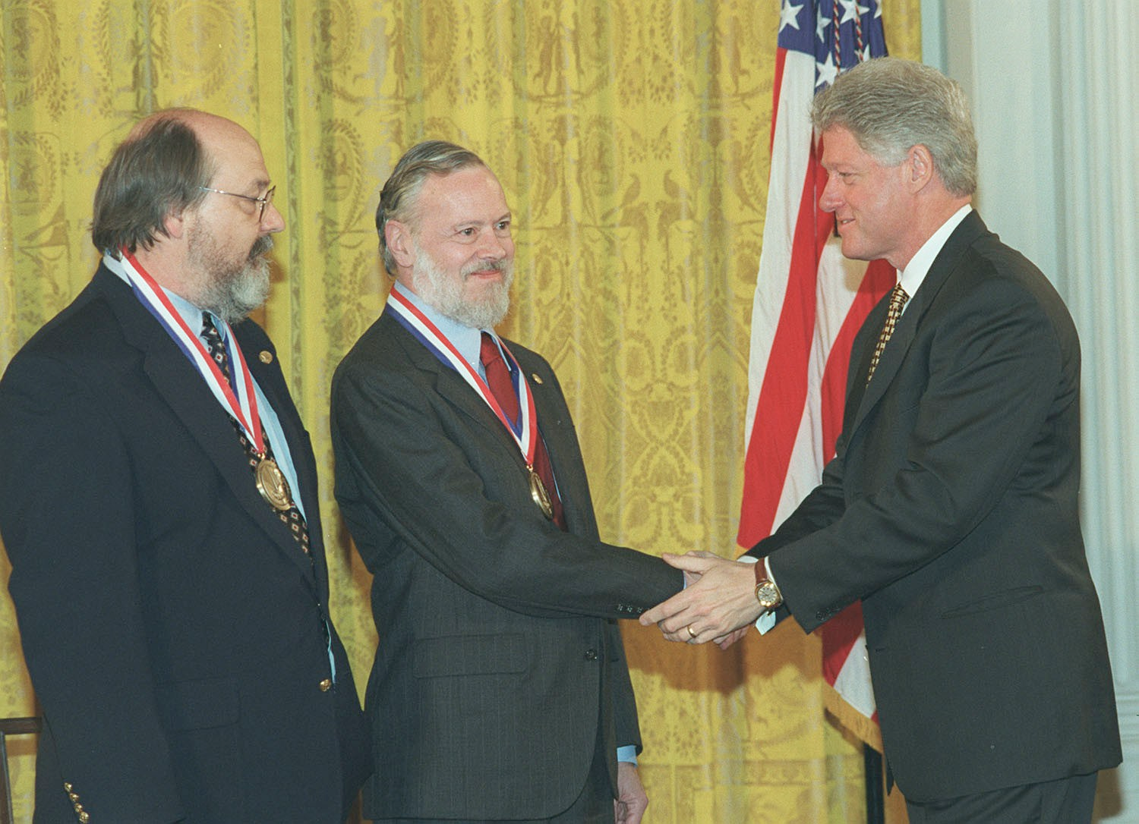
1983
Ken Thompson
(born 1943)
Dennis Ritchie

Slide 4
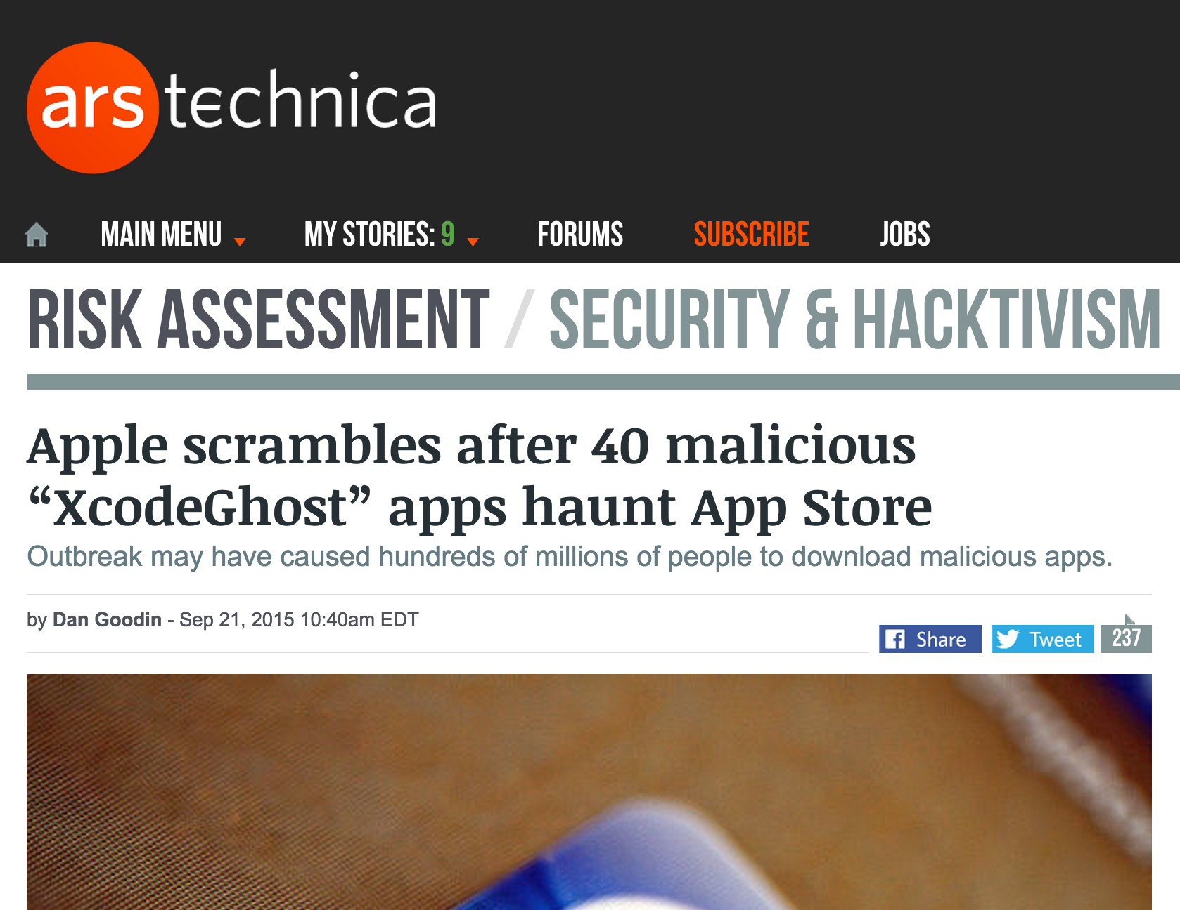

Slide 5
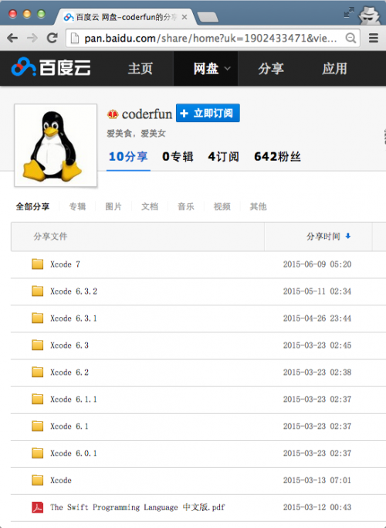
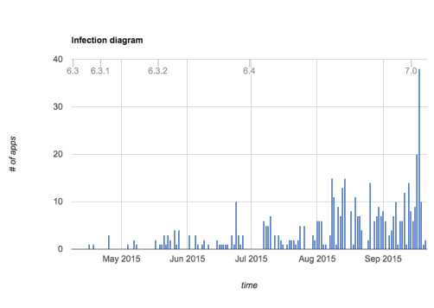
Benign Developer
Malicious Xcode Compiler
(Infected) App
Thousands of infected apps in App Store

Slide 6
Plan for Today
Costs and benefits of mining
Checkup 2
Stop to Start Checkup by 2:40

Slide 7
Mining and Mining
How much coal is mined to mine a bitcoin?

Slide 8
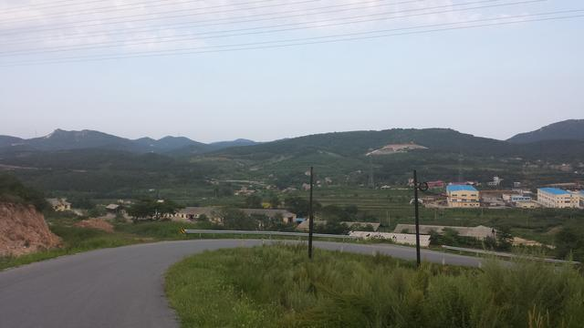
Bitcoin Mining
The first thing you notice as you approach the warehouse is the noise. It begins as soon as you step out of the car, at which point it sounds like massive swarm of angry bees droning away somewhere off in the distance. It becomes louder and louder the closer you get to the building, and as you step through the doors it becomes a deafening and steady roar…
http://www.thecoinsman.com/2014/08/bitcoin/inside-chinese-bitcoin-mine/

Slide 9
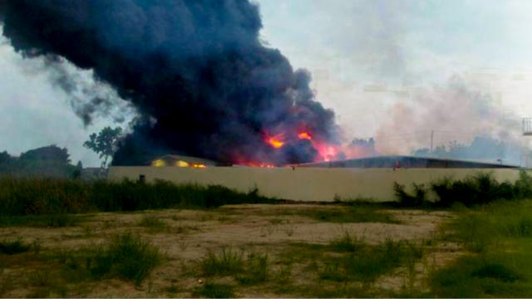
Fire at mining facility in Thailand, 14 Oct 2014
Photo credit: www.thairath.co.th

Slide 10
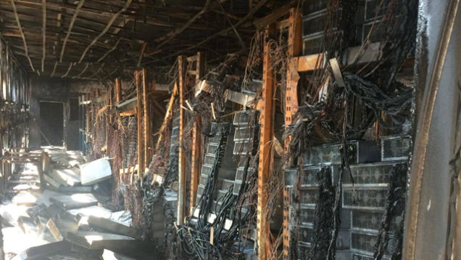

Slide 11
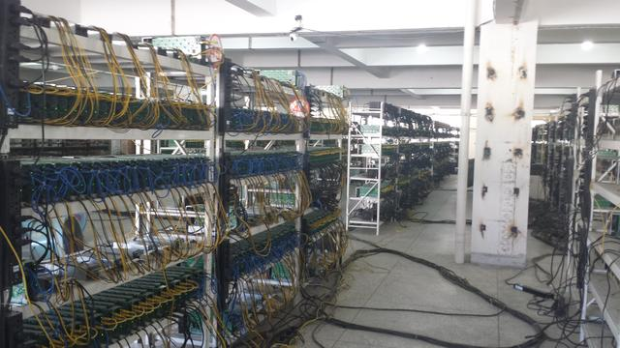
http://www.thecoinsman.com/2014/08/bitcoin/inside-chinese-bitcoin-mine/
Cost of electricity: ¥400,000 ($60,000 US)/month

Slide 12
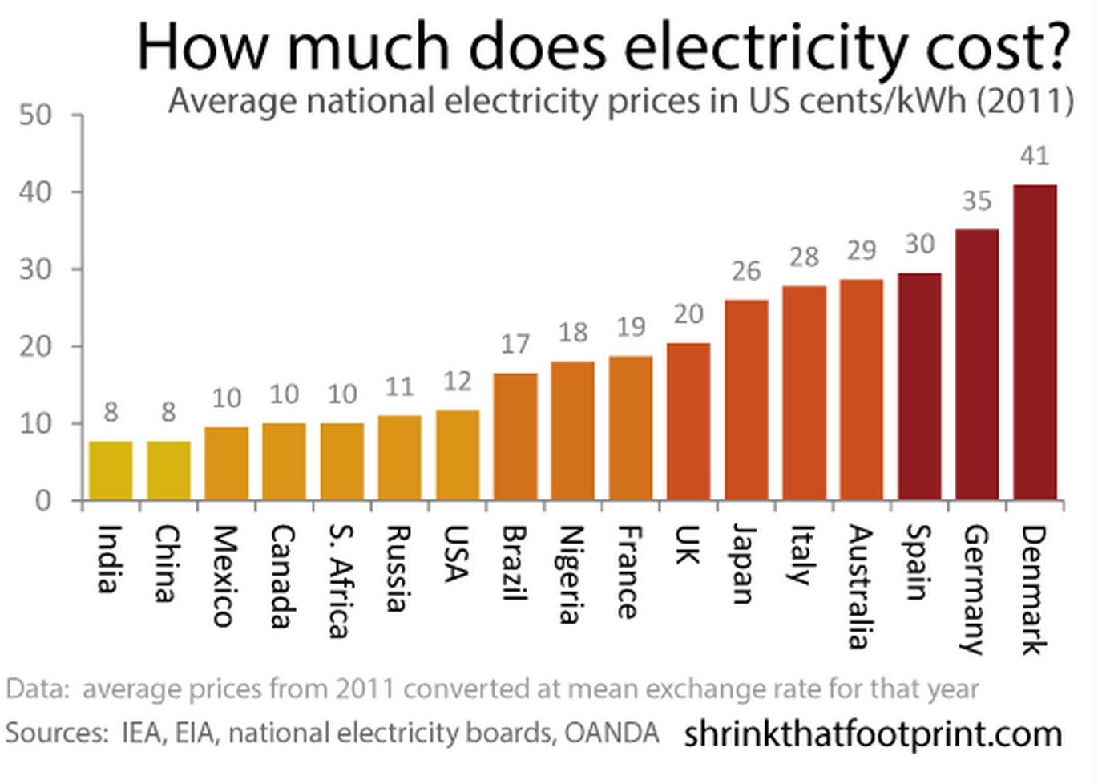
http://shrinkthatfootprint.com/average-electricity-prices-kwh

Slide 13
$60,000/month × 0.08/kWh = 750,000 kWh
http://shrinkthatfootprint.com/average-electricity-prices-kwh

Slide 14
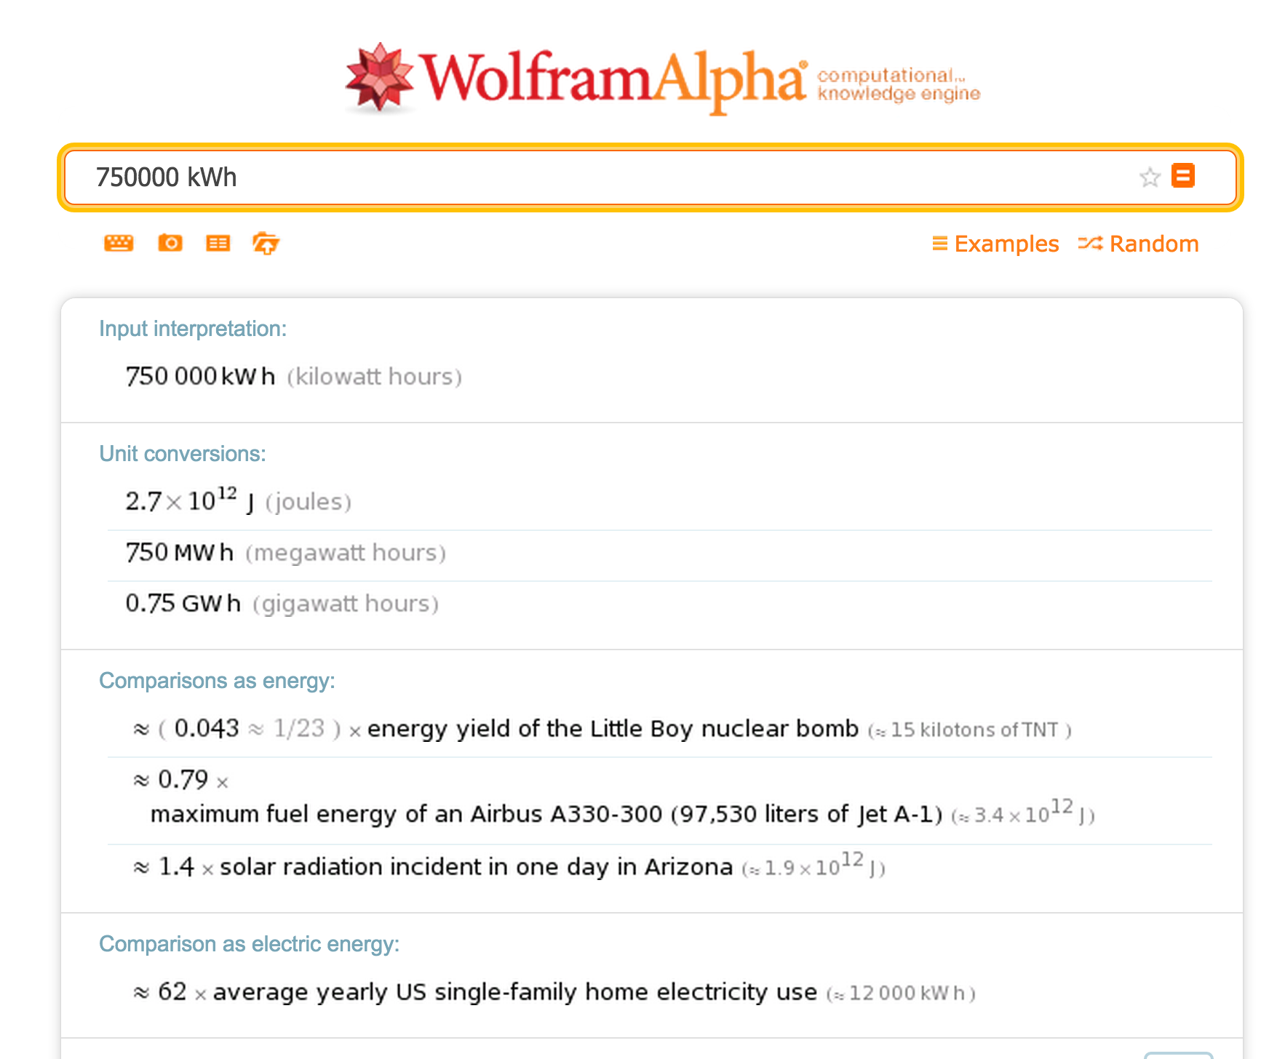

Slide 15
Total Network Hashing Power
Difficulty is adjusted to mine one block every 10 minutes.
Target = T_{max} / Difficulty
Expected hashes = 2²⁵⁵ / Target
Network hashes per second ~ Expected hashes / 600s

Slide 16
>>> difficulty = 59335351234
>>> target = 2 ** 224 / difficulty
>>> success_probability = target / 2**256
>>> expected_hashes = 1 / success_probability
>>> expected_hashes
2.5484339304670328e+20
>>> hashes_per_second = expected_hashes / 600
4.247389884111721e+17

Slide 17
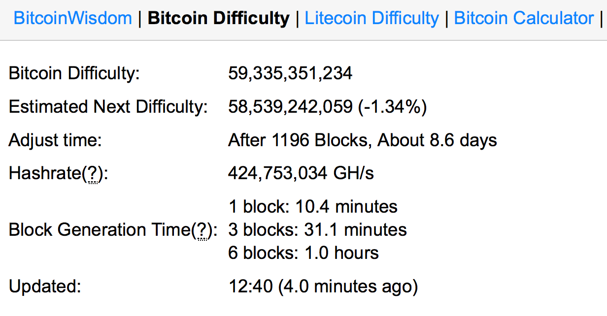
>>> difficulty = 59335351234
>>> target = 2 ** 224 / difficulty
>>> success_probability = target / 2**256
>>> expected_hashes = 1 / success_probability
>>> expected_hashes
2.5484339304670328e+20
>>> hashes_per_second = expected_hashes / 600
4.247389884111721e+17

Slide 18
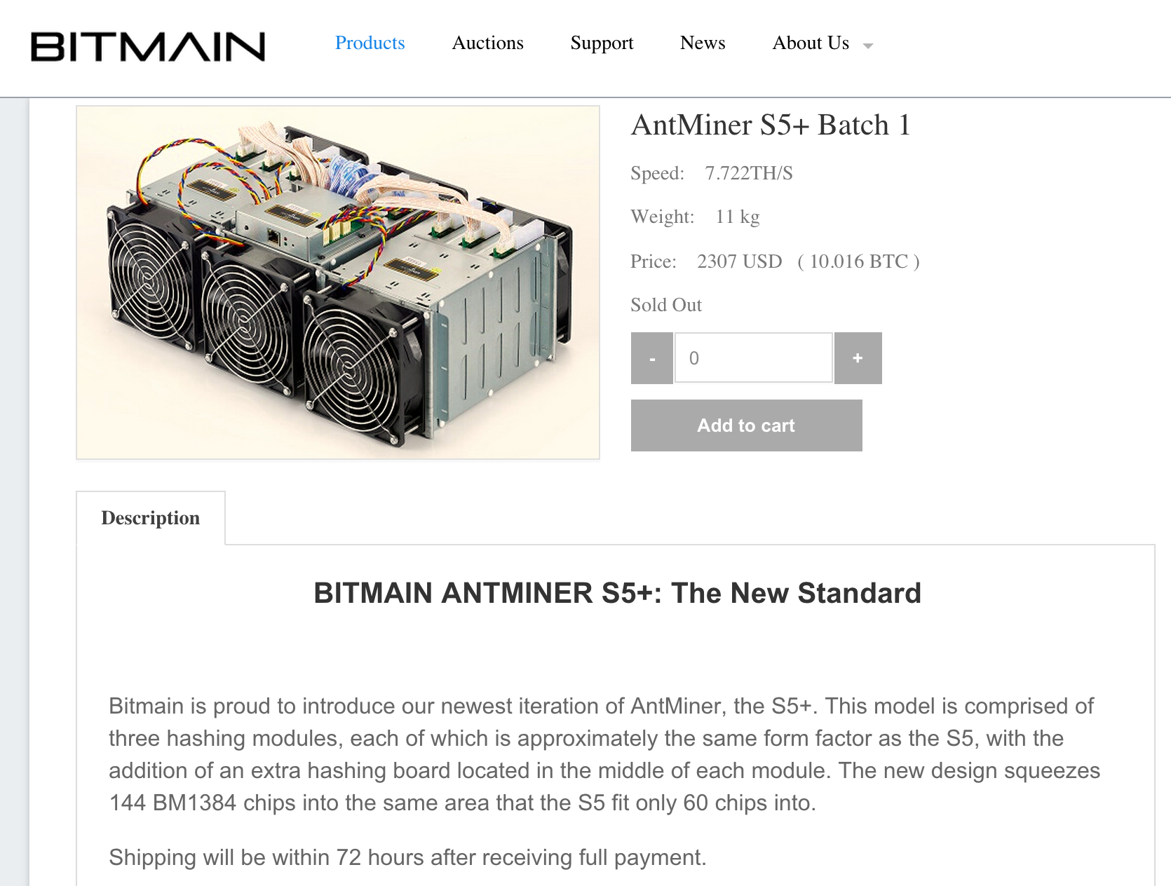
Estimating Energy Use

Slide 19
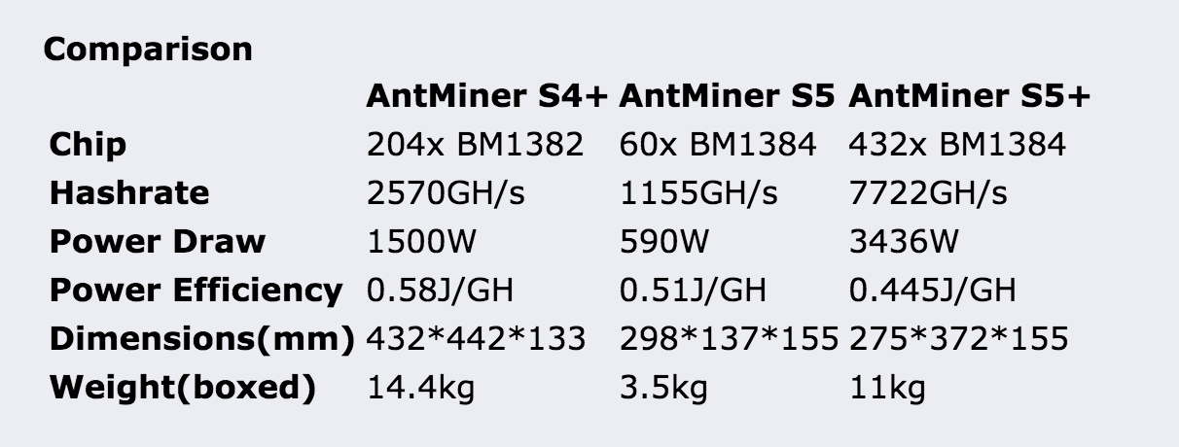
Estimating Energy Use

Slide 20
>>> gh_per_second = hashes_per_second / 10**9
>>> gh_per_second
424738988.4111721
>>> j_per_gh = 0.5
>>> j_per_s = j_per_gh * gh_per_second
212369494.20558605
212 MJ/second
Compare: Princeton book’s estimate is 117MW (mostly because they use 3 GH/J

Slide 21
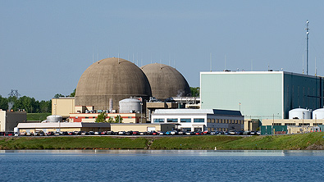
Dominion Power
Lake Anna Power Station
1892 MW (450,000 homes)
~9x entire bitcoin mining power (with efficient ASICs)

Slide 22
Is Mining Profitable?
Joules per block = 212 MJ * 600s = 127 421 MJ
KWh = 127 421 MJ/(60*60*1000) = 35395 KWh to find block

Slide 23
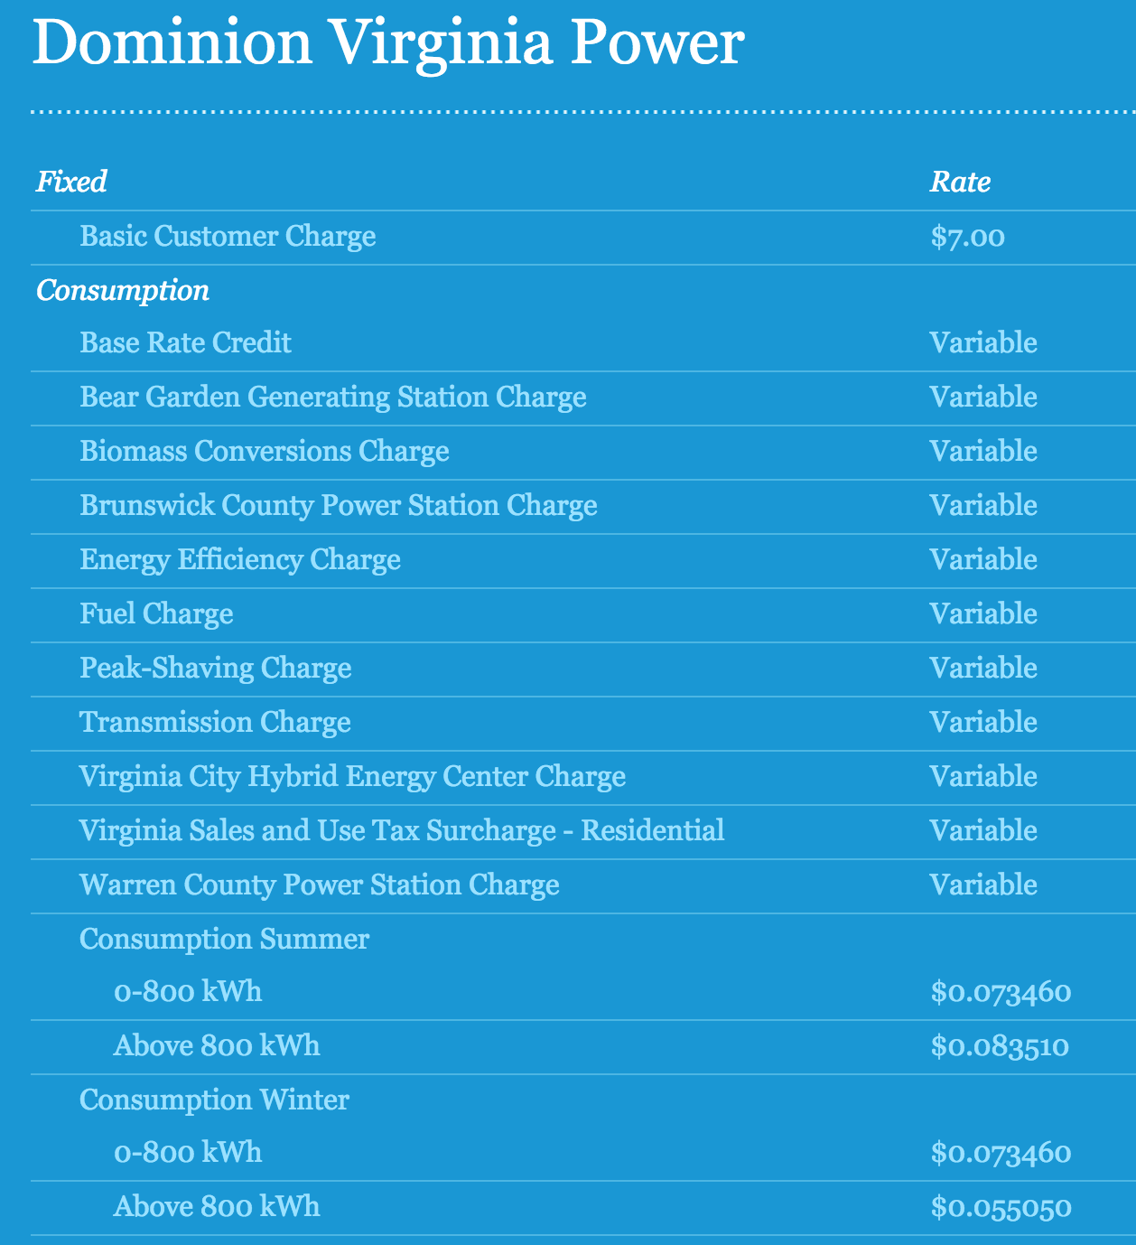
Is Mining Profitable?
Joules per block = 212 MJ * 600s = 127 421 MJ
KWh = 127 421 MJ/(60*60*1000) = 35395 KWh to find block

Slide 24
Is Mining Profitable?
Joules per block = 212 MJ * 600s = 127 421 MJ
KWh = 127 421 MJ/(60*60*1000) = 35395 KWh to find block
Dollars of electricity per block = KWh * 0.08 = $2831
1 BTC = $234.54 (9/23 1:15pm)
Mining reward = 25 BTC + fees = $5863.5

Slide 25
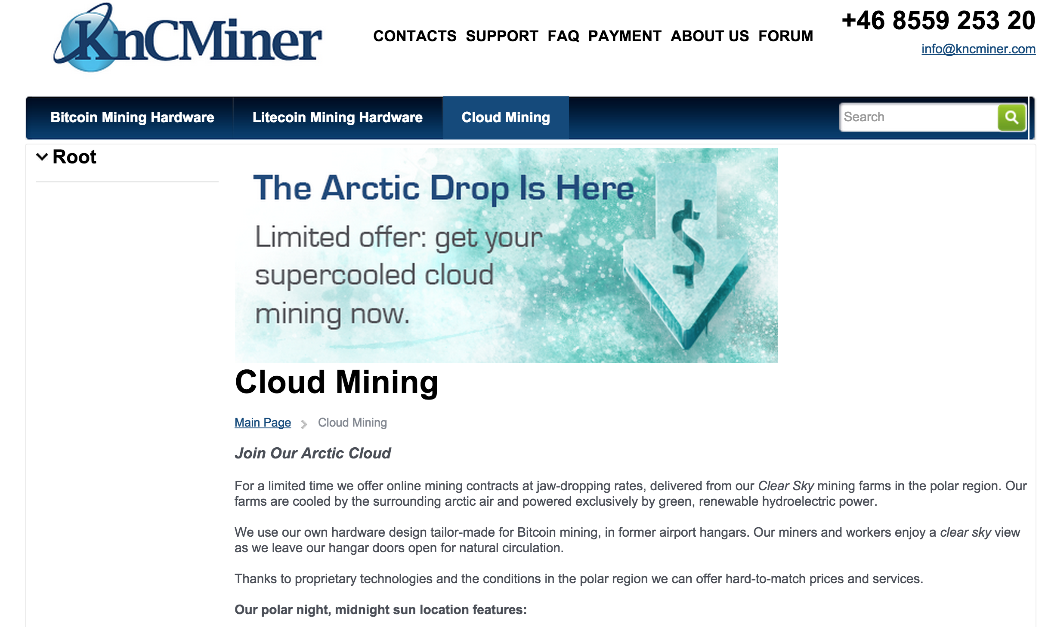

Slide 26
Checkup 2

