Slide 1
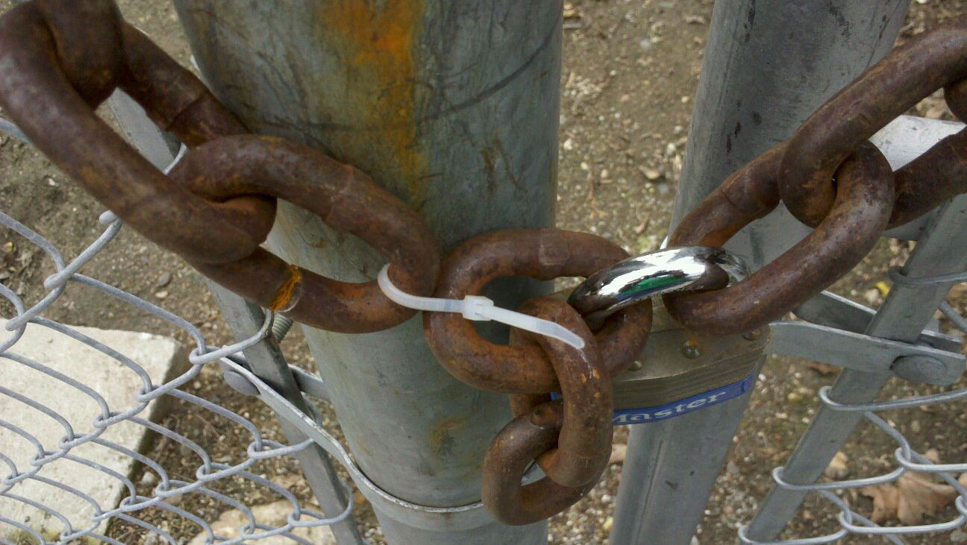
Class 7:
The Blockchain
Cryptocurrency Cabal
cs4501 Fall 2015
David Evans and Samee Zahur
University of Virginia

Slide 2
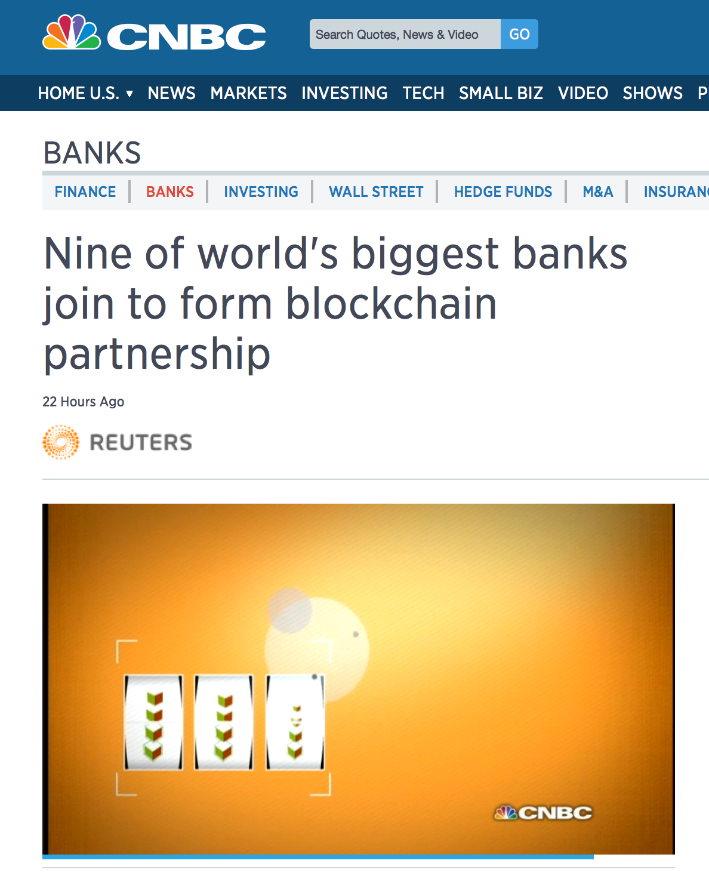
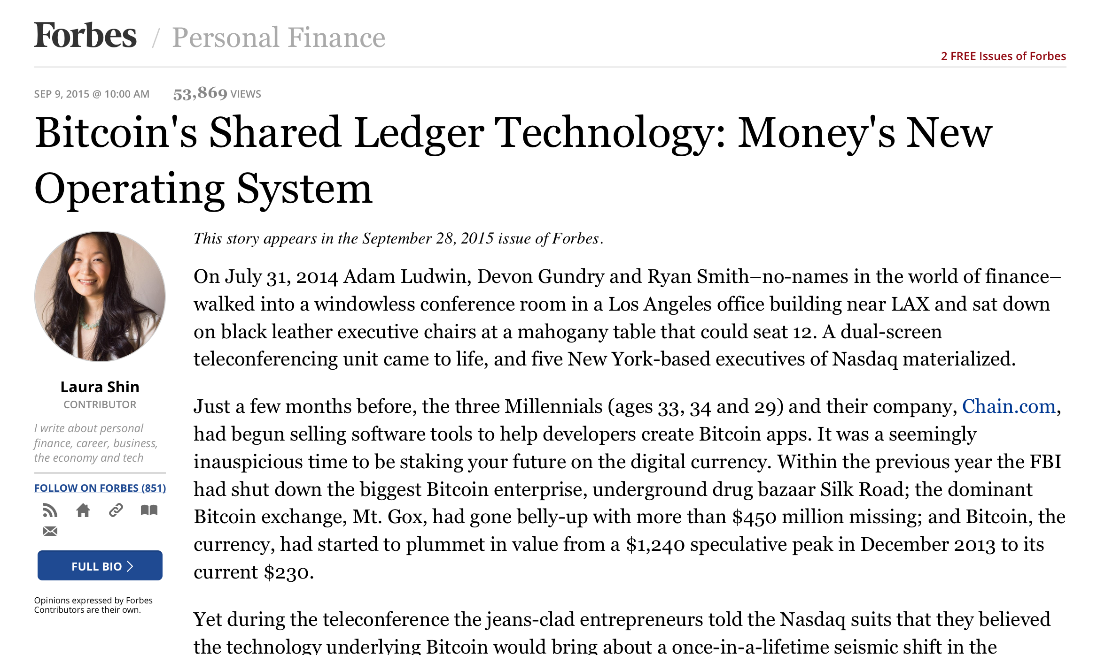
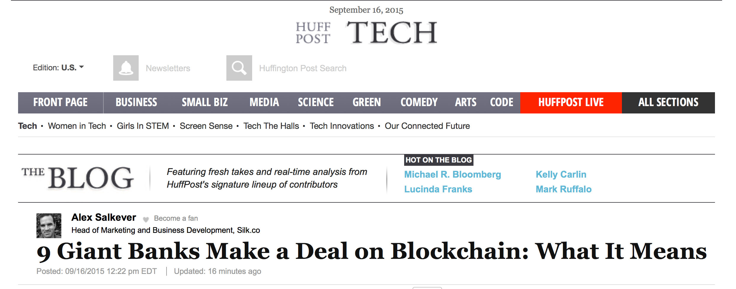

Slide 3
Plan for Today
Trust
Distributed Consensus
Proof-of-Work
Blockchain
Next Wednesday: Checkup 2
Classes through next Monday
Checkup 1, PS1
Readings:
Satoshi paper
Antonopoulos book: Ch 6 and 7
Princeton book: Ch 2 and 5

Slide 4
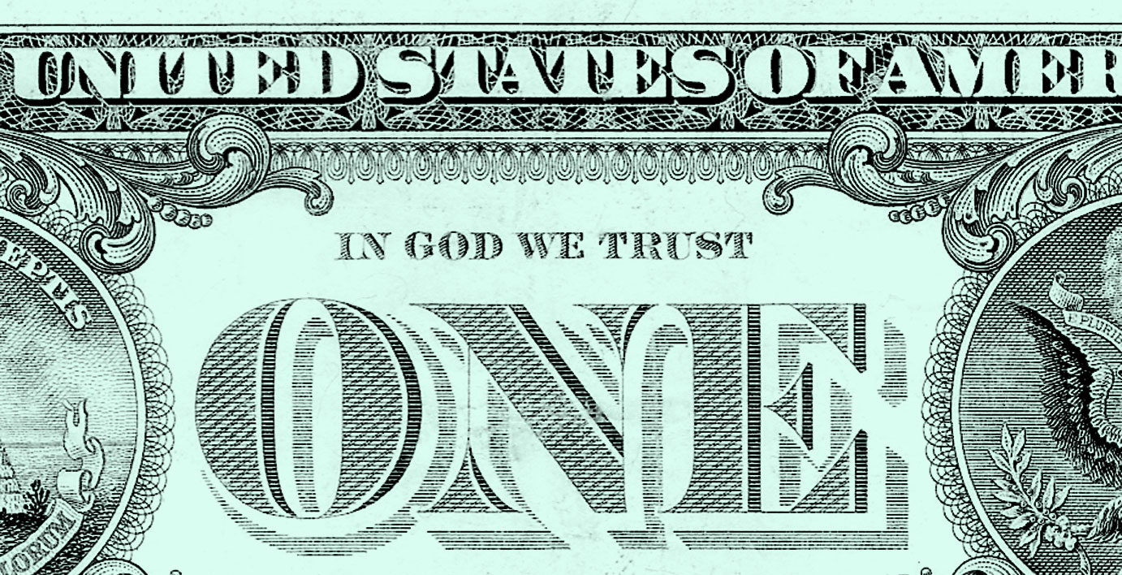
Where does trust come from?

Slide 5
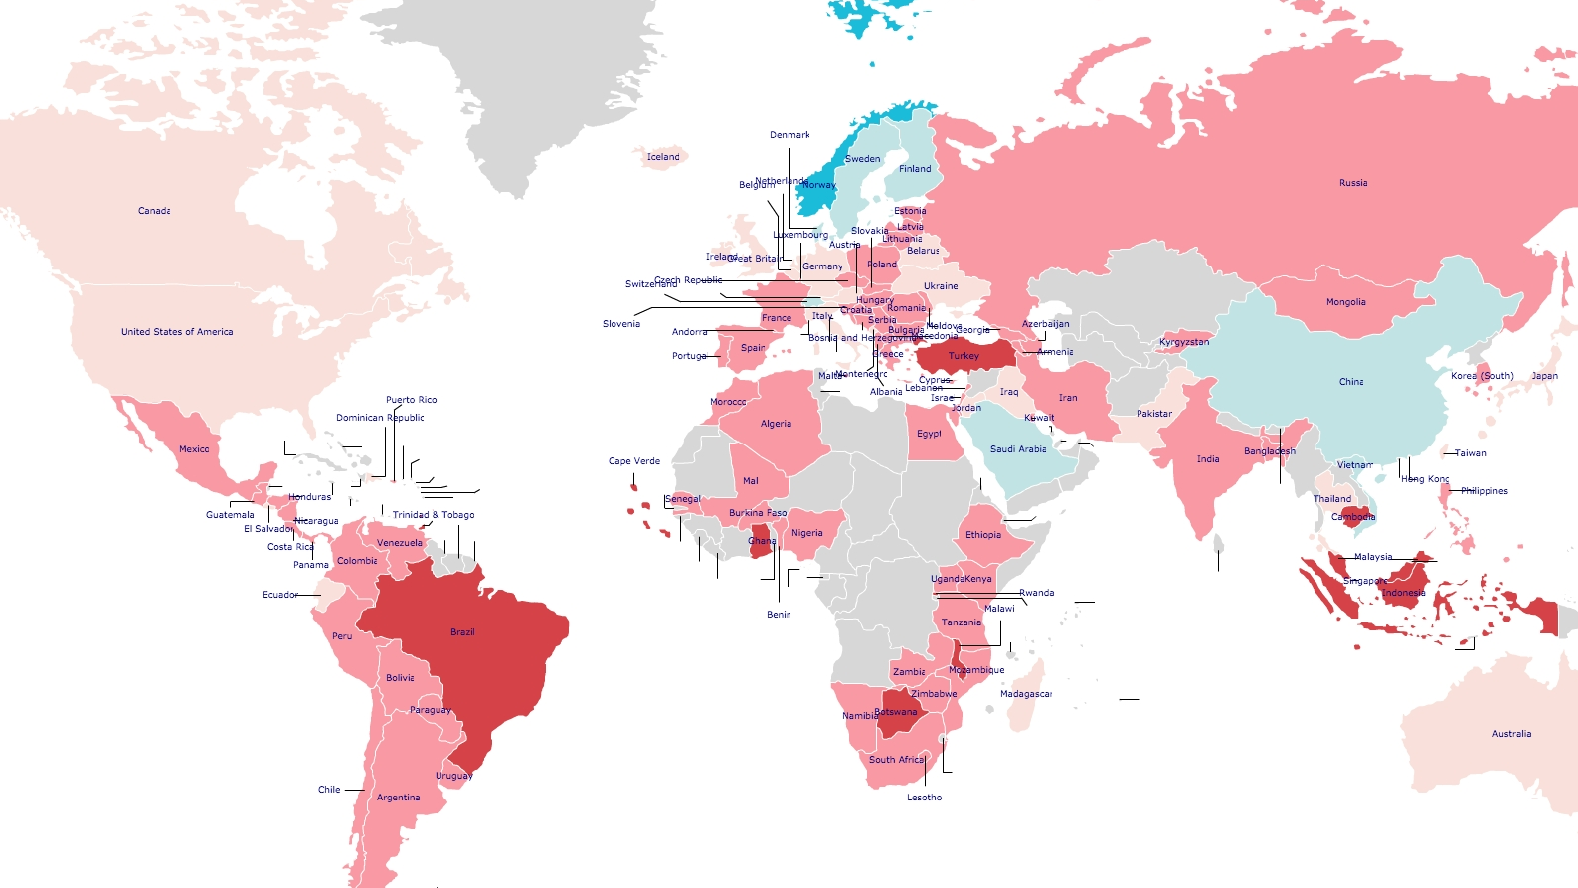
http://www.jdsurvey.net/jds/jdsurveyMaps.jsp

Slide 6
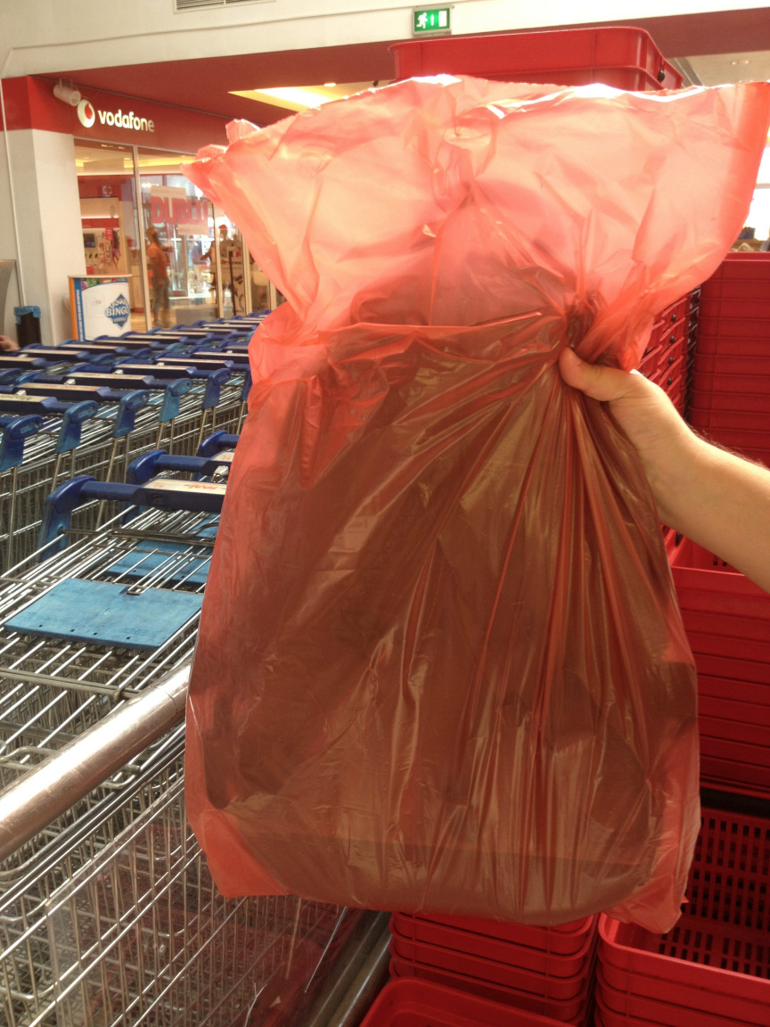
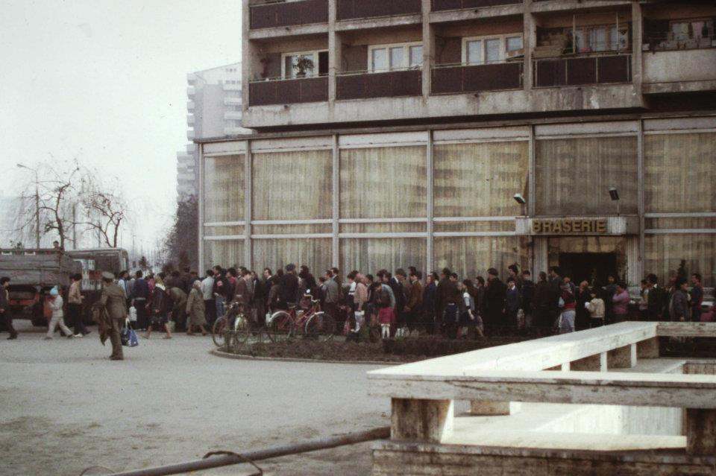
Queuing for cooking oil (Bucharest, 1986)
Scott Edelman
Image credit: https://howveryromanian.wordpress.com/2013/09/15/bag-wrapping/

Slide 7
Image: Queerbubbles CC BY-SA

Slide 8
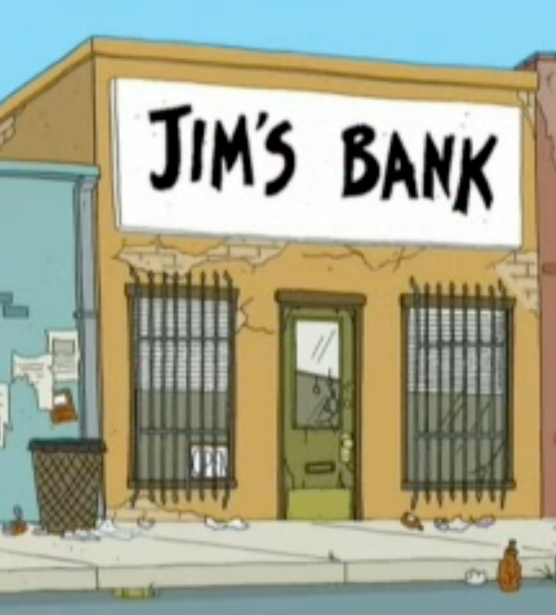
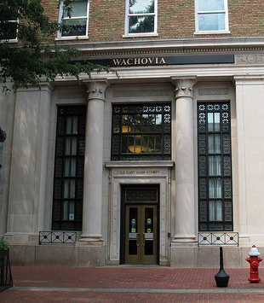

Slide 9
Sources of Trust
Yourself (super trustworthy!)
Mathematics and Science
Trustworthy because of logic, verified experiments
Organizations and People
Trustworthy because of what they have to lose (reputation)
Trustworthy because of trusted oversight (law, police)
Trustworthy because incentives are aligned
Trustworthy because of processes they follow

Slide 10
Bitcoin’s solution: a public ledger
Trust in resources

Slide 11
Public Ledger
Node A
Node B
Node C
Bob wants to verify:
Alice hasn’t already transferred X
The coin will be valuable for Bob
M = transfer X to Bob
Sign_{KRA}[H(M)]

Slide 12
Public Ledger: Distributed Trust (?)
Node A
Node B
Node C
t_{b}
t_{b}
t_{b}
Bob wants to verify:
Alice hasn’t already transferred X
The coin will be valuable for Bob
M = transfer X to Bob
Sign_{KRA}[H(M)]
t_{b}

Slide 13
Transactions
1 | t_{b} (X->Bob)
Transactions
1 | t_{b} (X->Bob)
t
Node A
Node B
Node C
ok!
t_{b}
t_{b}
t_{b}
ok!
Bob wants to verify:
Alice hasn’t already transferred X
The coin will be valuable for Bob
M = transfer X to Bob
Sign_{KRA}[H(M)]
t_{b}

Slide 14
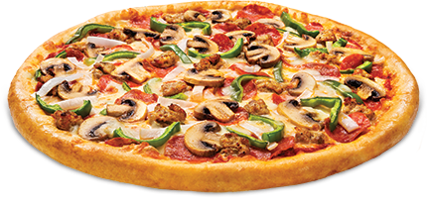
Transactions
1 | t_{b} (X->Bob)
Transactions
1 | t_{b} (X->Bob)
t
Node A
Node B
Node C
ok!
t_{b}
t_{b}
t_{b}
ok!
t_{b}
Bob wants to verify:
Alice hasn’t already transferred X
The coin will be valuable for Bob

Slide 15
Transactions
1 | t_{b} (X->Bob)
Transactions
1 | t_{c} (X->Cathy)
Transactions
1 | t_{b} (X->Bob)
t
Node A
Node B
Node C
BAD!
t_{c}
t_{c}
t_{c}
M = transfer X to Cathy
Sign_{KRA}[H(M)]
t_{c}

Slide 16
Scaling the Network
Node D
Node E
Node F
Node G
Node A
Node B
Node C
t_{b}
t_{a}
t_{b}

Slide 17
Blockchain
Public ledger without fixed set of nodes – decentralized, distributed trust
Requires coalition with majority of computing power to collude to cheat

Slide 18
Blockchain
B0
H(B0)
Nonce
H(B1)
Nonce
H(B2)
Nonce
Transactions
Transactions
Transactions

Slide 19
Inconsistent Blockchains
Node D
Node E
Node F
Node G
Node A
Node B
Node C
How do we know which blockchain is “correct”?

Slide 20
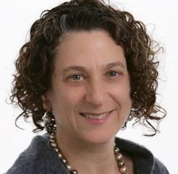
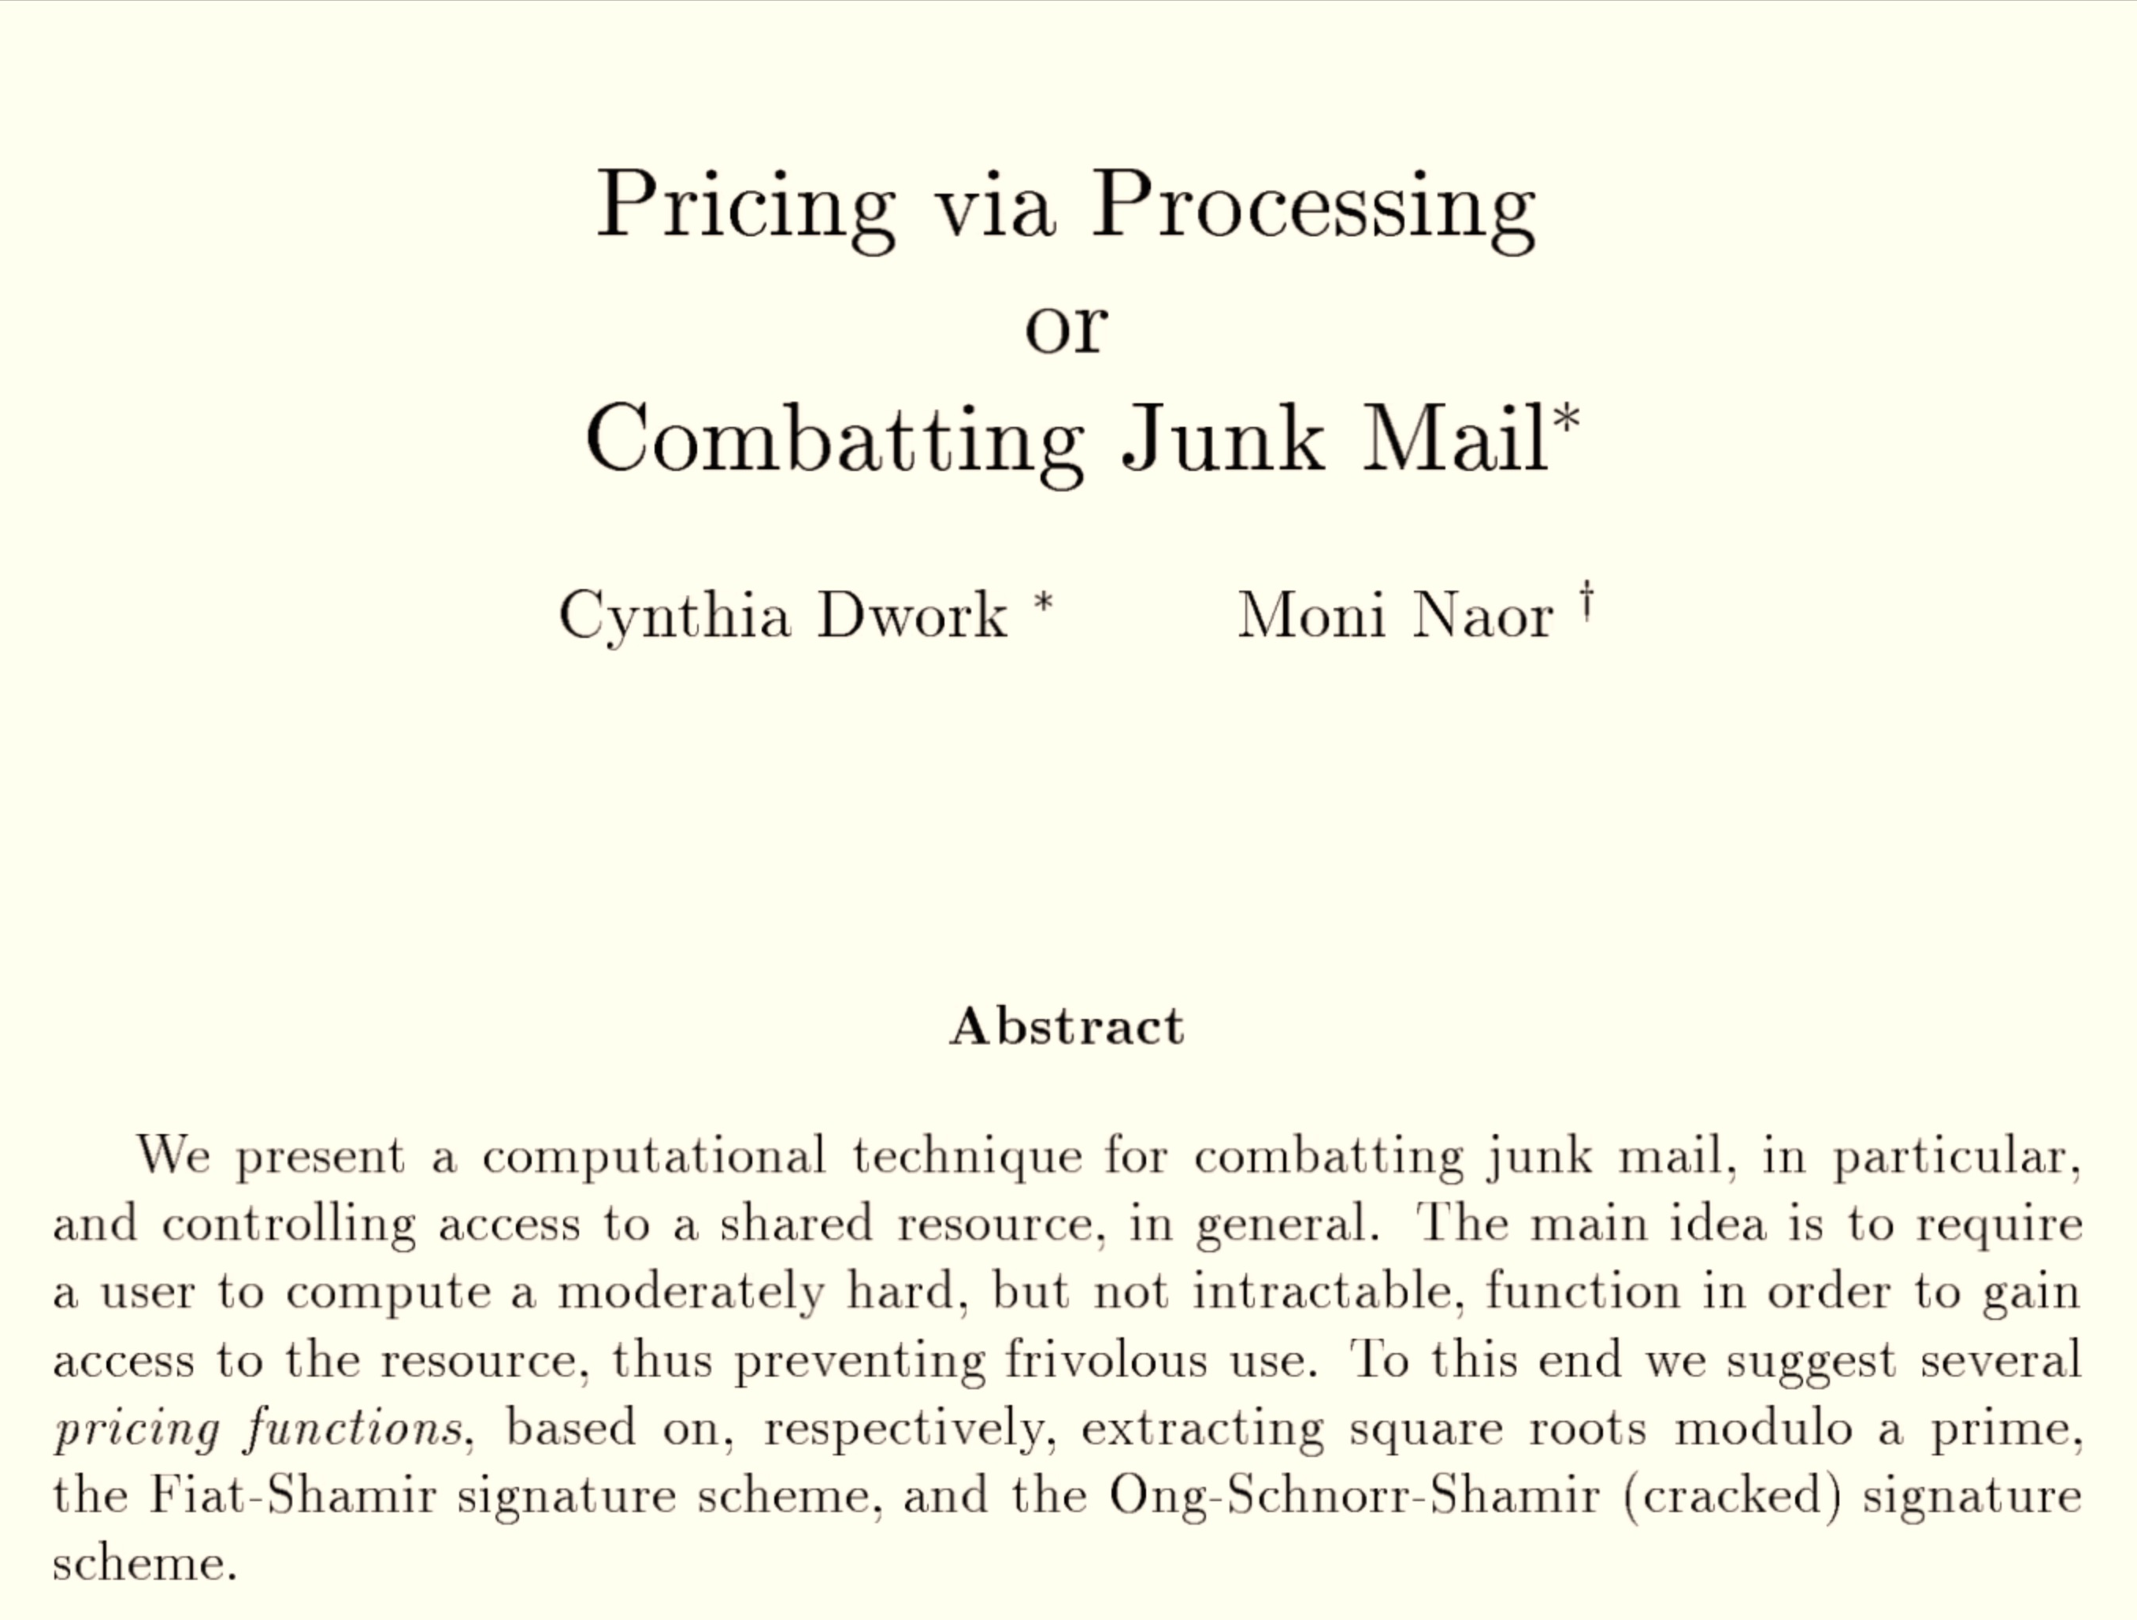
CRYPTO 1992
Cynthia Dwork
(now at MSR)
Moni Naor
(Weizmann Institute)

Slide 22
Idea: Proof-of-Work
Pricing Function: (f)
- moderately easy to compute
- cannot be amortized
computing f(m₁),…, f(m_{l}) costs l times as
much as computing f(m_{i}).
- easily verified: given x, y easy to check y = f(x)

Slide 23
Proposed Pricing Function
Extracting Square Roots
index: p
find x, y such that y² = x mod p
Dwork and Naor proposed two other pricing functions, designed to have “shortcuts” (backdoors) to allow administrators to compute them efficiently.

Slide 24
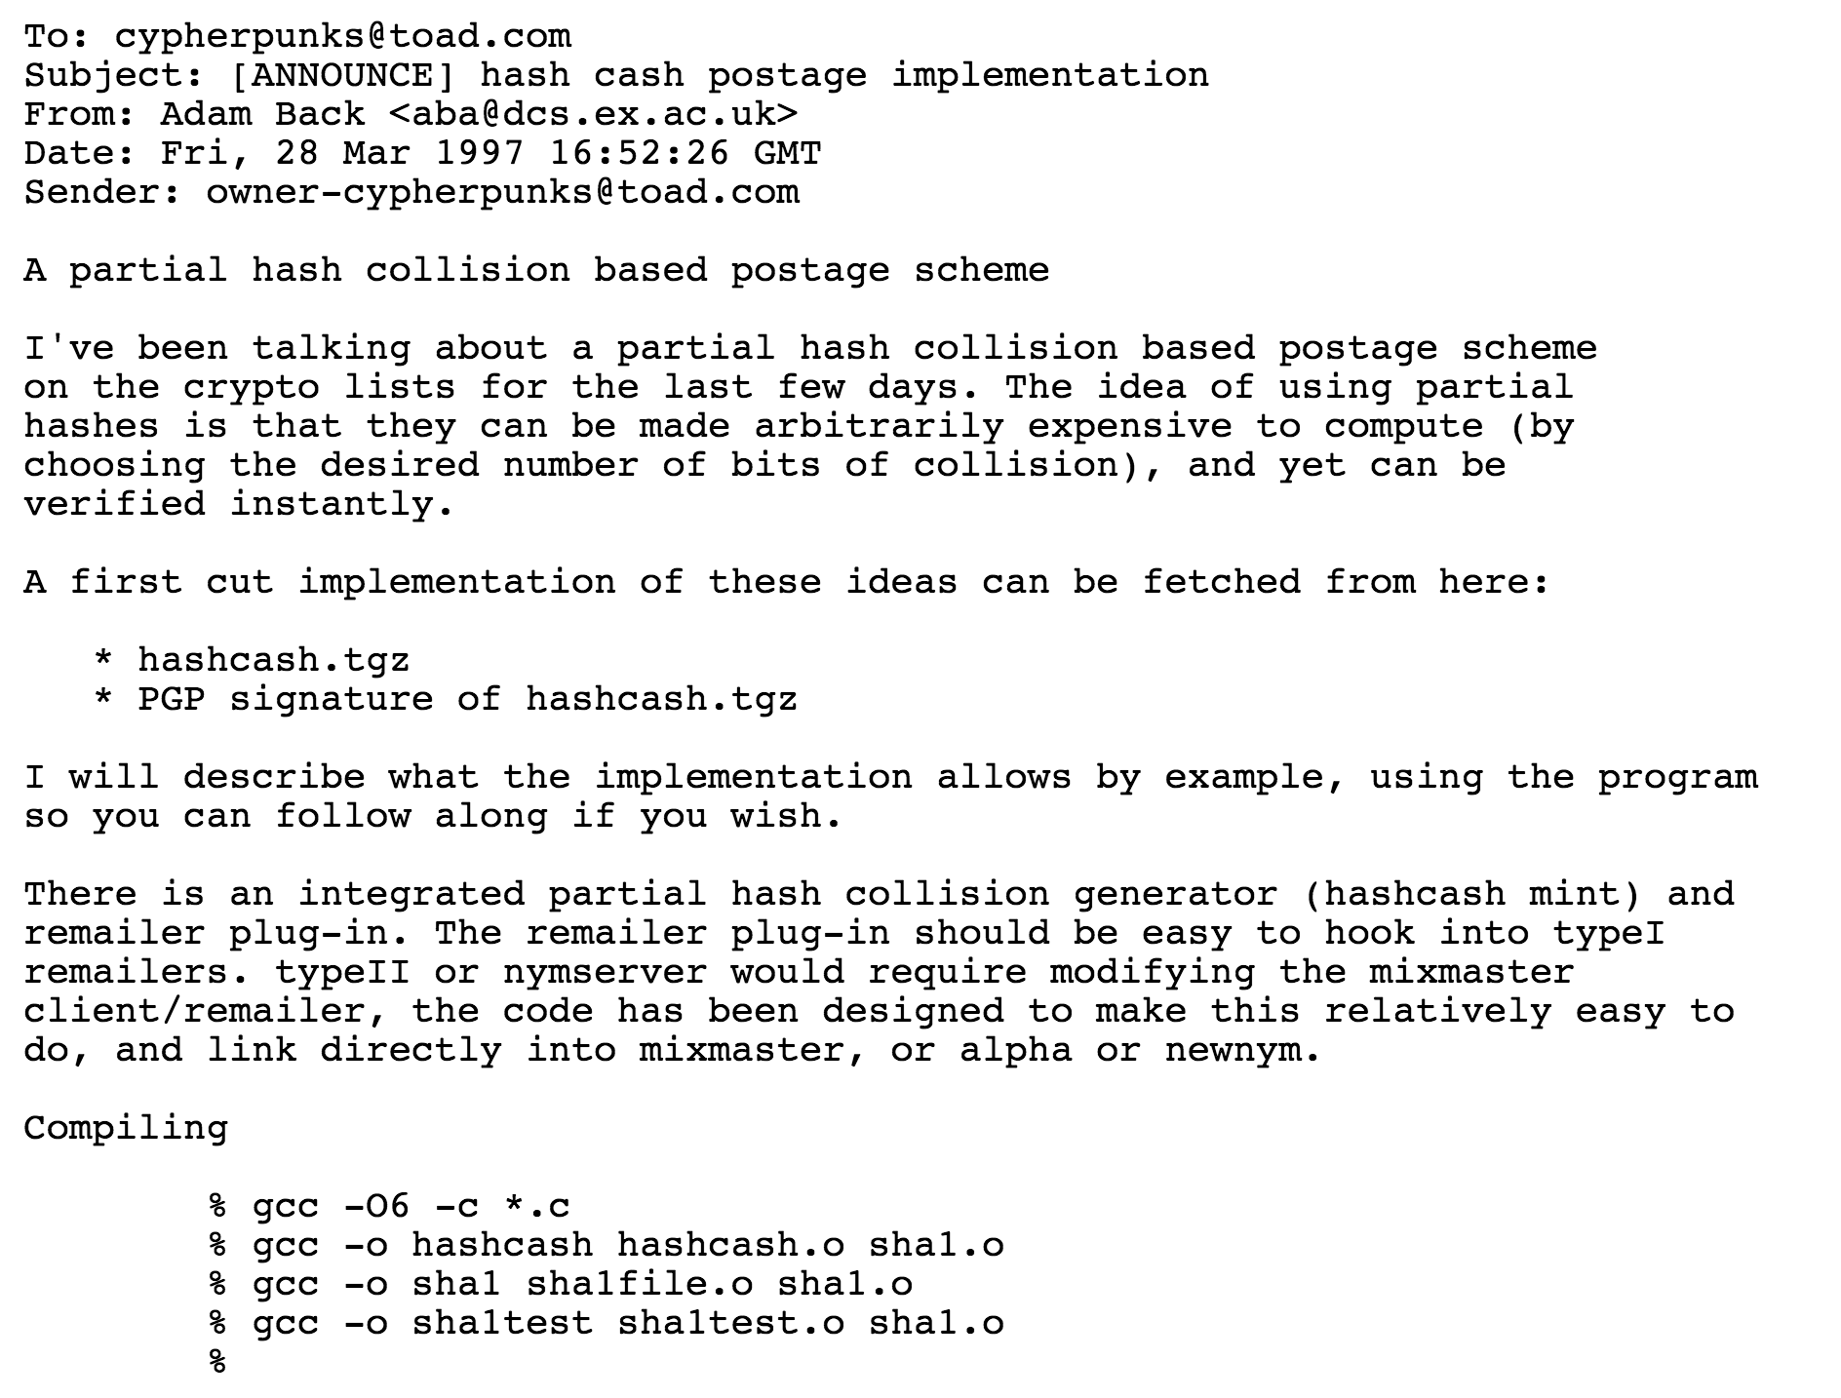
Hashcash Adam Back 1997

Slide 25
Interactive Hashcash
Everyone agrees on one-way function f
mail sender
mail recipient’s server
Hello
r ⬅ random nonce
Challenge: r

Slide 26
Interactive Hashcash
Everyone agrees on one-way function f
mail sender
mail recipient’s server
Hello
r ⬅ random nonce
Challenge: r
search for x such that
f(x) = r
(x, Mail)

Slide 27
Interactive Hashcash
Everyone agrees on one-way function f
mail sender
mail recipient’s server
Hello
r ⬅ random nonce
Challenge: r
search for x such that
f(x) = r
(x, Mail)
Verify f(x) = r

Slide 28
Interactive Hashcash
Everyone agrees on one-way function f
mail sender
mail recipient’s server
Hello
r ⬅ random nonce
Challenge: r
search for x such that
f(x) = r
(x, Mail)
Verify f(x) = r
Can we make this non-interactive?

Slide 29
Non-Interactive Hashcash
Everyone agrees on one-way function f
mail sender
mail recipient’s server
Verify

Slide 30
Non-Interactive Hashcash
Everyone agrees on one-way function f
mail sender
mail recipient’s server, s
msg || x
Verify f(msg || x) = s
How well would this work if f is SHA-256?

Slide 31
Pre-image Attack on SHA-256
search for x such that
f(msg || x) = s

Slide 32
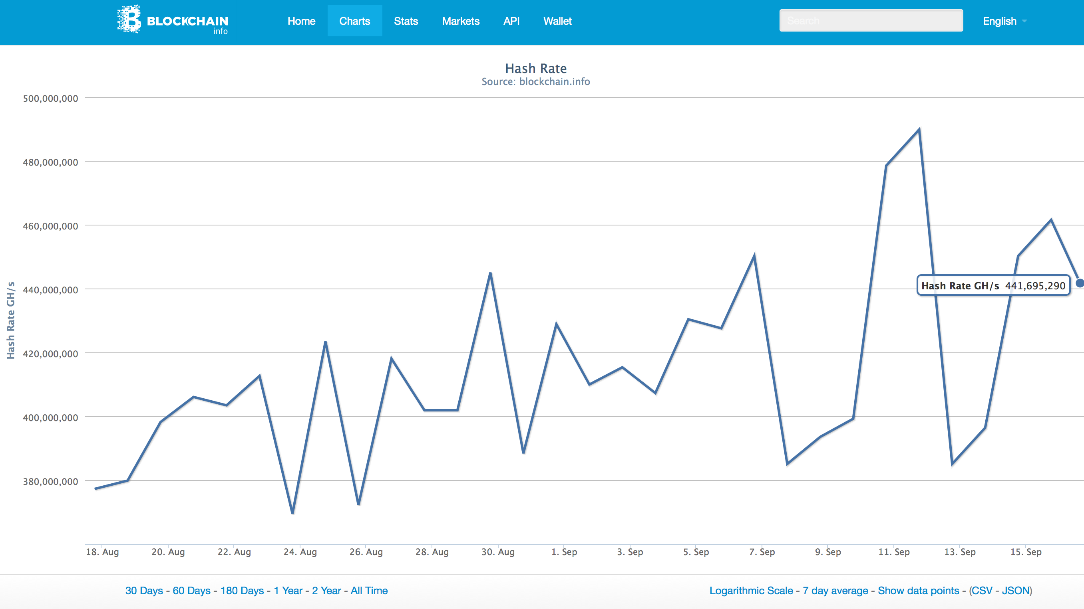
Estimated hash rate of entire bitcoin network:
441,695,290 GH/s

Slide 33
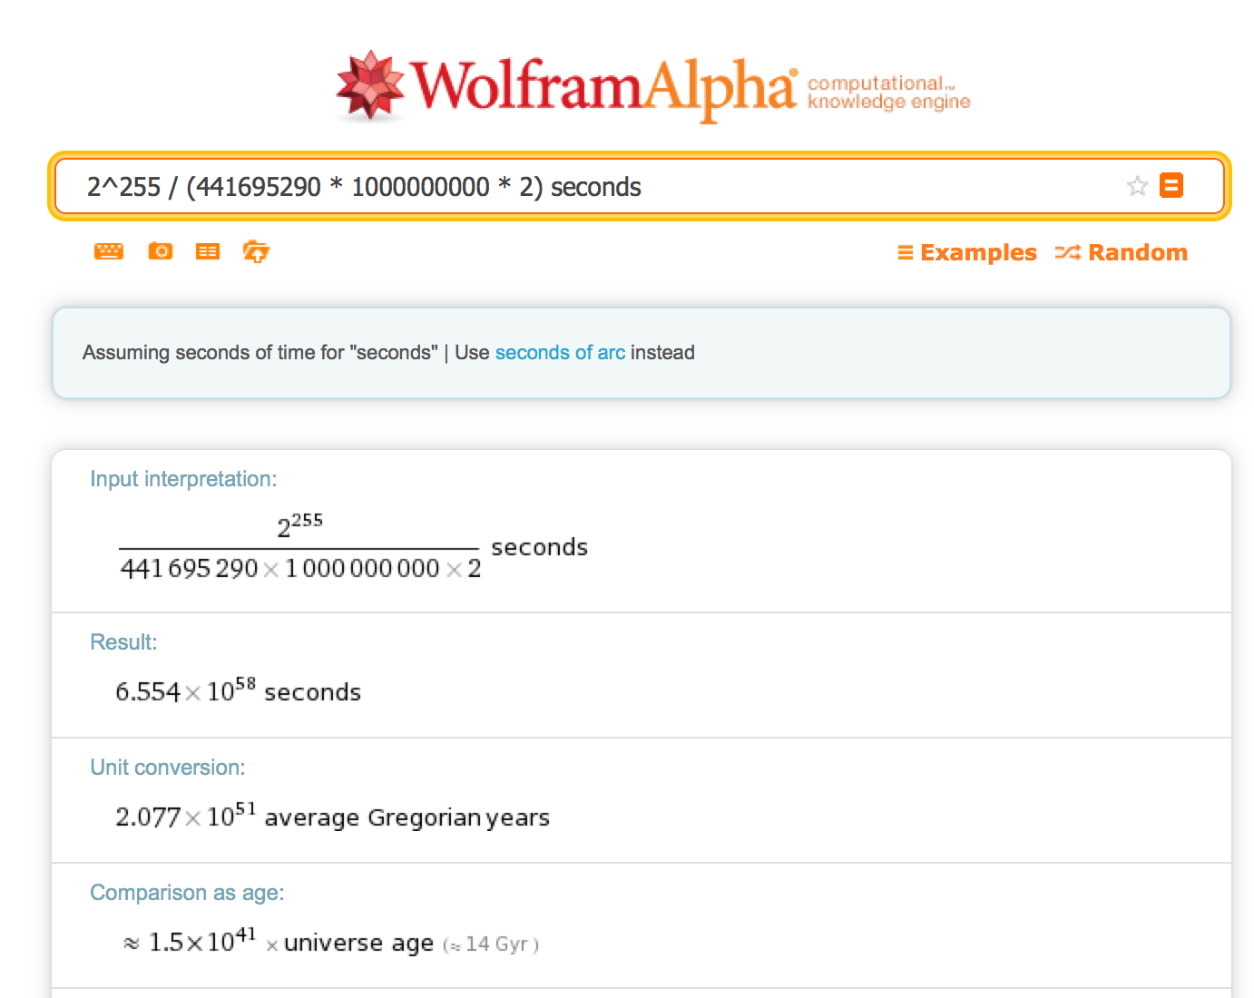

Slide 34
Variable-Difficulty f
Challenge: r, Difficulty: d
Find an x such that:
SHA-256(msg || x) < T/d
T is some set “target”.
If the difficulty doubles, how much more work is expected?

Slide 35
Bitcoin’s Proof-of-Work
Find an x such that:
SHA-256(SHA-256(r + x)) < T/d
Why use double SHA-256?

Slide 36
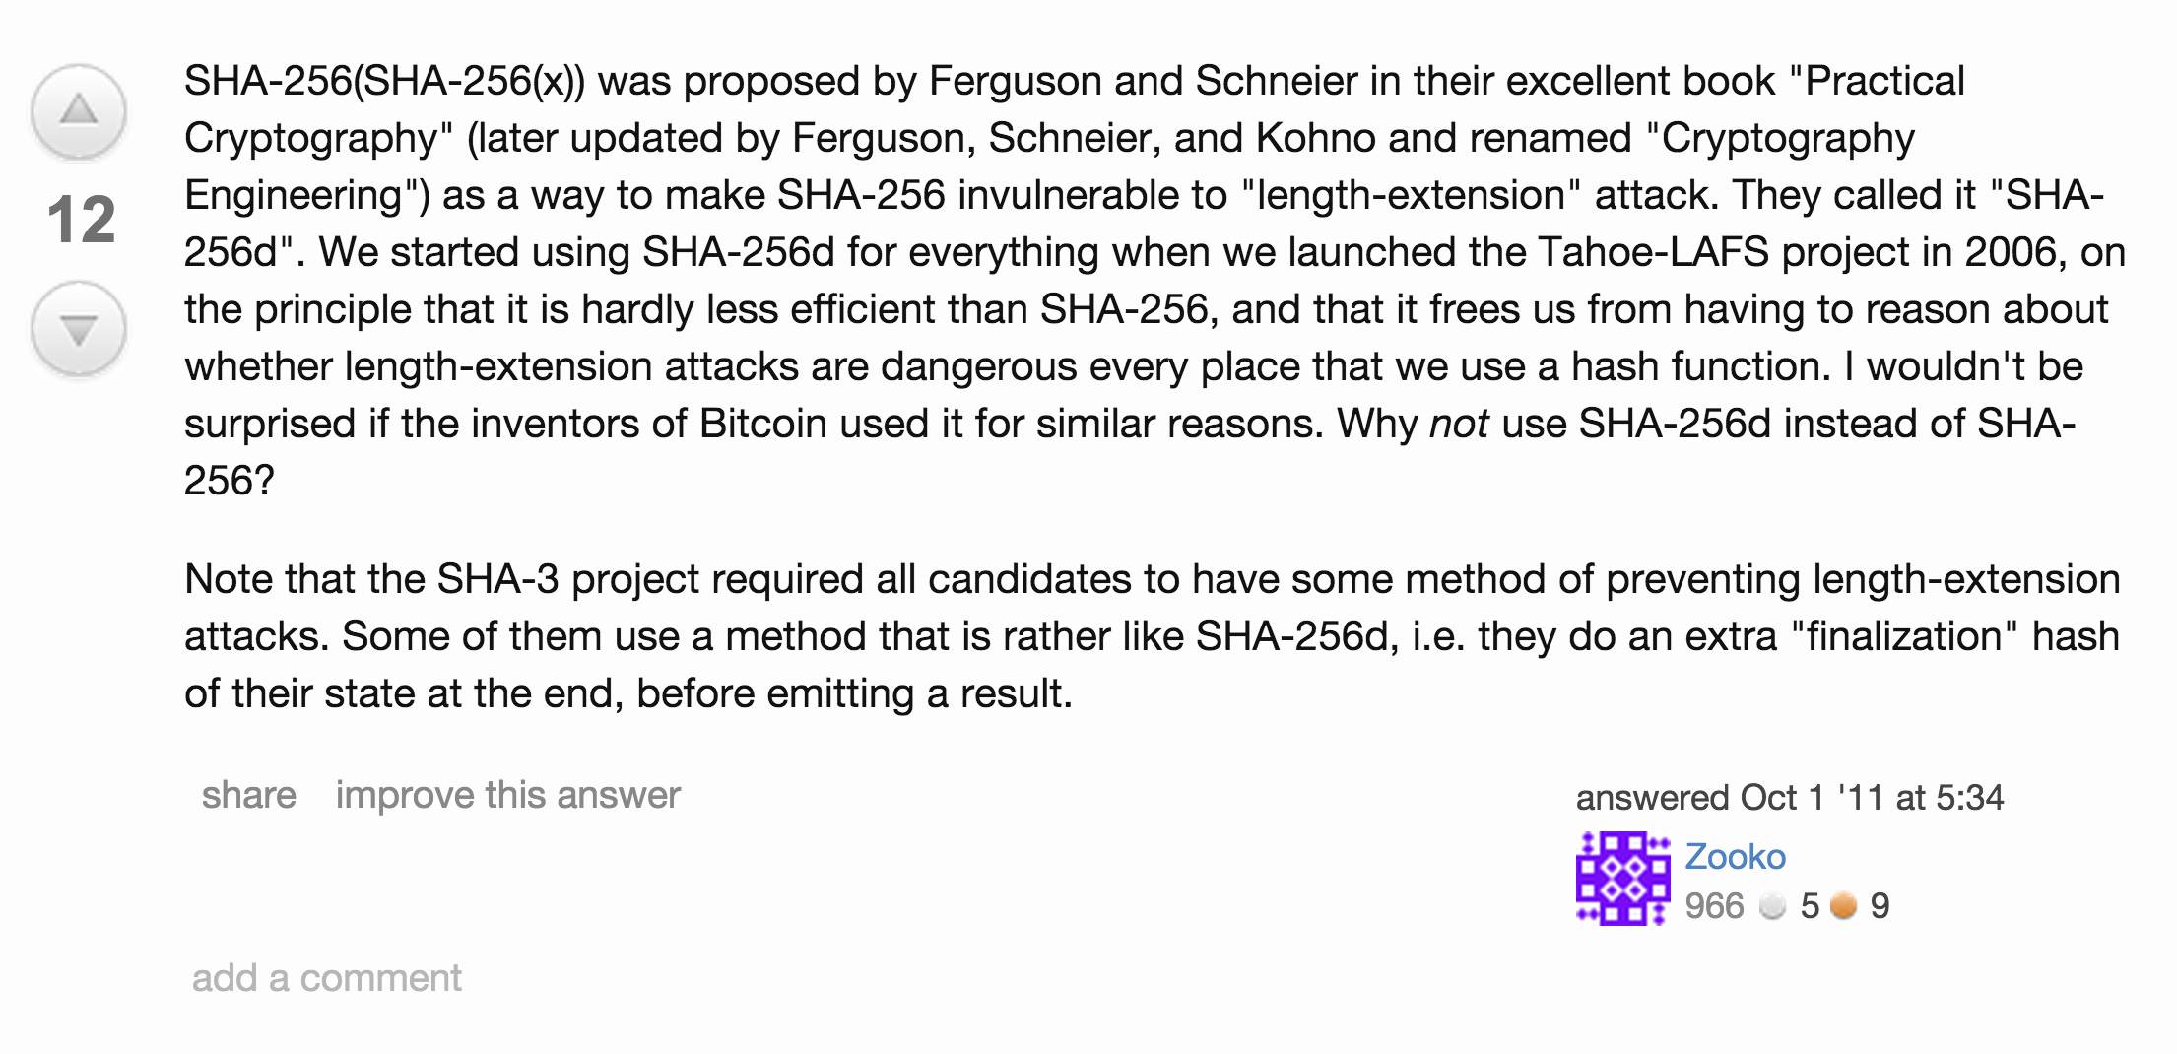
http://crypto.stackexchange.com/questions/779/hashing-or-encrypting-twice-to-increase-security

Slide 37
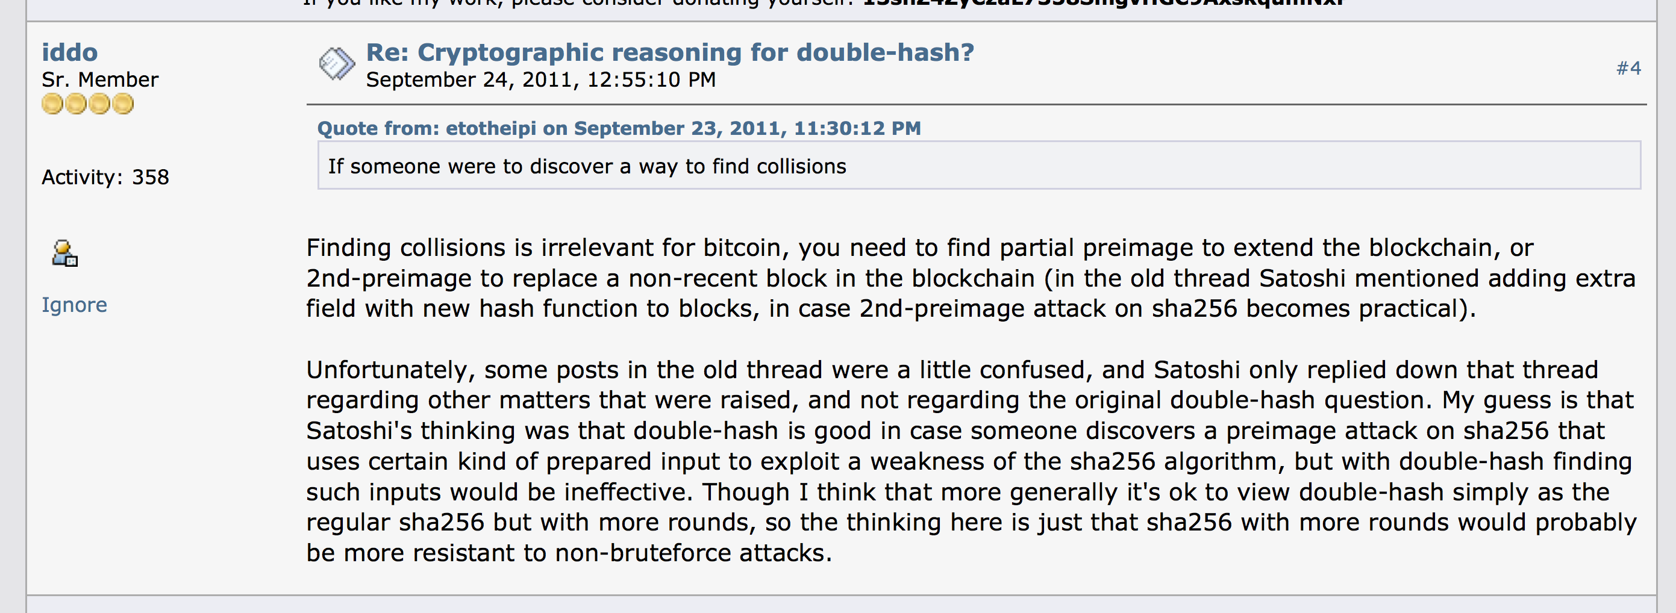
https://bitcointalk.org/index.php?topic=45456.0;all

Slide 38
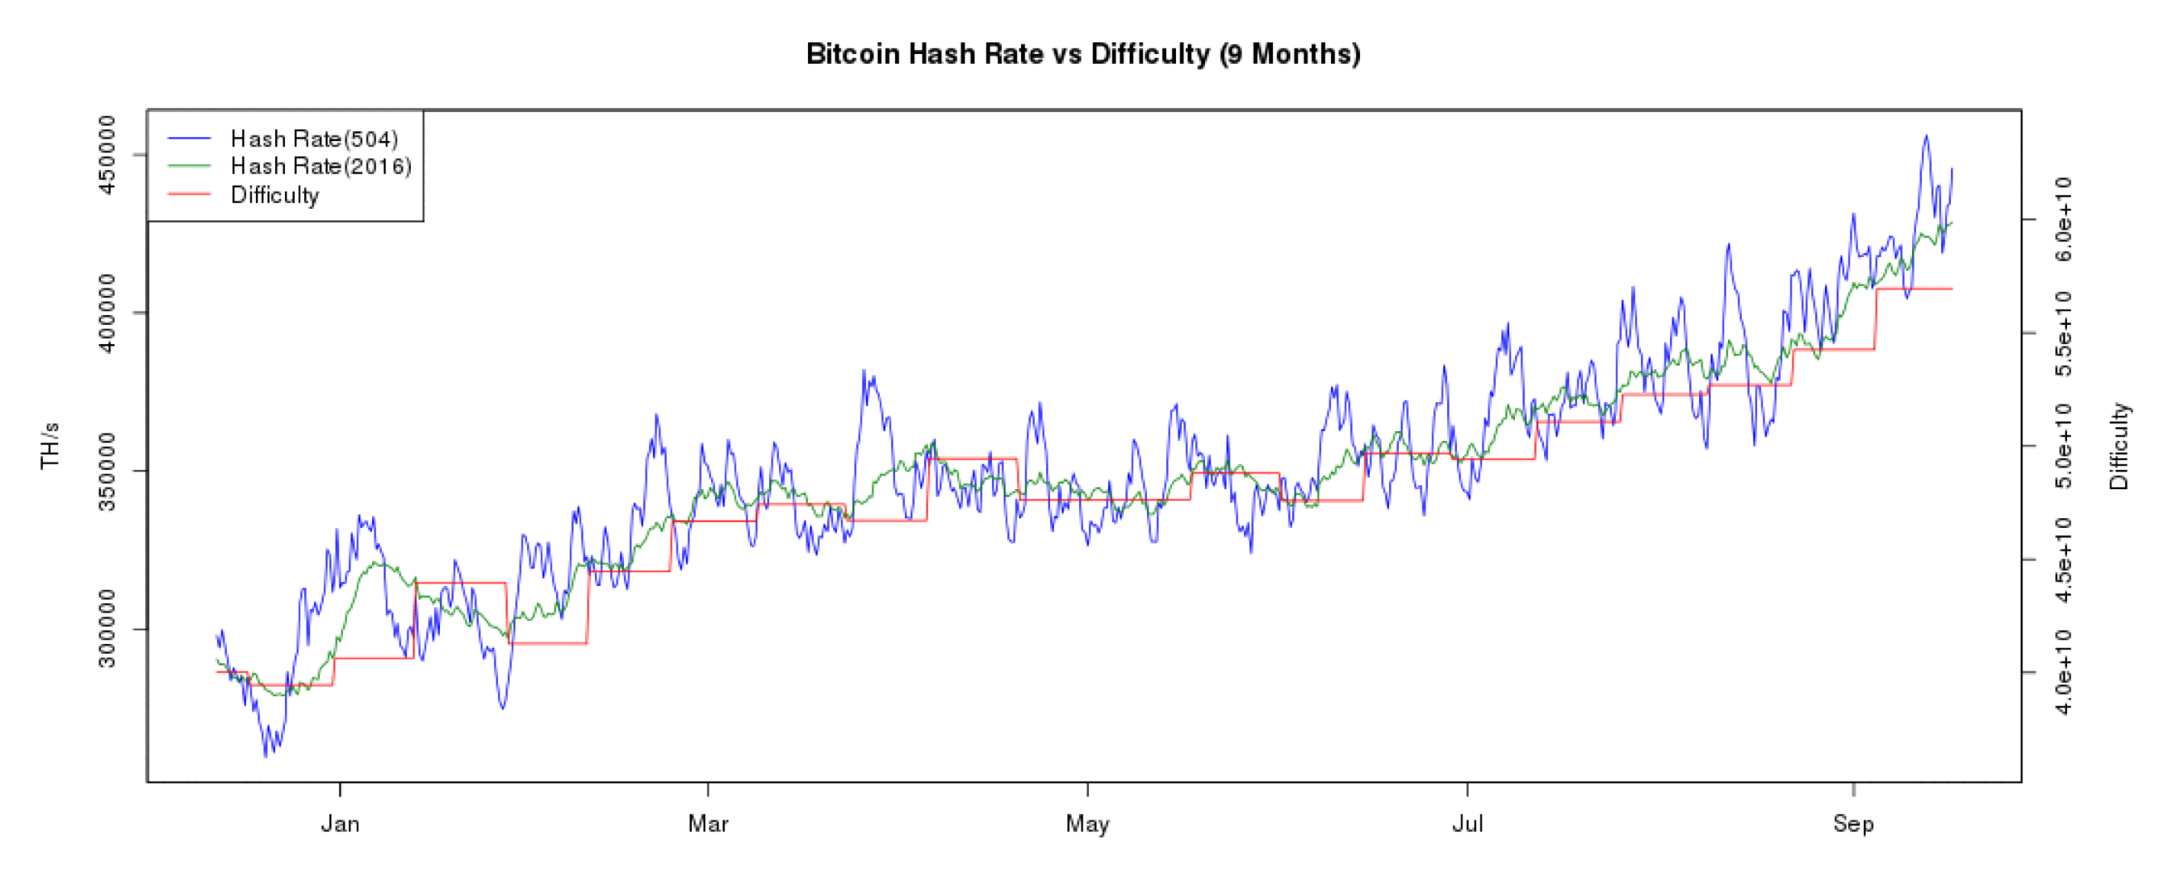
Difficulty adjusts (every 2016 blocks) to keep block-finding time around 10 minutes
https://bitcoinwisdom.com/bitcoin/difficulty

Slide 39
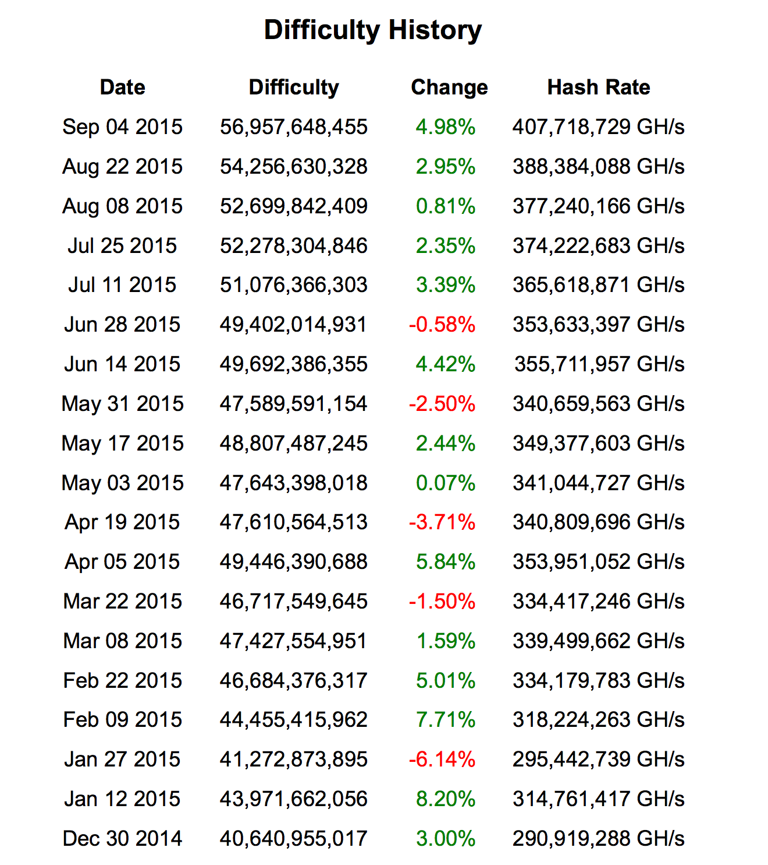
https://bitcoinwisdom.com/bitcoin/difficulty

Slide 40
Finding the Next Block
B0
H(B0)
Nonce
H(B1)
Nonce
H(B2)
Nonce
Transactions
Transactions
Transactions
Find a nonce x such that:
SHA-256(SHA-256(r + x)) < T/d

Slide 41
Finding the Next Block
B0
H(B0)
Nonce
H(B1)
Nonce
H(B2)
Nonce
Transactions
Transactions
Transactions
Find a nonce x such that:
SHA-256(SHA-256(r + x)) < T/d
r = header + transactions (including mining fee)
header = H(previous block)

Slide 42
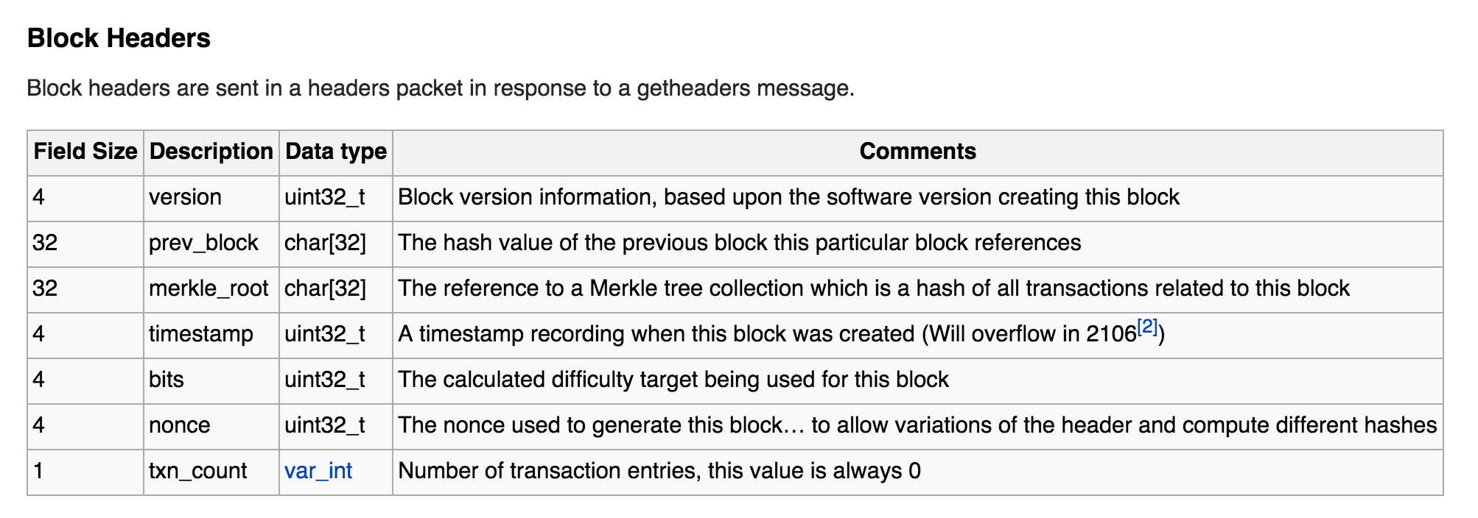
Actual Bitcoin Block
https://en.bitcoin.it/wiki/Protocol_documentation#Block_Headers

Slide 43
Inconsistent Blockchains
Node D
Node E
Node F
Node G
Node A
Node B
Node C
The longest blockchain is the “right” one.

Slide 44
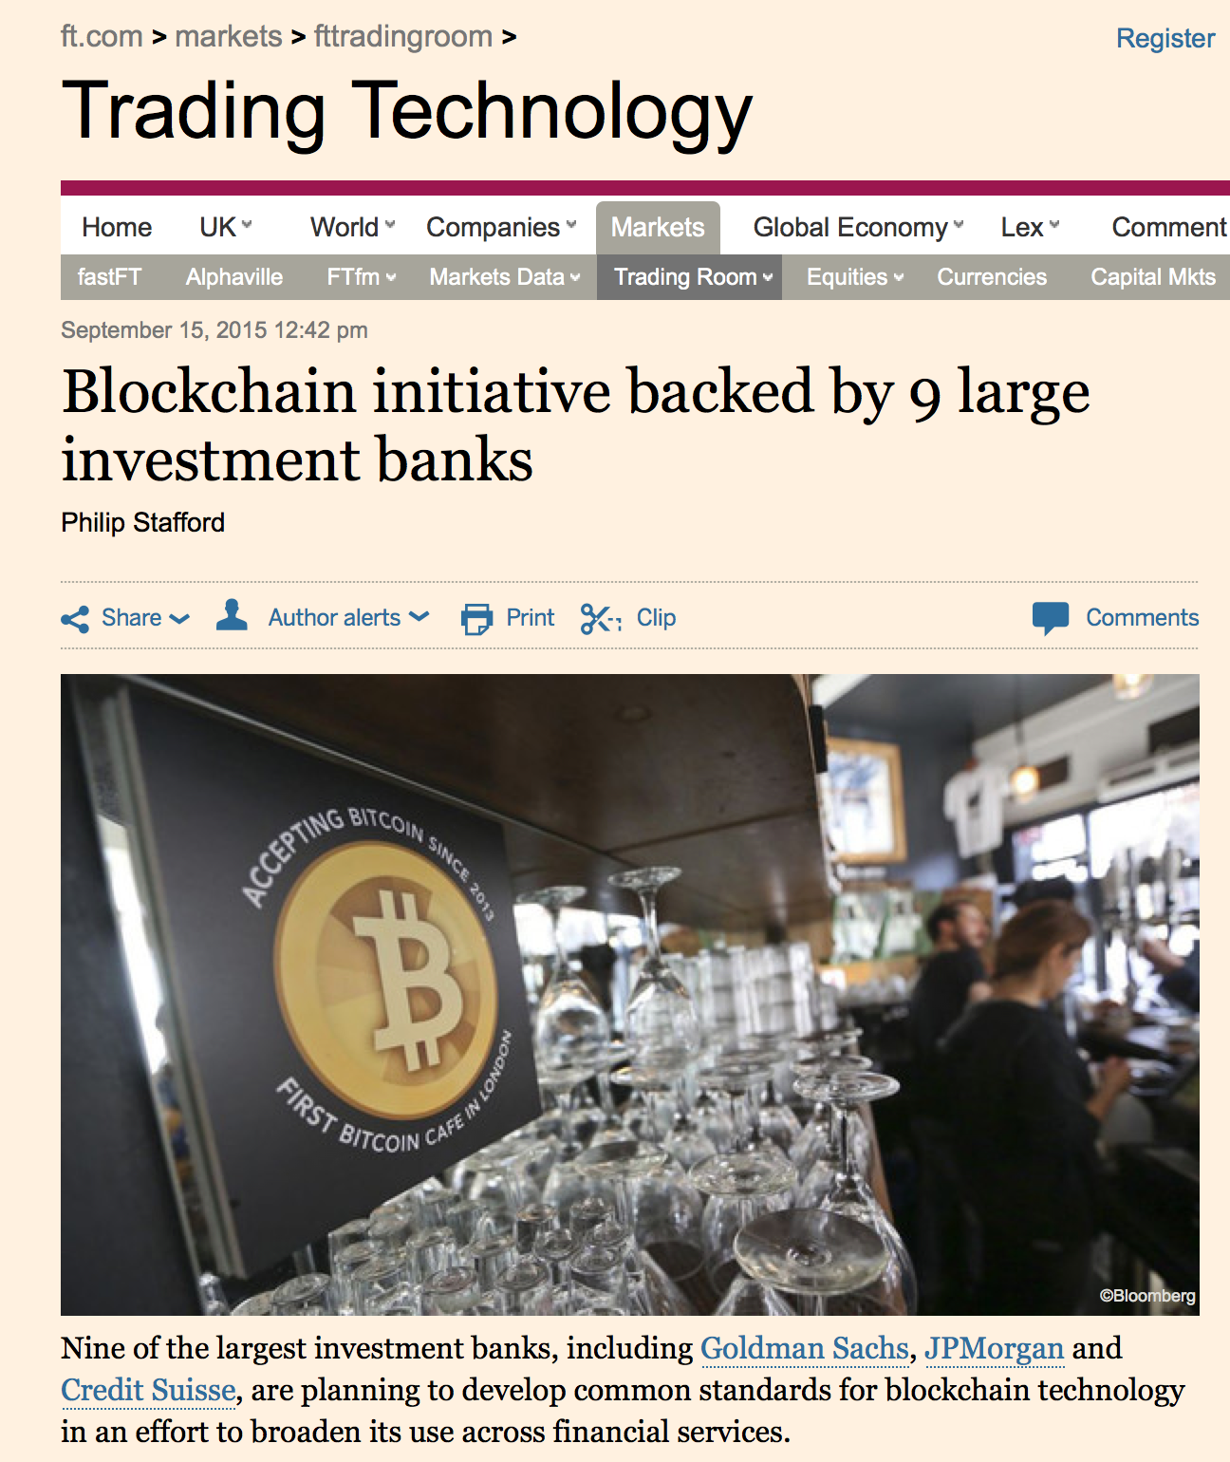
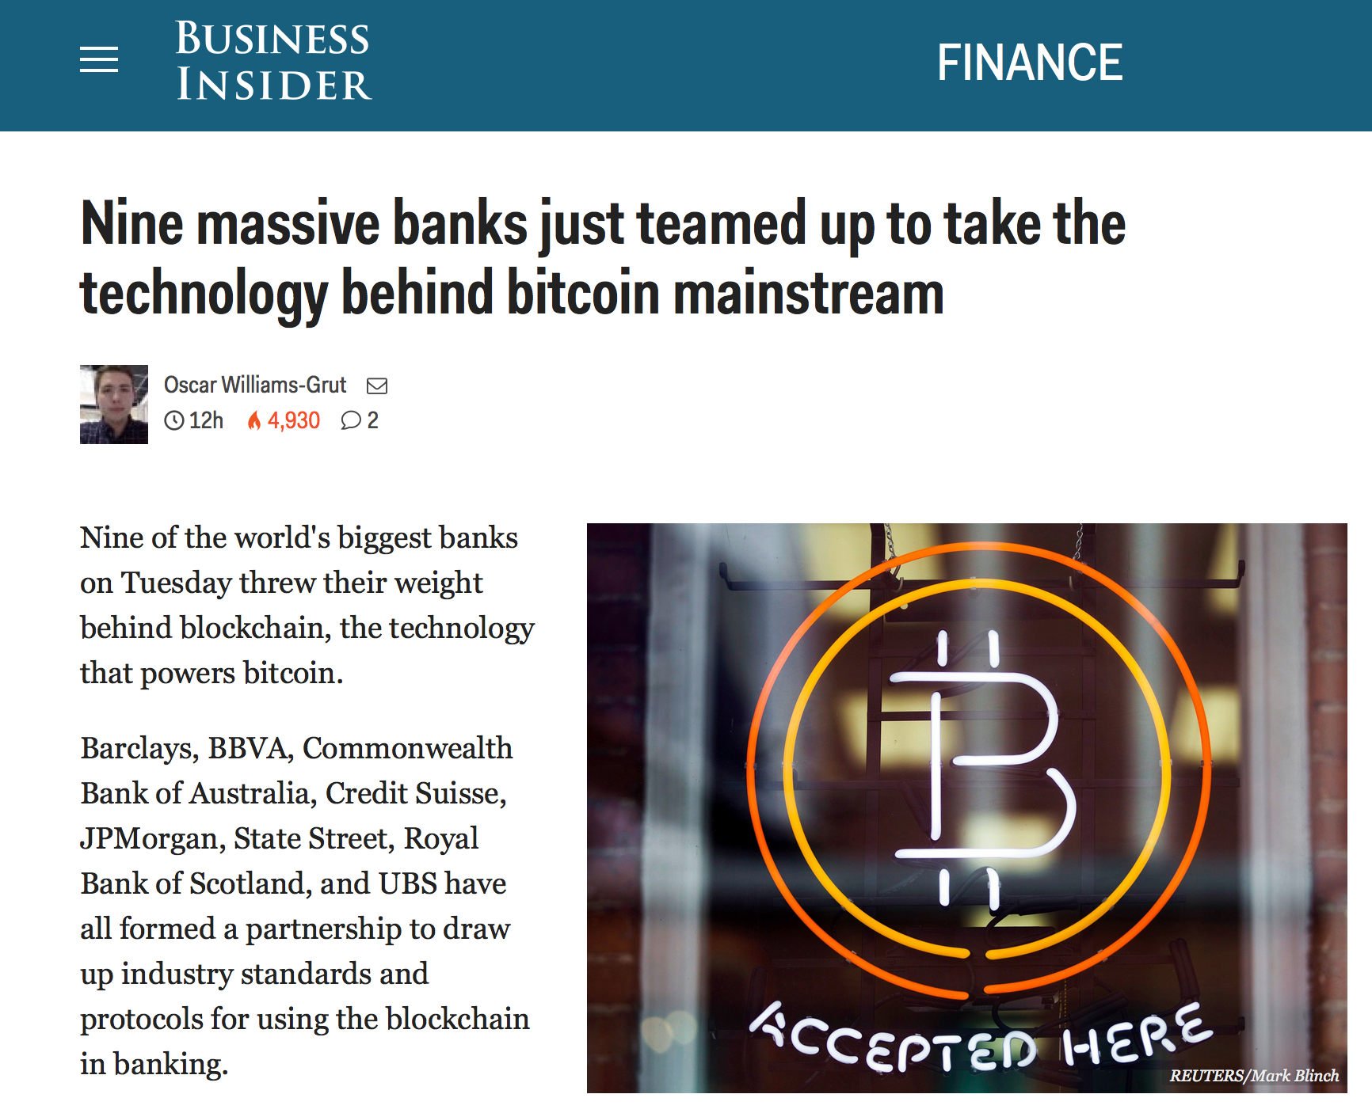

Slide 45
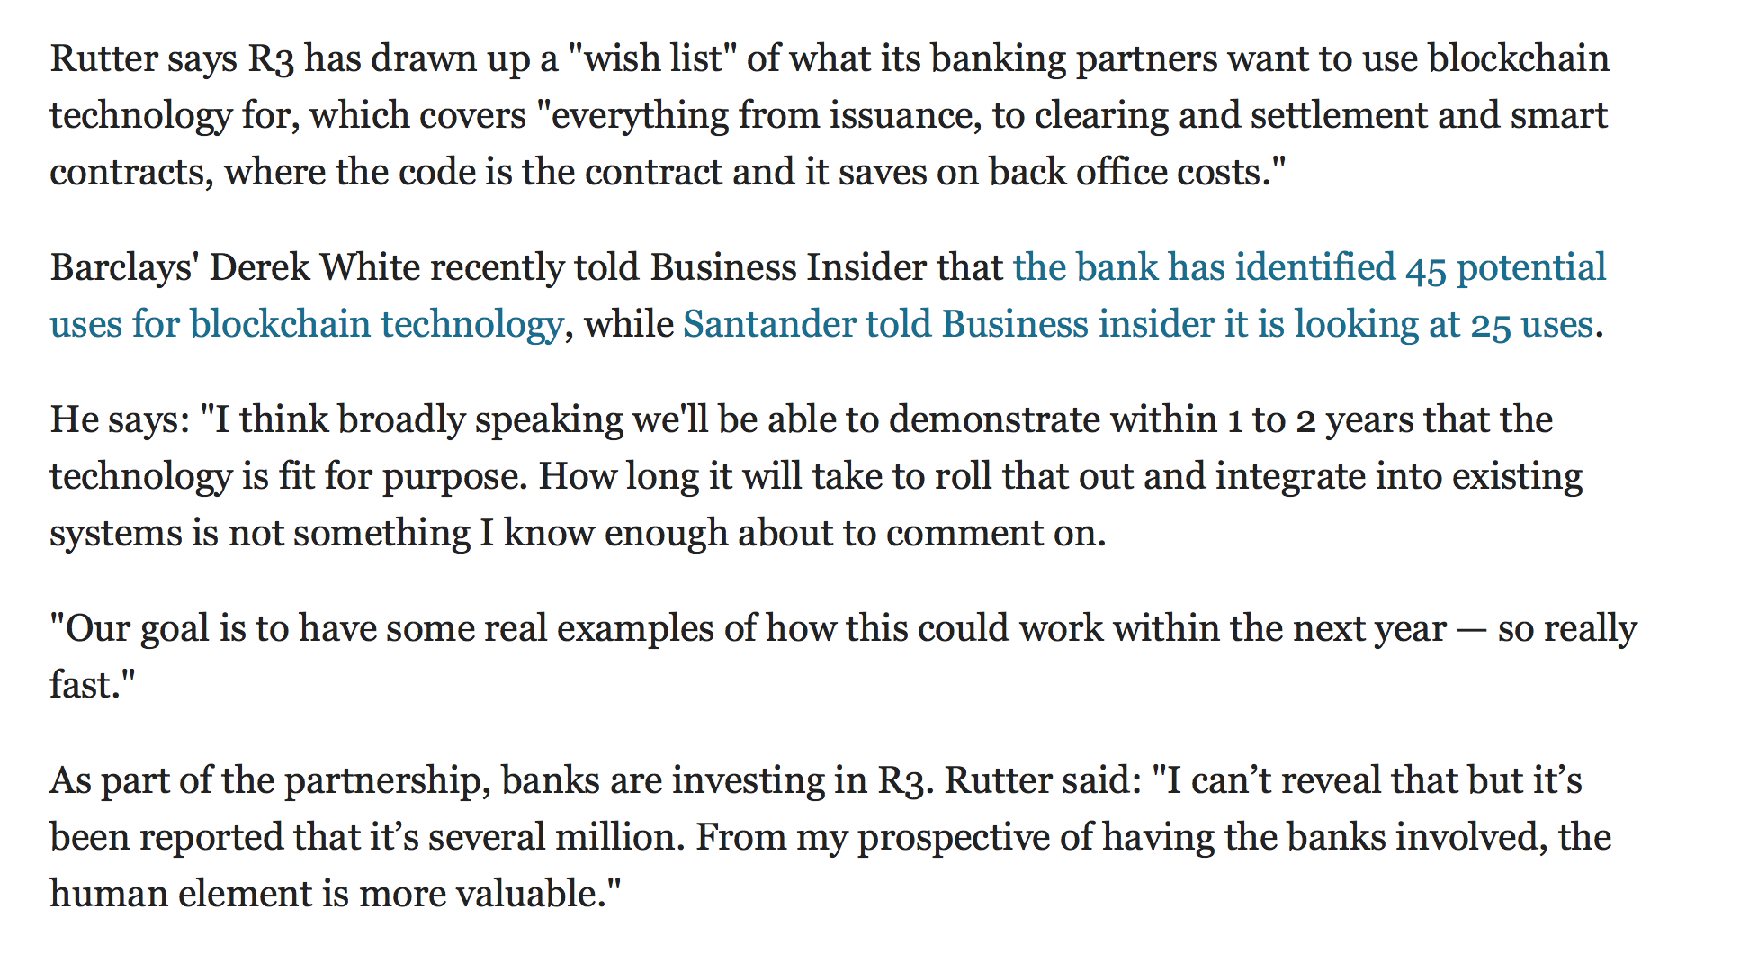

Slide 46
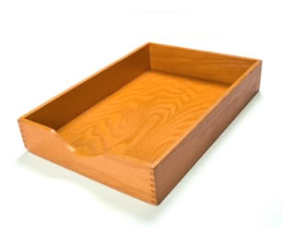
What happened to proof-of-work for sending email?

Slide 47
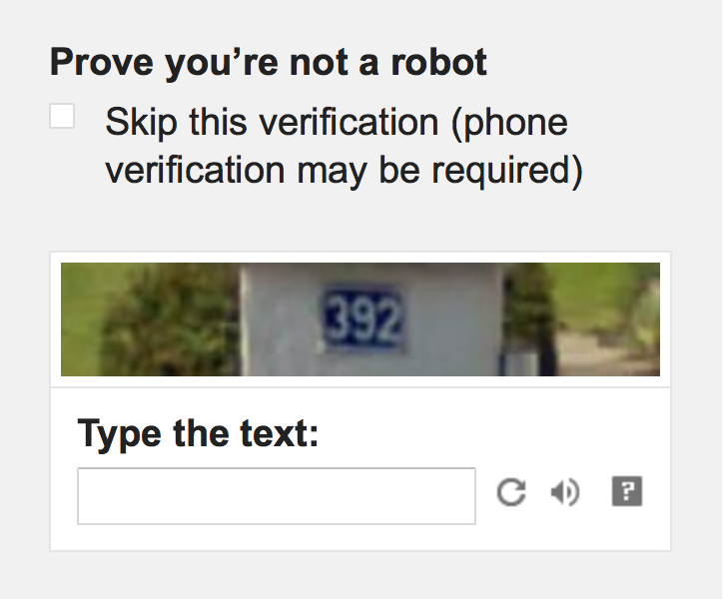
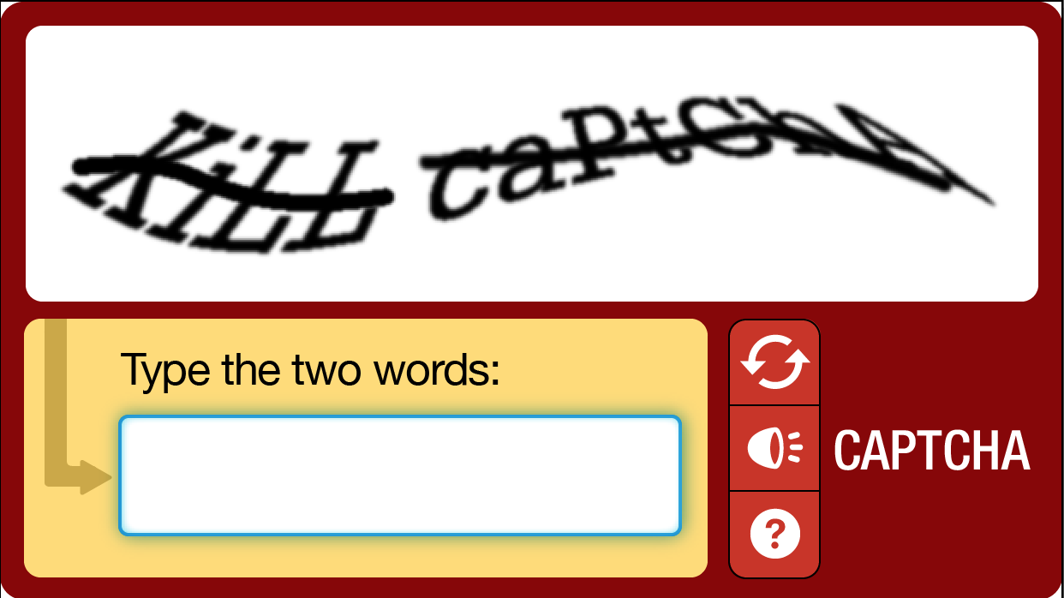
Instead of making computers do inane, repetitive work to prevent mass automation, we make humans do inane, soul-killing work!

Slide 48
Charge
Readings:
Satoshi paper
Antonopoulos book: Chapters 6 and 7
Princeton book: Chapters 2 and 5
Wednesday: Checkup 2

