Slide 1
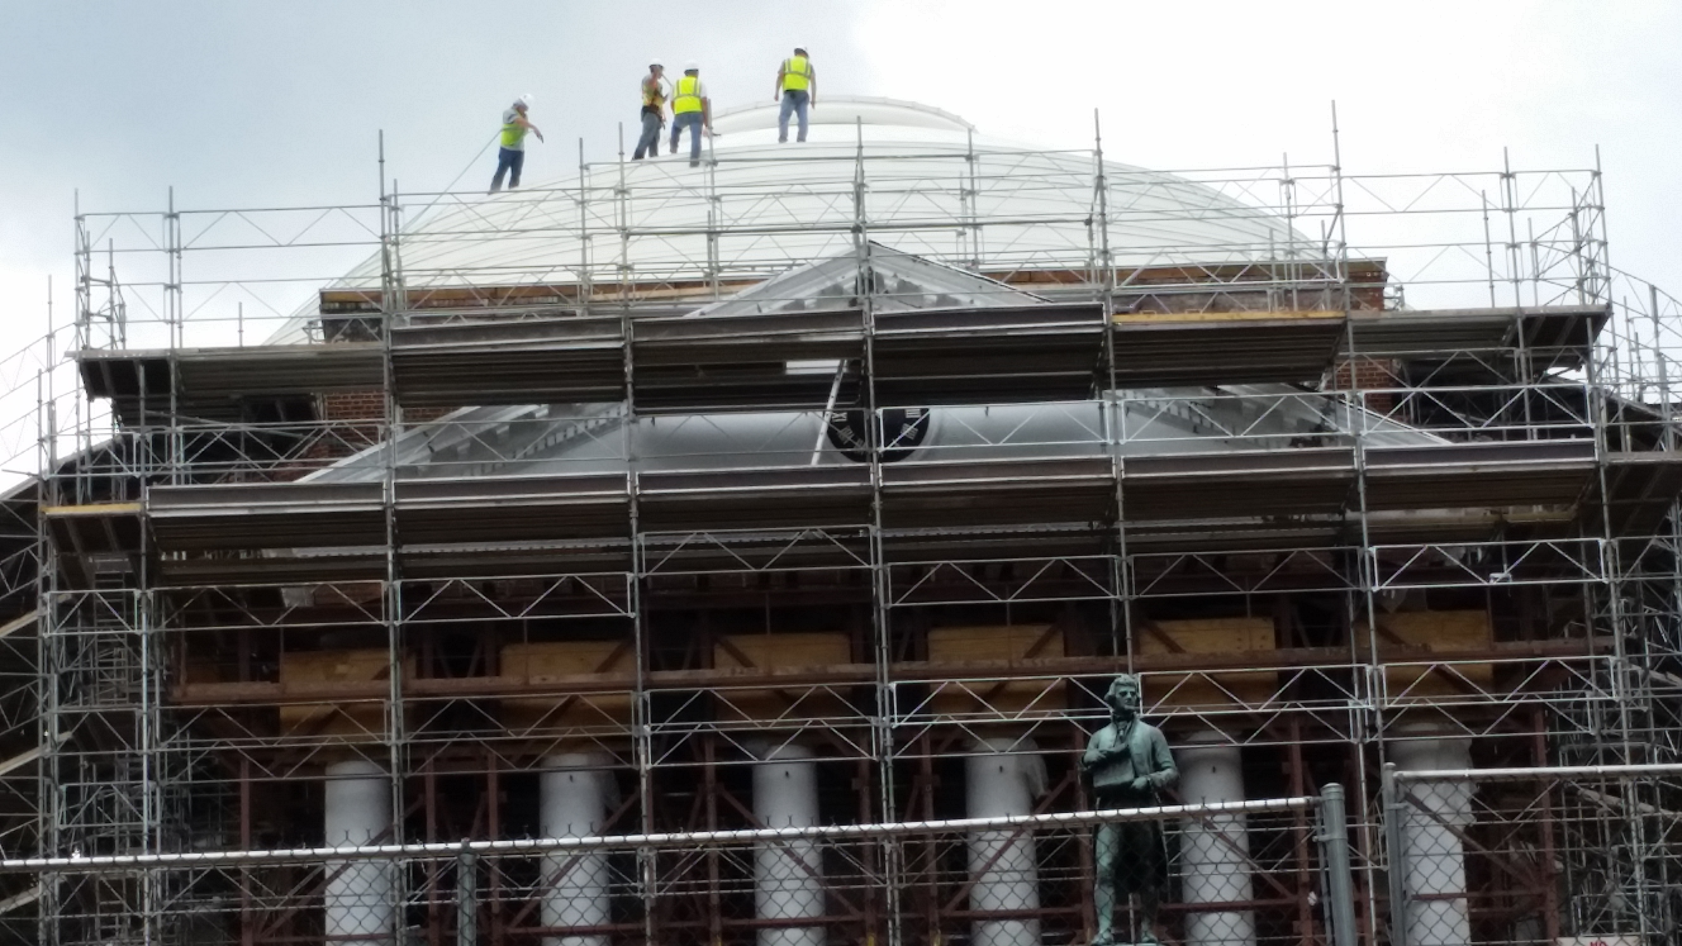
Class 15:
Scripting Transactions
Cryptocurrency Cabal
cs4501 Fall 2015
David Evans and Samee Zahur
University of Virginia

Slide 2
Plan for Today
Scripting Transactions
Review/PS2
Reminders
Extra office hours (see notes)
Midterm Wednesday (in class)
Problem Set 3

Slide 3
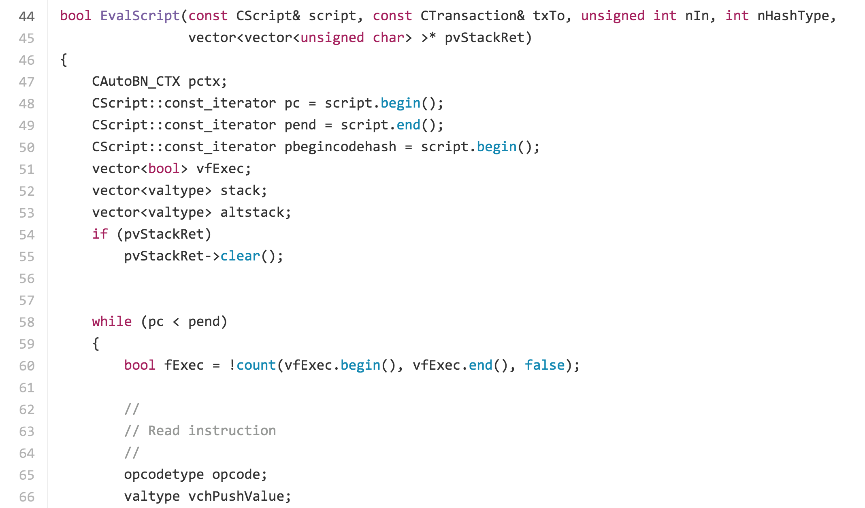
https://github.com/bitcoin/bitcoin/blob/v0.1.5/script.cpp#L41

Slide 4
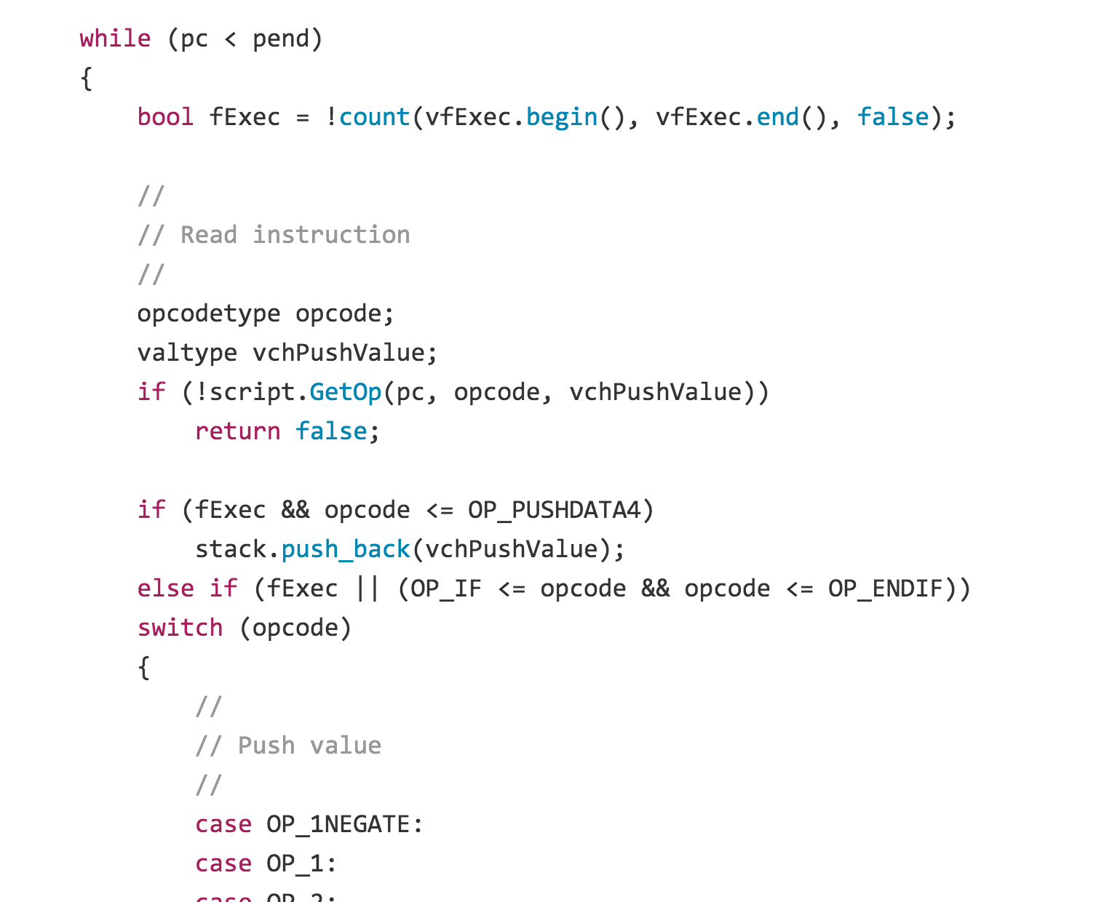
https://github.com/bitcoin/bitcoin/blob/v0.1.5/script.cpp#L58

Slide 5
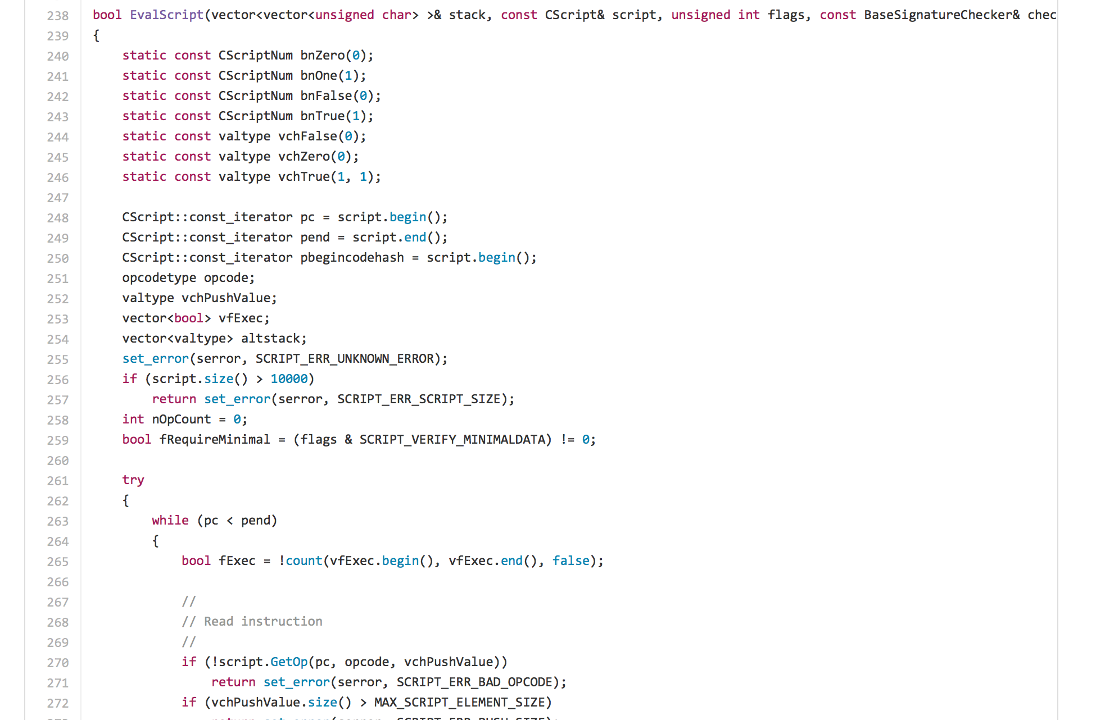
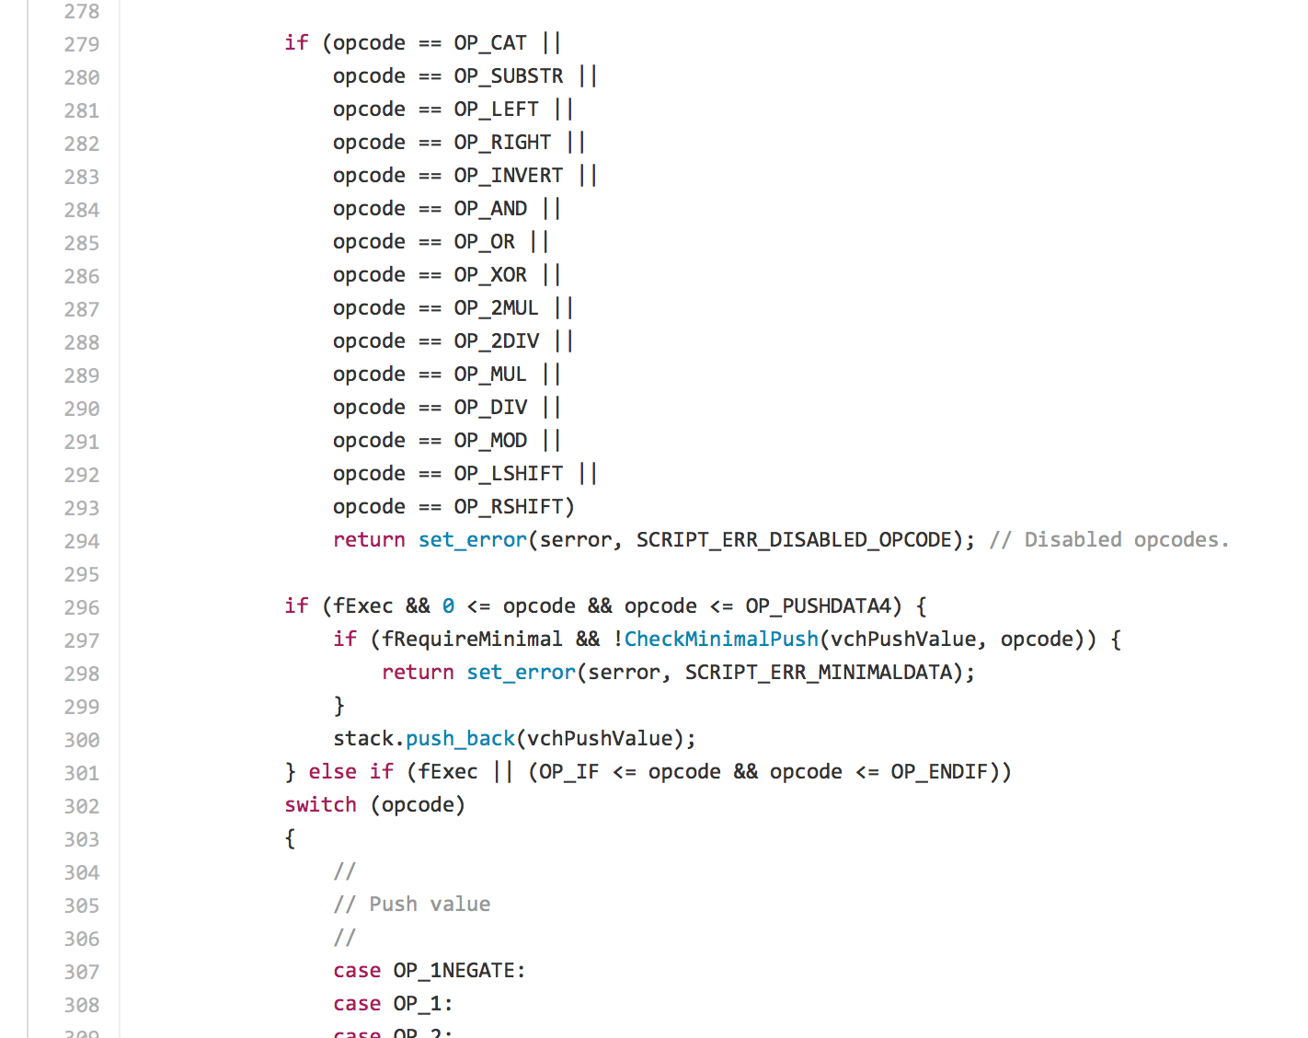
https://github.com/bitcoin/bitcoin/blob/master/src/script/interpreter.cpp

Slide 6
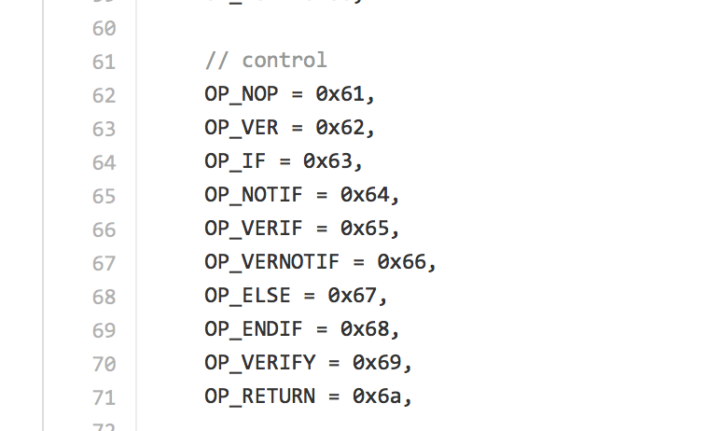
https://github.com/bitcoin/bitcoin/blob/master/src/script/interpreter.cpp

Slide 7
Interpreting Script
https://github.com/bitcoin/bitcoin/blob/41e6e4caba9899ce7c165b0784461c55c867ee24/src/script/interpreter.cpp#L524

Slide 8
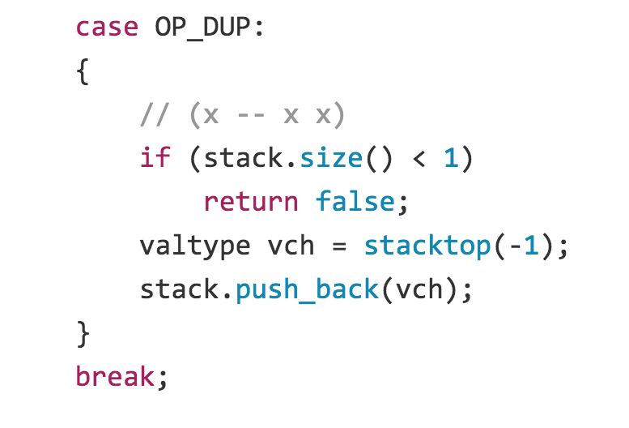
https://github.com/bitcoin/bitcoin/blob/41e6e4caba9899ce7c165b0784461c55c867ee24/src/script/interpreter.cpp#L524
Latest
Version 0.1
Project idea: look at how bitcoin core code has evolved over time

Slide 9
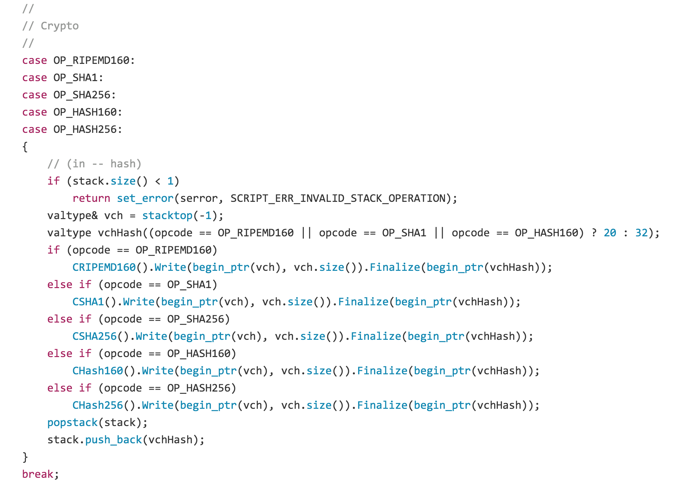

Slide 10
Vout: ([]btcjson.Vout) (len=2 cap=4) {
(btcjson.Vout) {
Value: (float64) 229,
N: (uint32) 0,
ScriptPubKey: (btcjson.ScriptPubKeyResult) {
Asm: (string) (len=85) "OP_DUP OP_HASH160 d6980467719f0e93e9742b6389e09117b6b630a3 OP_EQUALVERIFY OP_CHECKSIG",
Hex: (string) (len=50) "76a914d6980467719f0e93e9742b6389e09117b6b630a388ac",
ReqSigs: (int32) 1,
Type: (string) (len=10) "pubkeyhash",
Addresses: ([]string) (len=1 cap=4) {
(string) (len=34) "PsVSrUSQf72X6GWFQXJPxR7WSAPVRb1gWx"
}
}
},

Slide 11
OP_DUP
OP_HASH160
d6980467719f0e93e9742b6389e09117b6b630a3
OP_EQUALVERIFY
OP_CHECKSIG
Locking Script
OP_DUP [x] Duplicates the top stack item
OP_HASH160 [x] Replaces top of stack with RIPEMD160(SHA256([top]))
OP_EQUALVERIFY [x1] [x2] If top two items are equal, outputs True;
otherwise, marks transaction as Invalid.
OP_CHECKSIG [pubkey] [sig] Checks that E_pubkey(sig)([entire transaction])

Slide 12
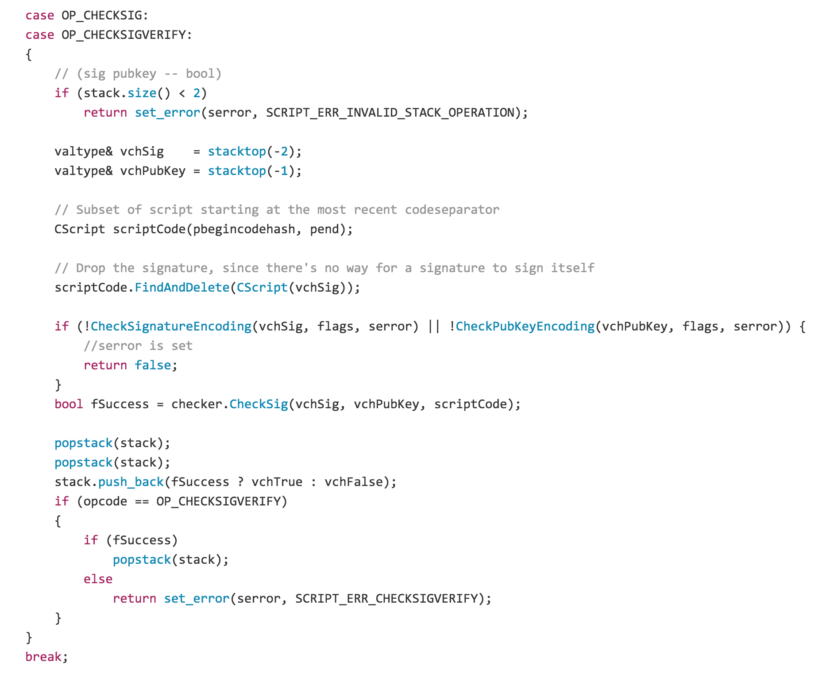

Slide 13
Unlocking Script
OP_DUP
OP_HASH160
d6980467719f0e93e9742b6389e09117b6b630a3
OP_EQUALVERIFY
OP_CHECKSIG
Locking Script

Slide 14
Unlocking Script

Slide 15
Unlocking Script
<signature>
<pub key>

Slide 16
“Pay-to-Script-Hash”
OP_HASH160
[20-byte hash]
OP_EQUAL
Locking Script

Slide 17
Unlocking/Locking (pre-2010)
Unlocking Script
<signature>
<public key>
OP_DUP
OP_HASH160
<bitcoin address (hash of public key)>
OP_EQUALVERIFY
OP_CHECKSIG
Locking Script

Slide 18
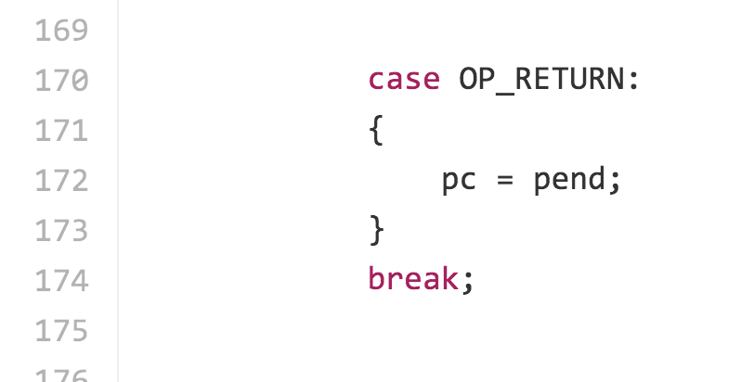
OP_RETURN
Original meaning: terminate script execution, leaving stack unchanged.
https://github.com/bitcoin/bitcoin/blob/v0.1.5/script.cpp#L170

Slide 19
Steal any output!
Unlocking Script
OP_DUP
OP_HASH160
<bitcoin address (hash of public key)>
OP_EQUALVERIFY
OP_CHECKSIG
Locking Script

Slide 20
Steal any output!
Unlocking Script
OP_DUP
OP_HASH160
<bitcoin address (hash of public key)>
OP_EQUALVERIFY
OP_CHECKSIG
Locking Script
This is the by far biggest bug in bitcoin (discovered so far!).

Slide 21
OP_RETURN (fixed July 2010)
https://github.com/btcsuite/btcd/blob/c153596542b3d87dd774c29aa5be5117ac01a234/txscript/opcode.go#L1239
https://github.com/bitcoin/bitcoin/blob/41e6e4caba9899ce7c165b0784461c55c867ee24/src/script/interpreter.cpp#L397

Slide 22
Actual Scripts in Bitcoin

Slide 23
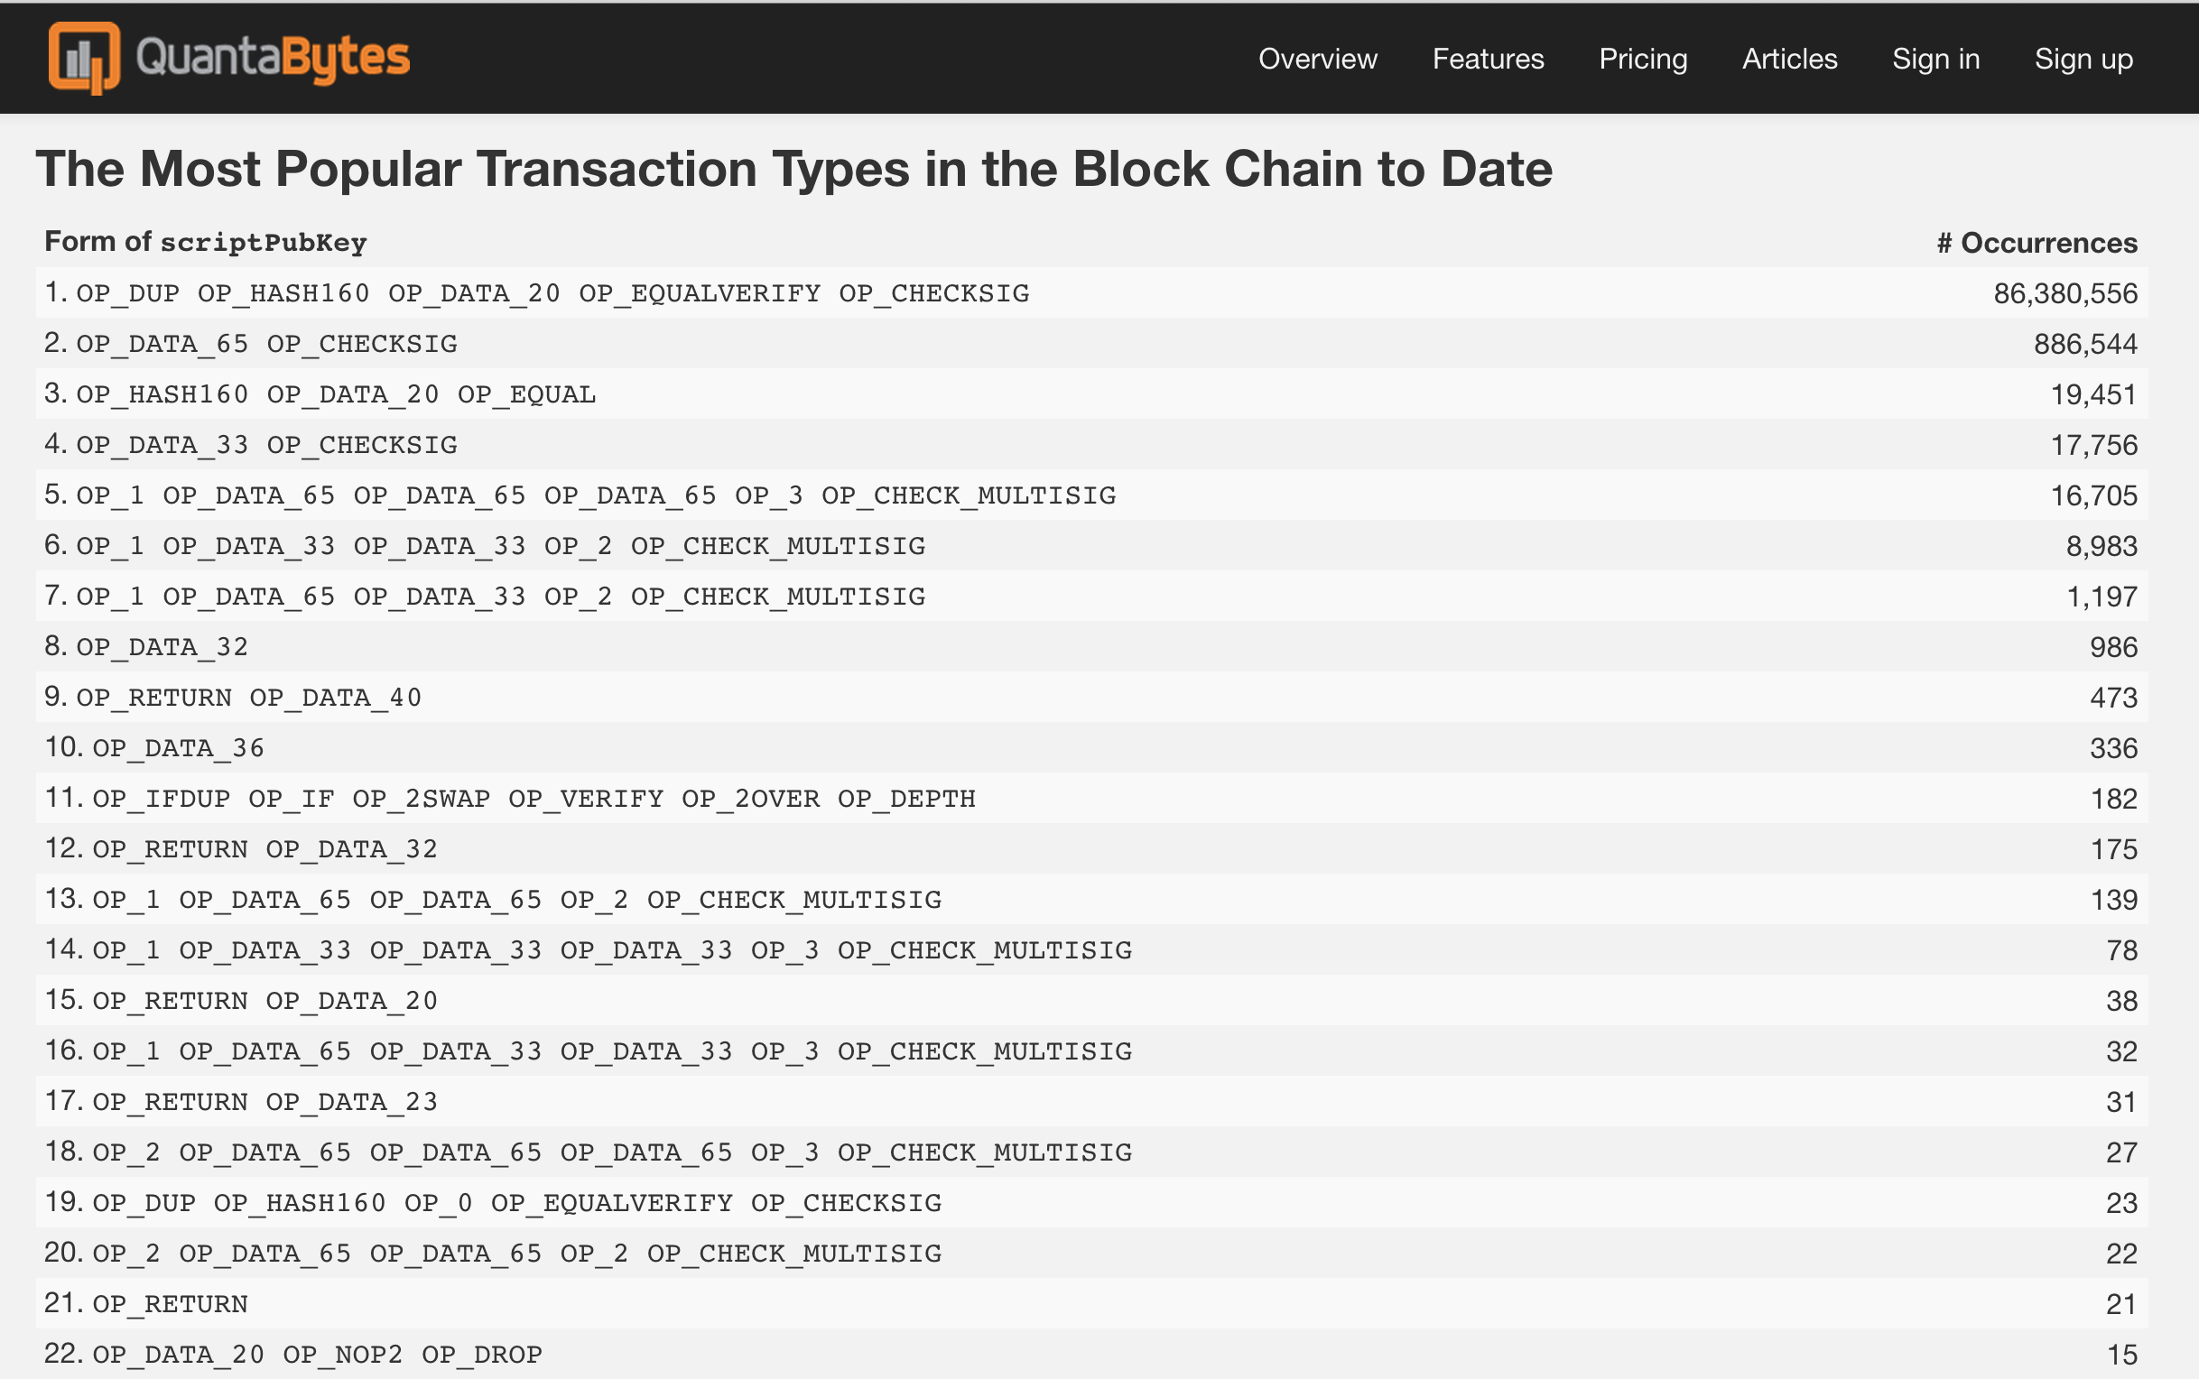
(first 290,000 blocks, through 2014-03-11)

Slide 24
^{OP_RETURN}
^{OP_DATA_40}

Slide 25
More Powerful Scripts
OP_CHECKMULTISIG [x] [sig]^{k} [pub key]^{k}
valid := 0
for each signature [1, k]:
if checksig(sig_{k}, pub_{k}): valid += 1
if valid >= x: 1
else: 0

Slide 26
Has this Changed?

Slide 27
Saba Eskandarian’s project last semester
https://github.com/SabaEskandarian/CryptocurrencyProject

Slide 29
Charge
Wednesday: Midterm
Upcoming office hours:
Today: 5-6:30 (Ori, Rice 442)
Tomorrow: 2-3:30pm (Dave, Rice 507)
Tomorrow: 3:30-4:30pm (Samee, Rice 442)

