Slide 1
Class 18
Cryptocurrency Café
UVa cs4501 Spring 2015
David Evans

Slide 3
Proofs-of-Work
Bitcoin: SHA-256
Compute intensive
No value, motivates investment in SHA ASICs
Litecoin, Dogecoin: scrypt
Memory-access intensive
No value, motivates investment in general- purpose computing (?)
Can we have a proof-of-work that also produces something useful?

Slide 4
Challenge of Useful Proofs-of-Work
Need to embed previous block and transactions in problem
Need random problem instances to be useful
Need partially-selected problem instances to be hard
Must be easy to verify winning results
Want adjustable difficulty

Slide 5
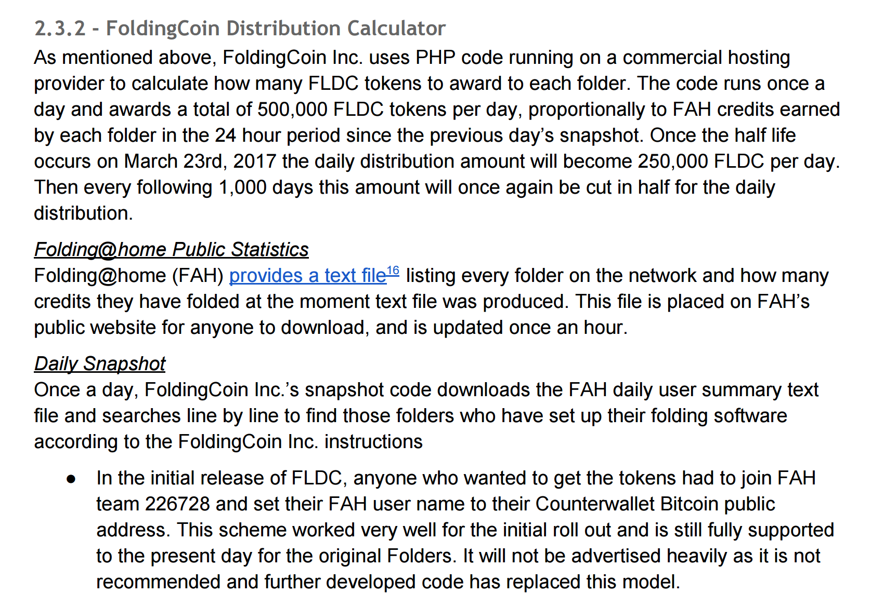
http://foldingcoin.net/wp/wp-content/uploads/2015/02/FoldingCoin-White-Paper-v1.0.pdf

Slide 6
IEEE Security and Privacy (“Oakland”), 2014
Proof-of-Retrievability: node is storing what it should
Ensure local storage: block access depend on private key, which is also owner of coin value.

Slide 11
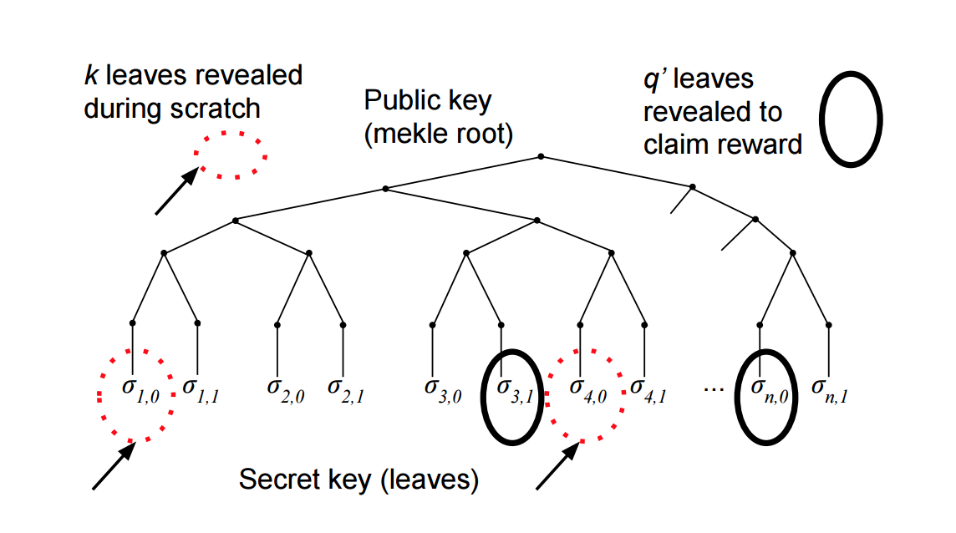
Permacoin: Merkle Tree

Slide 12
Charge
Wednesday’s class: Josh Cincinnati
Next week:
Project Proposal Presentations

