Slide 1
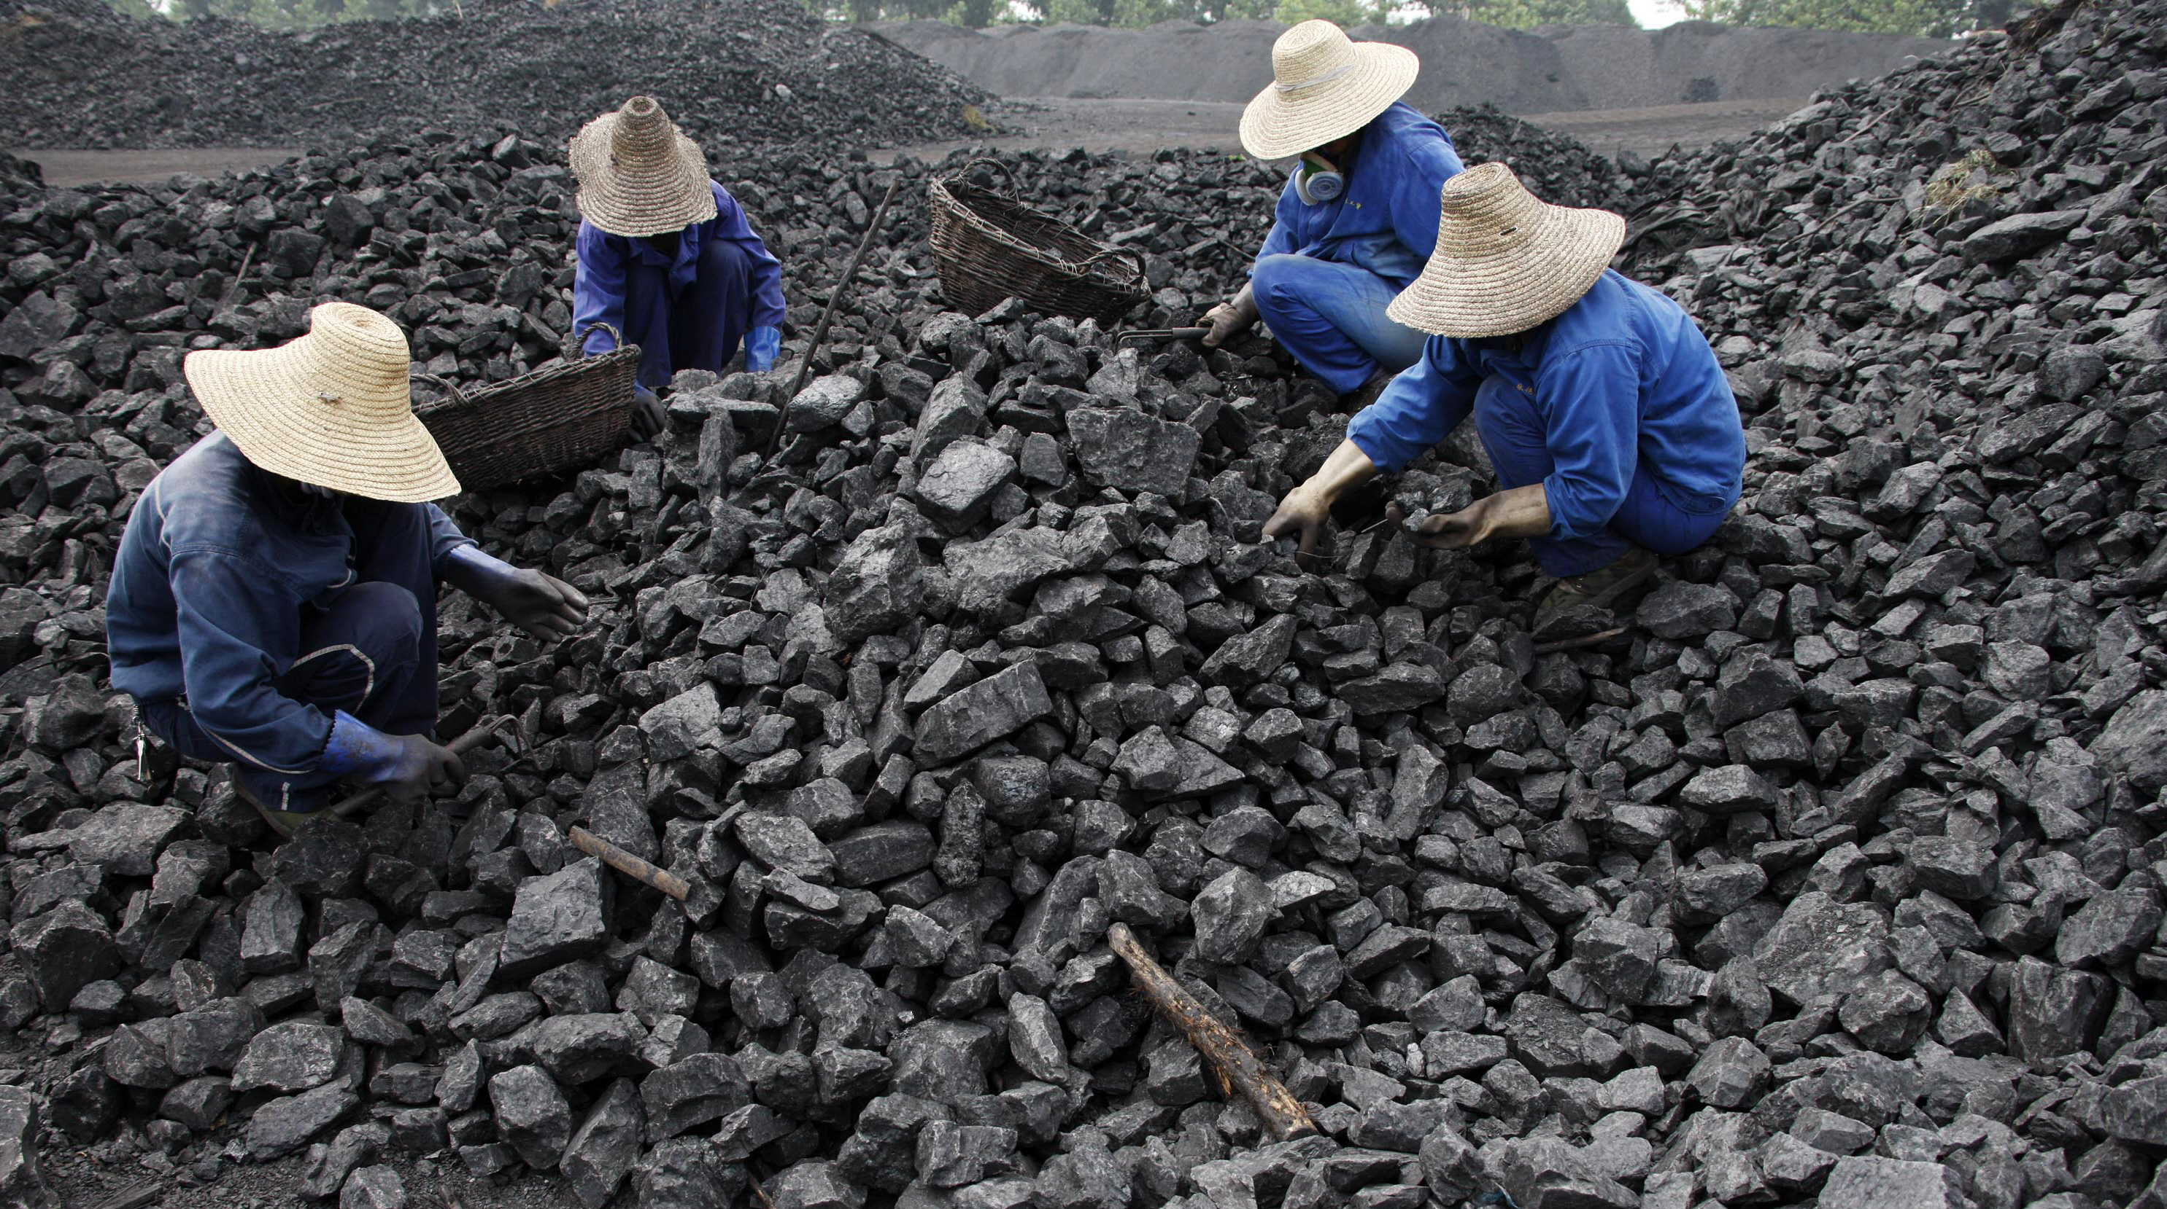
Class 10:
More Mining
Cryptocurrency Café
UVa cs4501 Spring 2015
David Evans

Slide 2
Plan for Today
Project Plans
PointCoin Forking
Bitcoin (PointCoin) Mining
Cost of Computing
Mining Economics
Return Quiz 1

Slide 3
Plan for Future
Project 2
Part 1 (due in 1 week): mining
Part 2 (due before spring break): attacks
Project 3 is no more
But, can do blockchain analysis for your project
Open-ended Project

Slide 4
Open-Ended Project
Proposal will be due March 20
Final project due at end of semester (April 28)
Anything you want related to cryptocurrency (broadly defined)
Some initial ideas posted on course site (and mentions throughout upcoming classes)

Slide 5
Project Teams
You may work in a team of size 1-7B
N | N^{2/3}
1 | 1.00
2 | 1.58
3 | 2.08
4 | 2.52
26 | 8.78
Expected value of your project scales as N^{2/3} where N is the number of students in the class on your team.
Feel free to post ideas on course site to recruit teammates

Slide 6
PointCoin Forking/Failing
params.go
UpdateBlockTime

Slide 7
Asymptotic Analysis
int gaussSum (int m) {
int sum = 0;
for (int i = 1; i <= m; i++) {
sum = sum + i;
}
return sum;
}
Assuming an (unspecified) idealized model of Java computation, running time of gaussSum is in θ(2^{N}) where N is the size of the input.

Slide 8
Asymptotic Analysis Questions
Is an algorithm with running time in O(N) better than one with running time in O(N²)?

Slide 9
Asymptotic Analysis Questions
Is an algorithm with running time in Θ(N) better than one with running time in Θ(N²)?

Slide 10
Cost of Mining
Setup:
block := construct next block header
difficulty := next difficulty
// look for nonce
while true {
block.Header.nonce += 1 // guess next nonce
hash, _ = block.Header.BlockSha()
if hash < difficulty { Success! }
}

Slide 11
package main
import "github.com/PointCoin/fastsha256"
import "log"
import "time"
func main() {
msg := "test"
hasher := fastsha256.New()
hasher.Write([]byte (msg))
starttime := time.Now()
num := 10000000
for i := 0; i < num; i++ {
hasher.Sum(nil) // ignore result
}
elapsed := time.Since(starttime)
log.Printf("Total time: %s", elapsed)
log.Printf("Average hashing time: %d ns", elapsed.Nanoseconds() / int64(num))
}

Slide 12
ubuntu@ip-172-31-39-215:~/template_miner$ go build timer.go
ubuntu@ip-172-31-39-215:~/template_miner$ ./timer
2015/02/11 16:50:42 Result: 9f86d081884c7d659a2feaa0c55ad015a3bf4f1b2b0b822cd15d6c15b0f00a08
2015/02/11 16:50:50 Total time: 7.650548619s
2015/02/11 16:50:50 Average hashing time: 765 ns
ubuntu@ip-172-31-39-215:~/template_miner$ time ./timer
2015/02/11 16:50:55 Result: 9f86d081884c7d659a2feaa0c55ad015a3bf4f1b2b0b822cd15d6c15b0f00a08
2015/02/11 16:51:03 Total time: 7.676091298s
2015/02/11 16:51:03 Average hashing time: 767 ns
real 0m7.681s
user 0m8.541s
sys 0m0.131s
ubuntu@ip-172-31-39-215:~/template_miner$
2.5 GHz processor on
M3.large EC2 node

Slide 13
Cost of Mining
Setup:
block := construct next block header
difficulty := next difficulty
One attempt:
block.Header.nonce += 1 // guess next nonce
hash, _ = block.Header.BlockSha()
if hash < difficulty { Success! }
How long will it take to find a block using free EC2 nodes?

Slide 14
Probability of Success
Assume: SHA-256 produces uniform random output
SHA-256(x) ⬅ [0, 2²⁵⁶)
Target = T_{max} / Difficulty
T_{max} = (2¹⁶ – 1)2²⁵⁶ ≈ 2²²⁴
Current (15 Feb) Difficulty = 44455415962

Slide 15
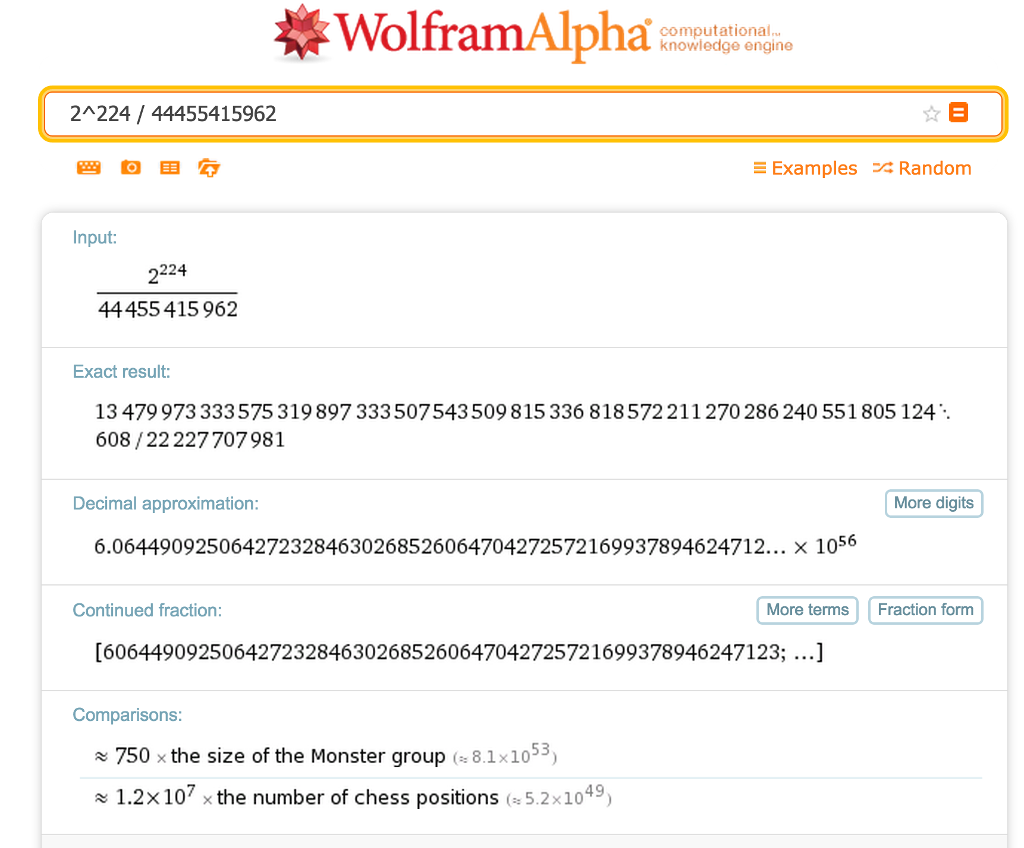

Slide 16
Free Money?
>>> target = 2 ** 224 / 44455415962
606449092506427232846302685260647042725721699378946247123L
>>> success_probability = target / 2**256
5.237396582969569e-21
>>> expected_hashes = 1 / success_probability
1.9093455768686638e+20
>>> nanos_needed = expected_hashes * 760
>>> seconds_needed = nanos_needed / 10**9
145110263842018.44
>>> days = seconds_needed / (60 * 60 * 24)
1679516942.6159542
>>> years = days / 365
4601416.2811396
>>> years * 2
~ 9.2 M years to find one block on EC2 (assuming difficulty doesn’t increase)

Slide 17
Why is energy/hash so much less for custom ASICs?

Slide 18
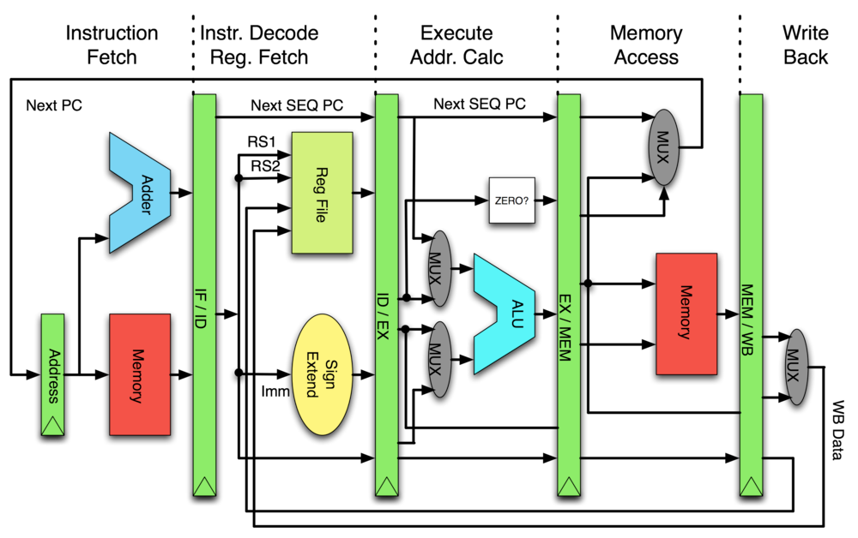
XOR two 32-bit values in CPU
XOR two 32-bit values in ASIC

Slide 19
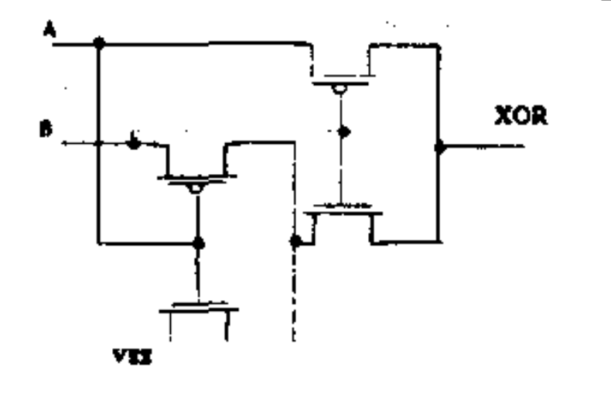
4 transistors XOR design
XOR two 32-bit values in CPU
XOR two 32-bit values in ASIC

Slide 20
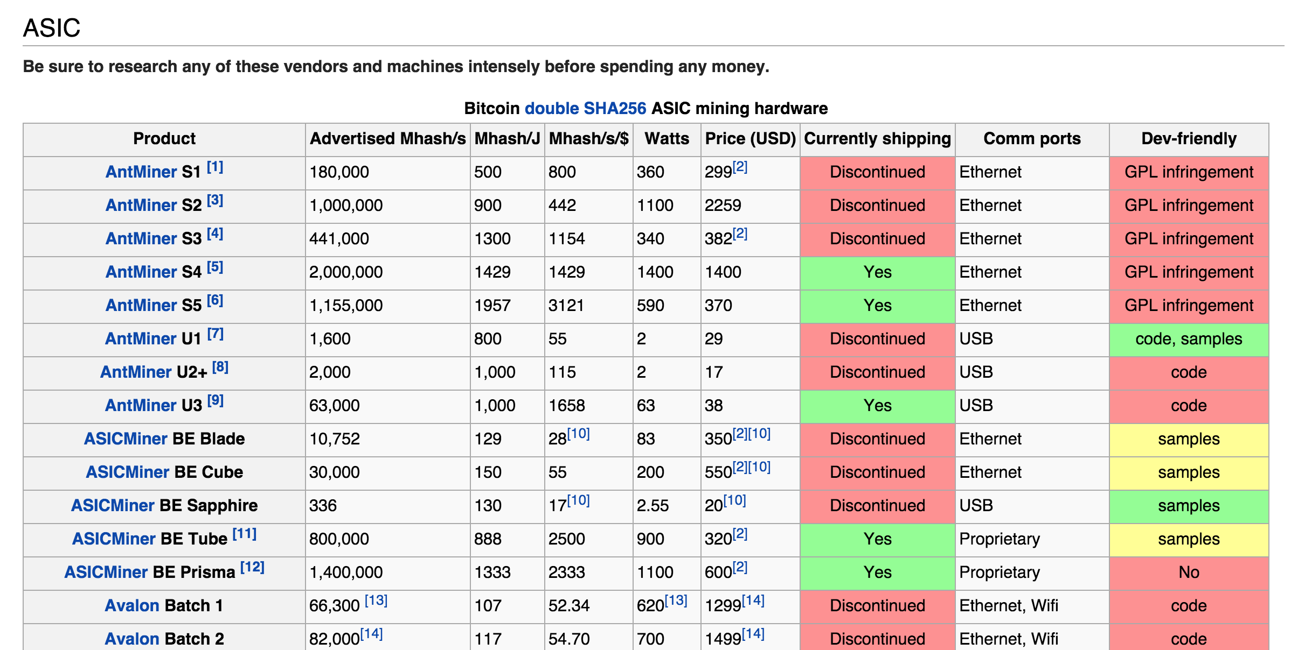
https://en.bitcoin.it/wiki/Mining_hardware_comparison
1J ~ “lift an apple one meter”

Slide 21
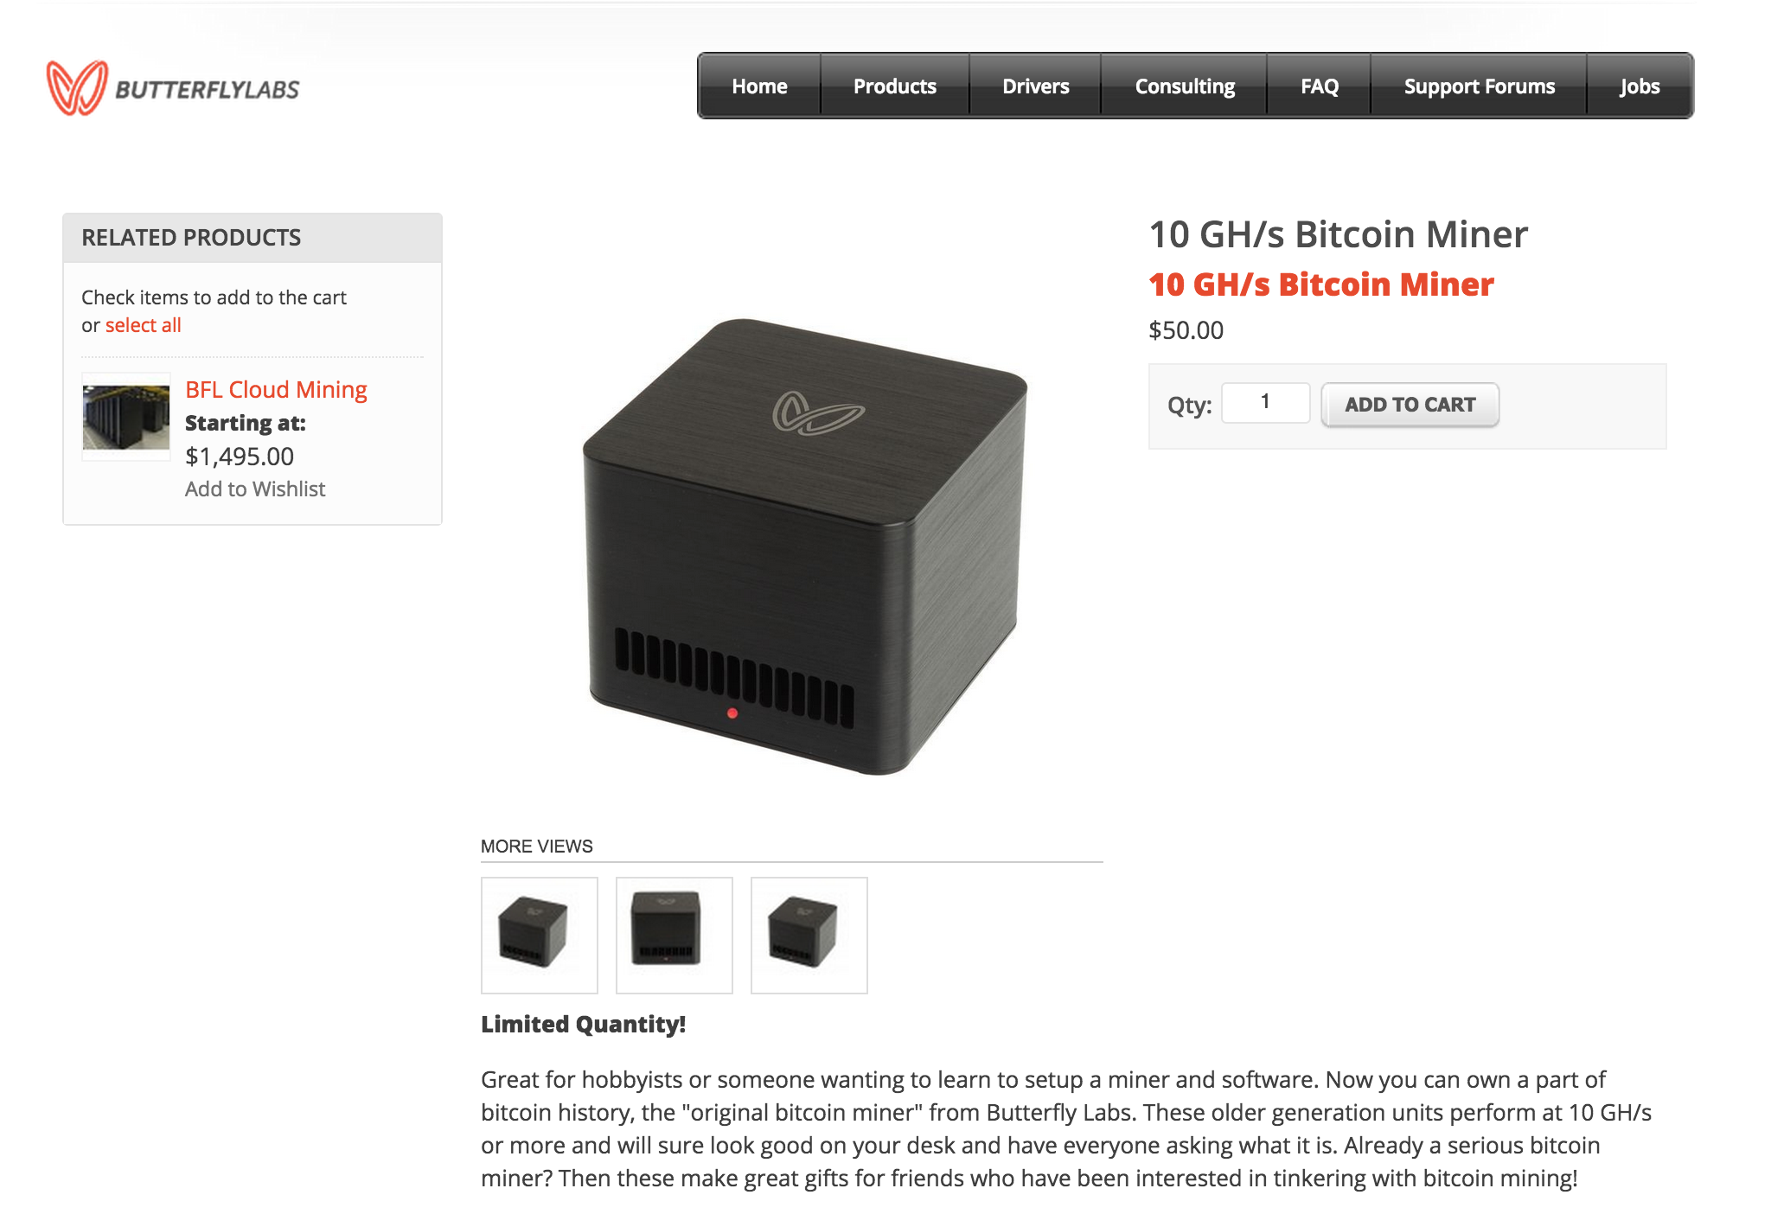
>>> 10**9/(760 * 2)
657894
= 0.0006 GH/s

Slide 22
Mining and Mining
How much coal is mined to mine a bitcoin?

Slide 23
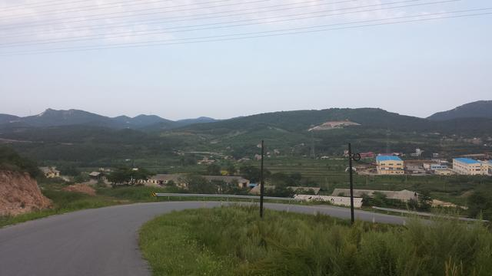
Bitcoin Mining
The first thing you notice as you approach the warehouse is the noise. It begins as soon as you step out of the car, at which point it sounds like massive swarm of angry bees droning away somewhere off in the distance. It becomes louder and louder the closer you get to the building, and as you step through the doors it becomes a deafening and steady roar…
http://www.thecoinsman.com/2014/08/bitcoin/inside-chinese-bitcoin-mine/

Slide 24
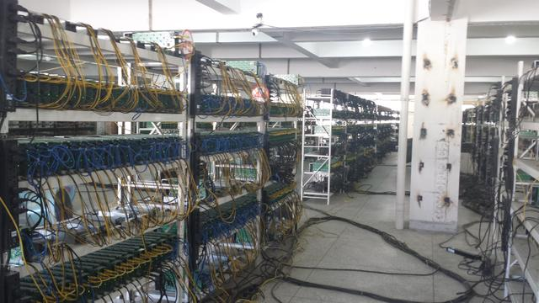
http://www.thecoinsman.com/2014/08/bitcoin/inside-chinese-bitcoin-mine/
Cost of electricity: ¥400,000 ($60,000 US)/month

Slide 25
How to Estimate Energy Cost?

Slide 26
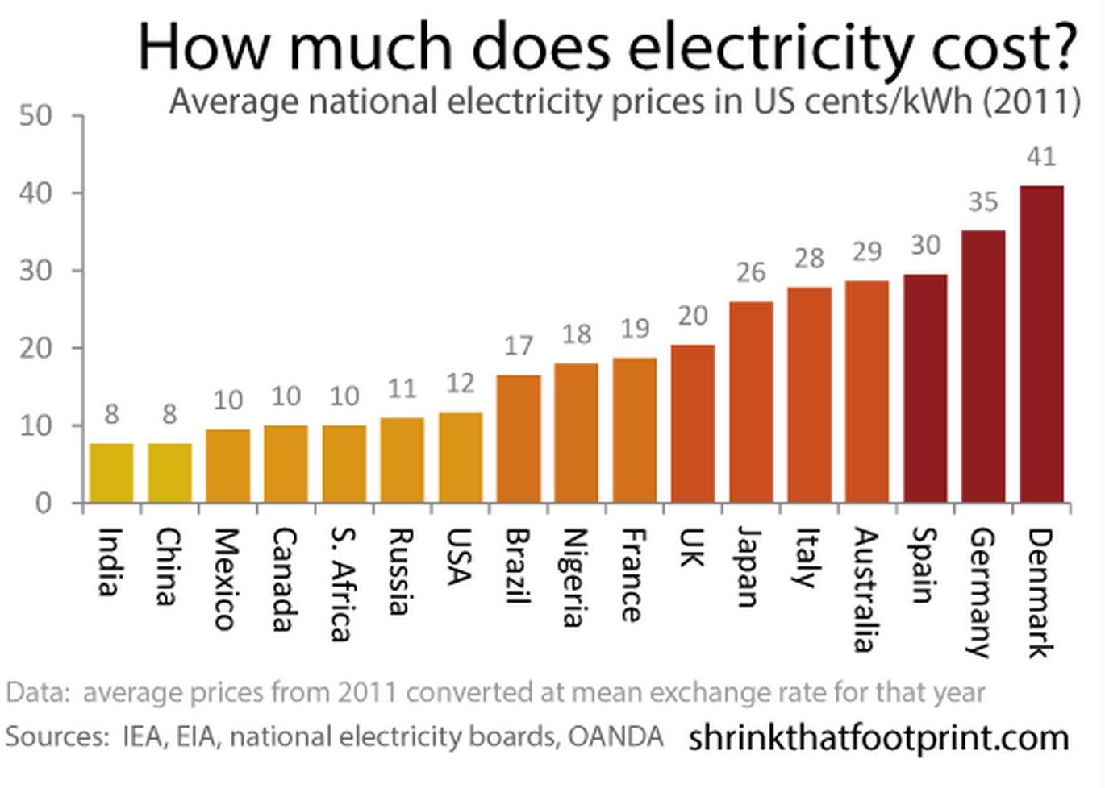
$60,000/month × 0.08/kWh = 750,000 kWh
http://shrinkthatfootprint.com/average-electricity-prices-kwh

Slide 27
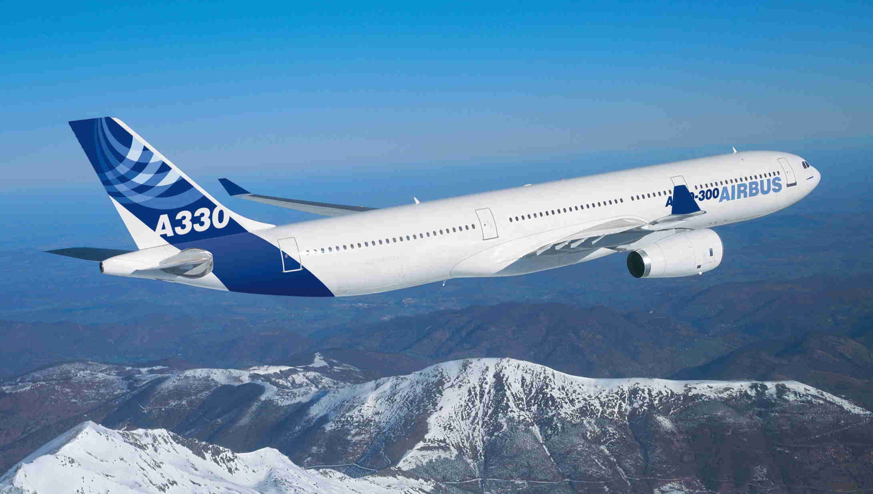

Slide 28
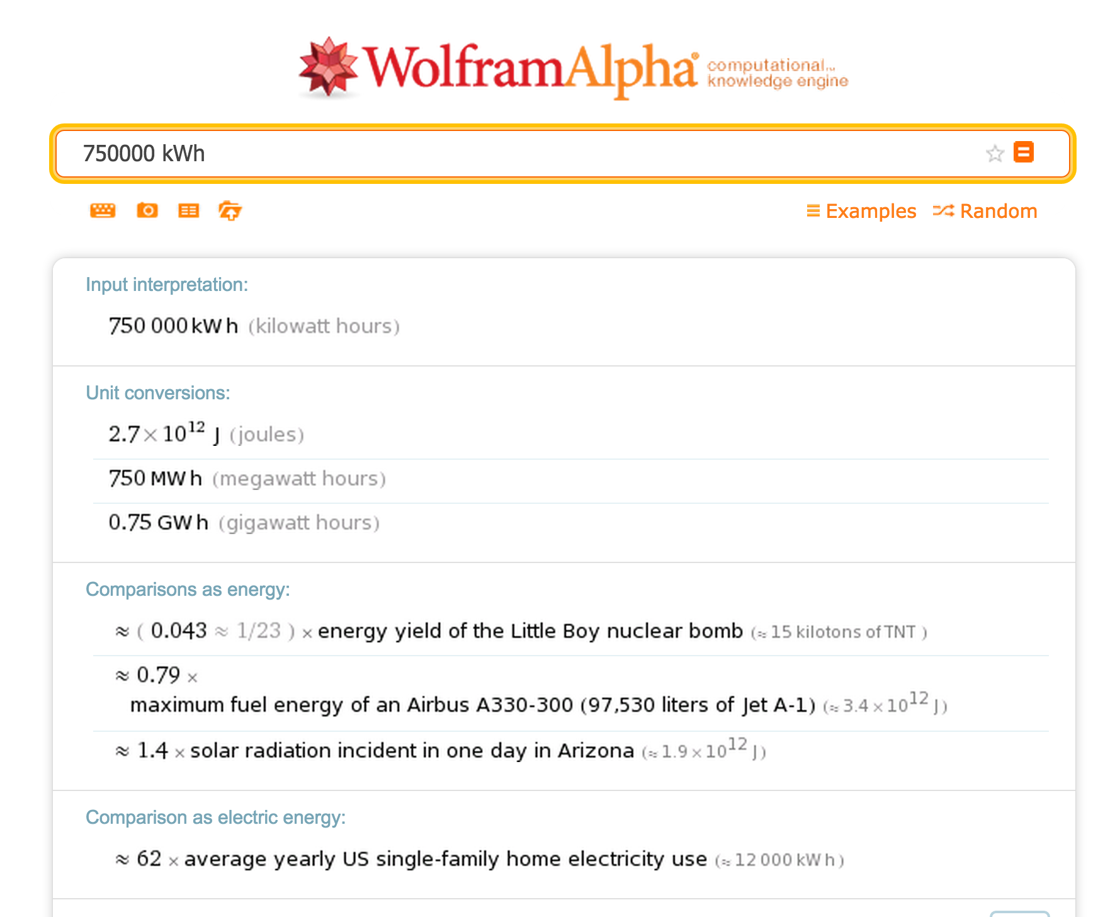

Slide 29
Total Network Hashing Power
Difficulty is adjusted to mine one block every 10 minutes.
Target = T_{max} / Difficulty
Expected hashes = 2²⁵⁵ / Target
Network hashes per second ~ Expected hashes / 600s

Slide 30
>>> expected_hashes
1.9093455768686638e+20
>>> hashes_per_second = expected_hashes / 600
3.18224262811444e+17
>>> # according to blockchain.info: 309,384,699.96 GH/s
>>> 309384699.96 * 10**9
3.0938469996e+17
>>> _ / hashes_per_second
0.9722222222361415

Slide 31
Estimating Energy Use
https://en.bitcoin.it/wiki/Mining_hardware_comparison
ASIC Miner | Ghash/s (advertised) | Mhash/J | Price
AntMiner S5 | 1,155 | 1957 | $370
ASICMiner BE Prisma | 1,400 | 1333 | $600
HashCoins Zeus | 4,500 | 1500 | $2299
Spondooliestech S35 Yukon | 5,500 | 1506 | $2235

Slide 32
>>> expected_hashes
1.9093455768686638e+20
>>> hashes_per_second = expected_hashes / 600
3.18224262811444e+17
>>> # according to blockchain.info: 309,384,699.96 GH/s
>>> 309384699.96 * 10**9
3.0938469996e+17
>>> _ / hashes_per_second
0.9722222222361415
>>> Mhash_per_J = 1500
>>> Mhash_per_second = hashes_per_second / 10**6
>>> J = Mhash_per_second / Mhash_per_J
212149508.54096264
212 MJ per second = 212 MW

Slide 33
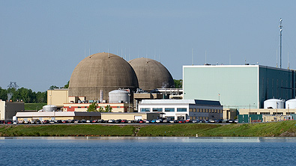
Dominion Power
Lake Anna Power Station
1892 MW (450,000 homes)
~9x entire bitcoin mining power (with efficient ASICs)

Slide 34
Charge
Project 2:
we hope to have PointCoin network restarted by tomorrow
still build your miner (just will operated on broken network)
Read: Chapter 8: Mining and Consensus
Start thinking about your project ideas
Coming up with a good way of analyzing mining energy use, and comparing it with energy cost of current financial infrastructure could be a good project…

